Slide 1
The experiences of people with learning disabilities during COVID-19

Slide 2


Who we are?
10 researchers from the London School of Hygiene & Tropical Medicine and the University of Glasgow
We specialise in disability research

Slide 3
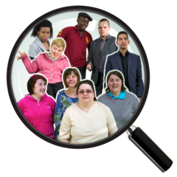

What did we do?
We talked to 71 disabled people
Some people we talked to were parents of disabled children
We talked to 28 organisations that worked with disabled people

Slide 4



What did we do?
We talked to people twice
Early in the pandemic and again later
We asked them how COVID-19 impacted their lives

Slide 5

What did we find?
COVID-19 has badly affected people with learning disabilities
Government actions to stop COVID-19 spreading have badly affected people with learning disabilities

Slide 6


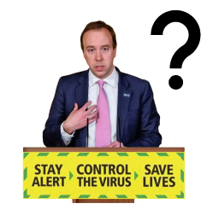
Accessible information
Information was not provided in accessible way
There was limited Easy Read information
Briefings from the government did not do enough to help people with learning disabilities know what they had to do

Slide 7
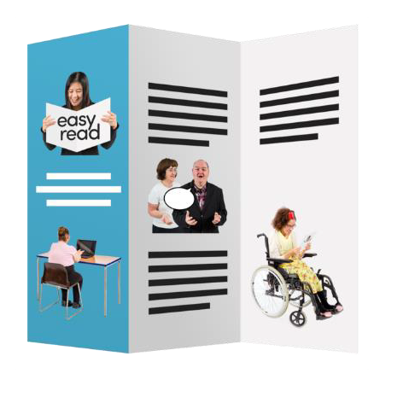
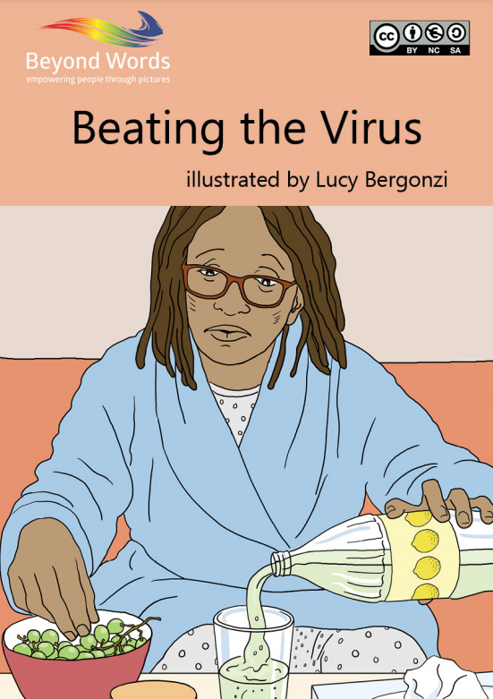
Accessible information
Disabled people’s organisations and other groups played a big role in helping people get the right information
For example, Books Beyond Words

Slide 8
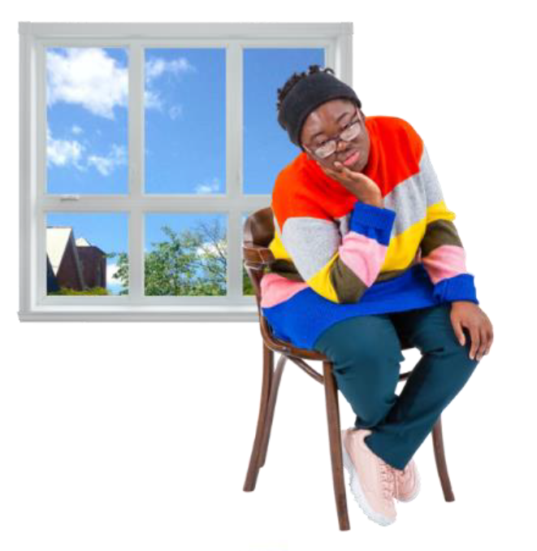
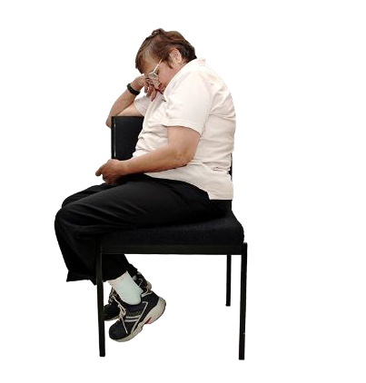
Daily activities
Daily activities had to stop and this disrupted people’s routines
People felt lonely

Slide 9
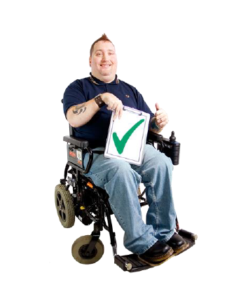

Daily activities
Charities and community groups worked hard to provide support
Organisations provided Zoom activities, such as online cooking classes and book clubs

Slide 10

Daily activities
But not everyone had access to a computer and not everyone was comfortable using Zoom

Slide 11
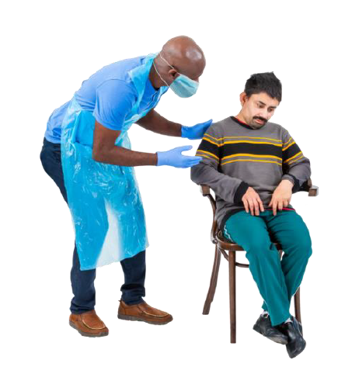
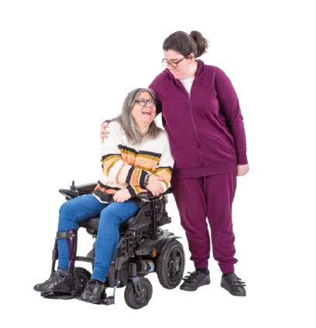
Social care
For many, social care and support was removed or reduced
Lots of people relied on family carers

Slide 12

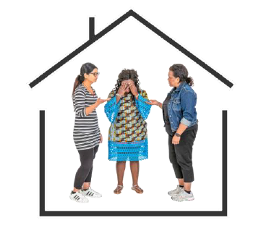
Social care
It was difficult to get help for problems
It was difficult for people and their families

Slide 13
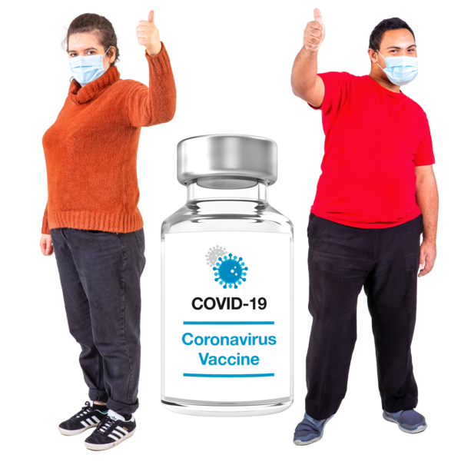
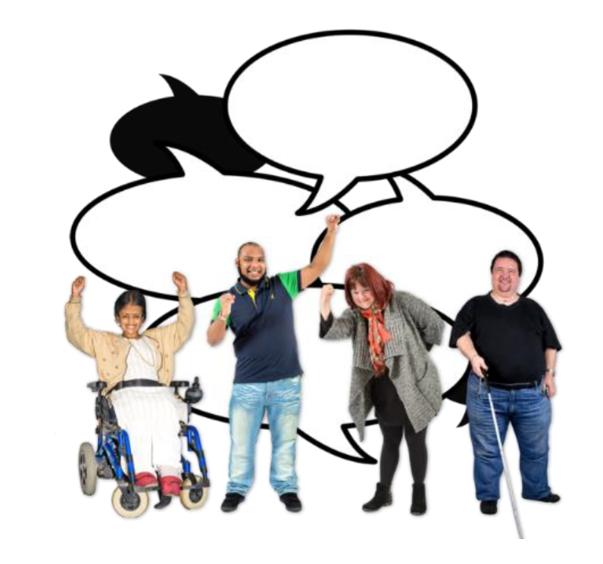
Vaccination
People with learning disabilities were pleased to be put on the priority list
But it required a lot of advocacy to get the right to priority vaccination

Slide 14
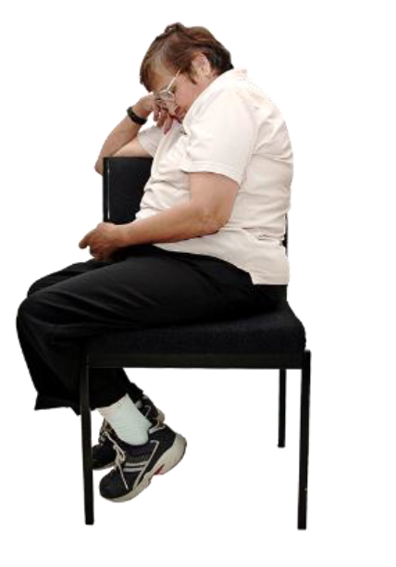
Conclusion
People with learning disabilities and their families felt abandoned and forgotten by the government
Charities, disabled people’s organisations and community groups worked hard to stop problems being even worse

Slide 15
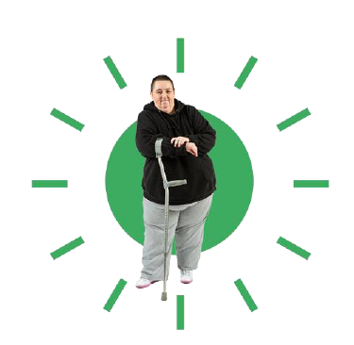

What next?
Disabled need priority support going forward
Government must listen to disabled people about they need during the pandemic and in the future

