Slide 1
Applying a ‘whole systems’ approach to infection prevention & control in primary health care clinics in South Africa
Critical reflections from the Umoya omuhle project
1000 UK | 1100 SA | Wednesday 28 April 2021
Funded by the ESRC/AMR Cross-Council Initiative and The Bloomsbury SET

Slide 2
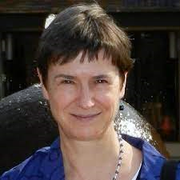
Welcome and introduction
Alison Grant
London School of Hygiene & Tropical Medicine and Africa Health Research Institute
Karina Kielmann
Queen Margaret University

Slide 3
Applying a ‘whole systems’ approach to infection prevention & control in primary health care clinics in South Africa
Notes:
Good morning. My name is Alison Grant. On behalf of the Umoya Omuhle team, welcome to our webinar. Umoya omuhle can be roughly translated as ‘good air’ in isiZulu. In this project we aimed to use a whole systems approach to bring fresh thinking to the problem of TB infection prevention and control in primary healthcare clinics in South Africa, hoping to inform health systems interventions to reduce TB transmission.
We have presented our results at previous webinars that many of you attended, and we have sent you a brief summary of those results.
In this session we would like to reflect on our experience of incorporating the complexity of the primary healthcare setting when trying to understand IPC and to design 'whole systems interventions’ to improve it. We hope you will be able to help us with critical thinking about how to do this.

Slide 4
RQ3
IPC: Clinic design, work practices
RQ2
TB transmission in facilities
RQ4
HCW and patient ideas and practices of IPC
RQ5
Systems interventions to improve IPC
RQ1: Analysis of IPC policy
RQ6
Mathematical modelling: effect on transmission?
RQ7
Economic impact of reduced transmission
Notes:
Umoya omuhle had 7 work packages: initially these comprised primary data collection to inform intervention development. These included [click] the epidemiology of TB transmission in primary healthcare clinics, [click] clinic design and infrastructure, ventilation, space and peoples’ movements within this space and [click] health care worker perspectives on IPC. These data informed a central work package which [click] used systems dynamics modelling techniques to map the relationships between processes and factors influencing IPC practice, and to identify and prioritise interventions. [click] Mathematical modelling allowed us to estimate the impact of these interventions on TB transmission within facilities, and [click] economic evaluation estimated costs and cost-effectiveness of the interventions. [click] All this work has to be situated within the IPC policy context.
[click] In the first half of the webinar we want to focus on the challenges of incorporating complexity into primary data collection, reflecting on our work on clinic infrastructure and the perspectives of HCW. In the second half, we will consider the implications of incorporating complexity into the design of interventions, and costing those interventions.
I’m now handing over to Karina Kielmann to tell you more.

Slide 5
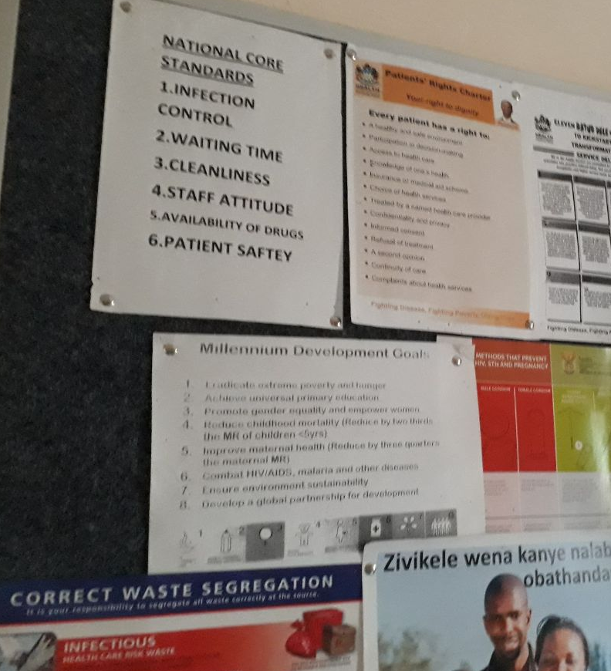
Why is IPC of interest to systems and social science researchers?
Growing emphasis on HCAI - clinics as ‘safe’ yet permeable ‘risky’ spaces
Compromised IPC generally seen as a 'behavioural problem' of non-compliance rather than a systems problem;
Complex - multiple components of IPC from buildings, space, technology through to less visible drivers of workflow, air flow, and flow of people is organised within given space
Notes:
When we first embarked on this project which was of course pre-COVID 19, I had a number of baffled reactions – why study infection prevention & control which seemed a quite dull and relatively mundane topic. Reflecting back on the work we have done as well as the current heightened attention to IPC measures for COVID-19, I think there are a few reasons why this topic is of interest for health systems researchers and social scientists.
First: a growing emphasis on HCAI in recent years drives home the stark point that although people go to clinics to get better, several features of health care settings create what has been called a ‘perfect storm’ for person-to-person transmission of infectious agents – so there is dual sense of where risk is located – on the one hand, clinics are sealed off, bounded spaces, yet also permeable and as such risky infrastructures.
Second, there is general agreement in the literature that infection prevention and control is poorly done and compromises health and safety of health care providers and users. Yet as we found in a recently published scoping review (led by Gimenne Zwama), most assessments of compromised IPC hinges on behavioural non-compliance with recommended measures, rather than on systemic short-comings.
Alison has already alluded to our starting point that TB IPC is a complex intervention – there are many ways of understanding complexity that we will be speaking to today and I will just point out here that very nature of TB IPC extends across concrete considerations of tangible infrastructure and technology to less the visible infrastructural drivers of workflow, air flow, and patient flow within clinic spaces – which makes this of interest to social scientists.

Slide 6
Relevance for other infectious diseases
Emergence of other ID outbreaks including COVID-19 highlight need for better IPC
Creating and sustaining a ‘culture of safety’ in resource-poor health systems experiencing ID outbreaks
Health care settings at frontline of ‘containment’ and response strategies; HCW balance global standards of IPC with locally specific constraints
Challenges of implementing systems change within context of discursive fragmentation in policy context
Dramowski, Woods, and Mehtar (2020)
Notes:
The emergence of infectious disease outbreaks in recent years such as severe acute respiratory syndrome (SARS) and viral haemorrhagic fevers (e.g., Ebola and Marburg viral infections) and COVID-19 more recently highlight the urgent need for a different, more contextually relevant and holistic approach to improving infection control.
This interest in IPC sits within broader questions of how to create and sustain a culture of safety, particularly in resource poor health systems experiencing ID outbreaks
At the same time, health-care settings are at the front-line of containment and response strategies - health care workers (HCW) have to respond to the demands of global standards for infection prevention control (IPC) within the locally specific contextual constraints and conditions
Although our focus was on IPC as applied to the problem of TB and DR-TB transmission, and that the recommendations are specific to these conditions, implementation of recommended measures will take place in a crowded platform of competing discourses that have their own agendas, speakers, prioritisation levels, and accordingly resources.

Slide 7
 | Structure of Webinar
1 | Understanding complexity through clinic ethnography of TB IPC | Anna Voce
2 | Assessing material and social infrastructure of TB IPC | Hayley MacGregor
3 | Discussant comments | Helen Schneider Thilo Govender
4 | ~ Open discussion ~ |  | Janet Seeley
5 | Generating evidence through system dynamics modelling | Karin Diaconu Justin Parkhurst
6 | Designing and costing whole systems interventions | Fiammetta Bozzani
7 | Discussant comments | Alastair Ager Gerald Bloom
8 | ~ Open discussion ~ |  | Chris Colvin Anna Vassall
9 | Wrap-up | Karina Kielmann, Chris Colvin, & Alison Grant
Notes:
We will be coming back to these points during the webinar today – so I’ll now just briefly provide a sense of the overall structure. We’ll have two speakers, comments from two discussants and an open discussion with you on issues raised, facilitated by Janet Seeley. We’ll then continue with our next two speakers, comments from two discussants, and Chris Colvin with then follow with a few reflections and questions to lead us into the final discussion slot, that will be facilited by Anna Vassall.

Slide 8
Housekeeping
This session will be recorded and made available on the Umoya omuhle websites at LSHTM and QMU.
Please mute during presentations
Please also feel free to use the chat function to put your questions in writing
During open discussion: please unmute, briefly introduce yourself, and ask questions or provide comment

Slide 9
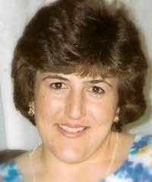
Unravelling complexity
Clinic ethnography of TB IPC Implementation in South African Public Sector Primary Care Health Facilities
Anna Voce
School of Nursing and Public Health University of KwaZulu-Natal
Notes:
In this part of the presentation, I will focus on unravelling the complexities of TB IPC implementation in primary care health facilities using clinic ethnography.

Slide 10
Background
Perspective adopted by Umoya omuhle - TB IPC studied as a ‘complex’ intervention, dependent on:
A number of interacting, multi-synergistic components, across the levels of the health system;
Changes to the organisation of care, use of space, and to administrative processes;
Changes in perception and behaviour, from different categories of health care workers, and from patients;
Different types of professional activity from within and across the levels of the health system
Flexibility and adaptations to local care contexts
Notes:
By definition of what comprises a complex intervention, TB Infection Prevention and Control measures meet the criteria shown on this slide. However, researchers have largely studied TB IPC from a ‘simple’ perspective, reporting TB IPC as not implemented adequately, and then offering behavioural explanations for non-implementation.

Slide 11
Aim
Analysis of TB IPC implementation within the micro-system of primary care health facilities
Understand TB IPC practices in context
Service delivery environment
Administrative systems and workflows
Organisation of care
Patient flows
Organisational structures, processes and culture
Notes:
Our aim was to analyse TB IPC implementation with an intentional focus on the health system, and specifically within the micro-system of primary care health facilities in which TB IPC interventions are embedded. We aimed to understand TB IPC practices in context - of the service delivery environment, and the local organisational structures, processes, and culture.

Slide 12
Methods
Case study approach, adopting immersive ethnographic methods
Data generated through:
Structured and unstructured observations (± 80 hours per clinic)
Formal interviews and informal conversations - with healthcare managers, healthcare workers, clinic support staff, and patients
Patient flow mapping
3-step thematic data analysis
Thick case descriptions
Within case analysis
Across case analysis
Notes:
TB IPC implementation was analysed within the micro-system of 12 purposively sampled primary care health facilities, located in the KwaZulu-Natal and Western Cape provinces.
A case study approach was implemented, adopting immersive, ethnographic methods, with data generated through structured and unstructured observations; both formal interviews and informal conversations with a diversity of health facility staff and patients; and through mapping of patient flows.
A three-step thematic analysis process was followed: firstly, we developed thick case descriptions for each clinic; secondly, we conducted a within case analysis; and thirdly, we implemented a cross case analysis.

Slide 13
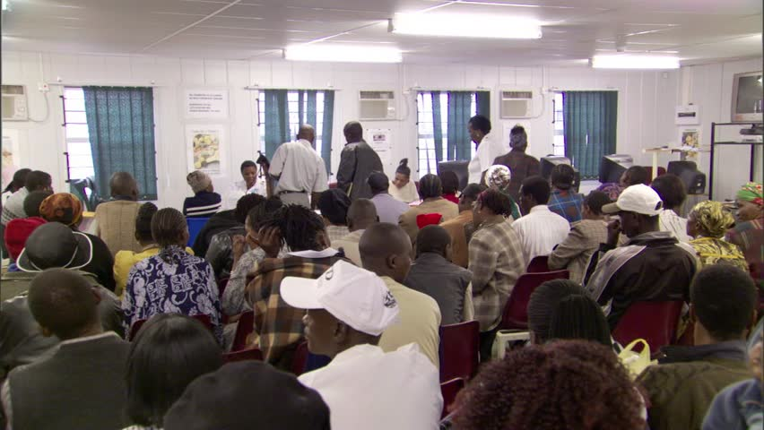
Results: The main waiting area – a lens on the micro-system
Conditions in the main waiting area embedded in the Integrated Clinical Services Model of care
Appointment scheduling (inefficiently implemented)
Pre-appointment retrieval of clinical records (not done)
Single administrative point (incomplete interpretation)
Re-organisation of patient flow based on streams of care (inefficiently implemented)
Analysis of system challenges
Technical expertise for policy translation to local context
Organisational structure: hierarchical
Organisational culture: compliance
Differentiation of management roles within and between system levels
Team synergies
Adaptive learning capacity and innovation
Not actual clinic – illustrative only
Compromised TB IPC in main waiting area:
Long waiting times in over-crowded waiting area, with possible extended exposure to people with active TB – exacerbated by poor ventilation, no cough triaging, no respiratory separation, no evidence of respiratory hygiene, poor use of PPE
Notes:
Health systems are complex entities, with the complexity reflected within the multiple micro-systems constituting the whole. Analysing health systems, even at the operational/micro-level, produces rich and complex findings – messy situations influenced by multiple, interacting, and dynamic components and forces.
The main waiting area of the clinic provides a snapshot of the complexities within the clinic micro-system.
[Text Box 1]
From a TB IPC perspective, clearly TB IPC is compromised in the main waiting area, increasing the risk of transmission of yet undiagnosed TB.
[Text Box 2]
A deeper exploration of the conditions in the main waiting area reveals that they are embedded in a national health system strengthening intervention known as the Integrated Clinical Services Model of Care, intended to circumvent this very situation.
[Text Box 3]
A deeper exploration still, reveals that the system challenges underpinning the problems manifested in the main waiting area are diverse, and are technical, organisational, managerial, and people related – limiting adaptive learning capacity and innovation to deal with the messy situation in the main waiting area of the clinic.

Slide 14
Implications for Health Systems Researchers
Multiple complexities
Multiple ways of knowing
Build ability to make paradigmatic choices
Notes:
Multiple complexities are unravelled in just the micro context of the waiting area:
The technical complexities inherent in the TB IPC interventions themselves; and inherent in the Integrated Model of Care
The structural complexities inherent in the dynamic interrelationships of all the elements within the waiting area
And the people complexities, inherent in the multiple personalities and perspectives represented in the waiting area
In unravelling the complexities in the health system through ethnographic methods the researcher relies on, and indeed stimulates, multiple ways of knowing:
Head/cognitive/analytical knowing
Heart/affective knowing and
Gut/intuitive knowing
It is incumbent upon health system researchers to draw on multiple system theories, and their paradigmatic underpinnings, to unravel the complexities, and to draw on the multiple ways of knowing to enable a ‘whole system’ understanding of, in this case, TB IPC implementation.

Slide 15
Assessing material and social infrastructure
Hayley MacGregor
Institute of Development Studies
Karina Kielmann
Queen Margaret University

Slide 16
Infrastructure
Generally refers to structural and logistical components of health facilities, e.g.
“the total of physical, technical and organizational components or assets that are prerequisites for the delivery of health care services”(1)
Infrastructures are not just material entities—they are also practiced and relational (2); “embedded” within established networks, relationships, dynamics, cultures or ‘social’ infrastructures
1. Scholz, S. et al (2015) Rapid assessment of infrastructure of primary health care facilities – a relevant instrument for health care systems management. BMC Health Serv Res 15, 183
2. Starr, SL (1999) The Ethnography of Infrastructure. American Behavioural Scientist
Notes:
• There has been considerable interest in Infrastructure in recent times, generally taken to refer to structural and logistical components
• The key shift is an understanding of Infrastructures not just as encompassing material entities, but also as practiced and relational elements that make up what is referred to as a social infrastruture
• Thus ‘Material’ infrastructures are conceptualised as “embedded” within established networks, relationships, dynamics, and clinic cultures

Slide 17
(WHO 2016)
WHO supports ‘multi-modal strategies’ for implementa-tion of IPC as “the way to achieve the system change, climate and behaviour that supports IPC progress and, ultimately, the measurable impact” for patients and HCW
IPC: A set of ‘control levers’ to reduce risk for staff and patients by reducing exposure and transmission in clinics; made visible in standard practices e.g. masks, gloves, guidelines, windows, air extraction
Limited understanding of the ‘enabling environment’:
focus on material components while social infrastructure is less visible, hence taken-for-granted
Notes:
· The WHO conceptualisation includes an understanding of infrastructure of relevance to IPC as extending beyond just material elements such as building structures, windows or PPE. As can be seen in the diagram, this wider set of factors affecting IPC is acknowledged as the ‘enabling environments’.
· However, the conventional approach to assessing IPC remains one of checklists that privilege a particular set of practices, namely masks, gloves, the availability of guidelines, or open windows for improving ventilation.
· This standard approach thus still has a limited understanding of the ‘enabling environment’, with a focus on material components. The social infrastructure underpinning practices and processes of IPC is often taken-for-granted, hence less visible.

Slide 18
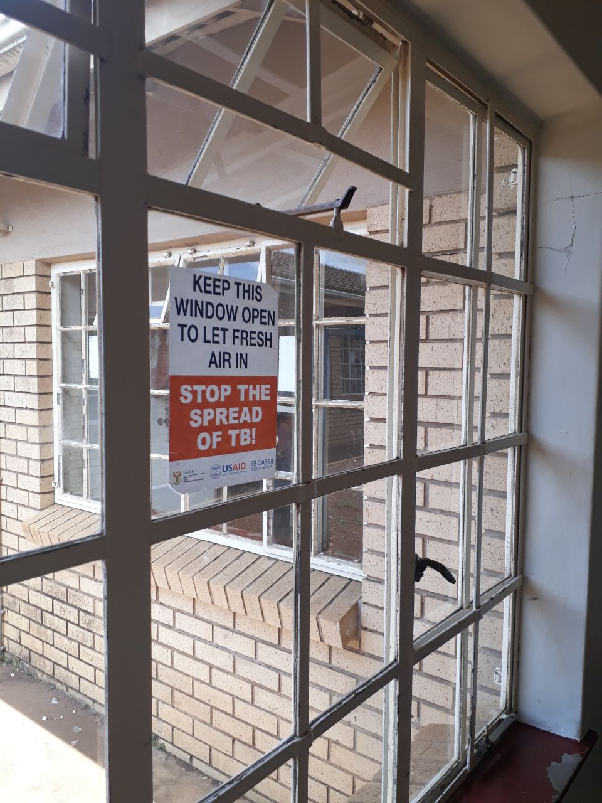
Ventilation, Flow and PPE
Interdisciplinary approach
Quantitative measurements of air exchange in different sizes of rooms with different degrees of ventilation; measurement of congregation of people in different sizes of rooms, at different times of the day; calculation of the risk of transmission associated with different scenarios.
Qualitative research: Interviews and observations of how staff and patients use space; exploration of reasons for lack of PPE use and ventilation of spaces; examination of the organisation of care and clinics logistics and the effect on patient flow; attention to where bottlenecks for congregation occur and why.
Clinic design: interviews with architects and engineers about design priorities and processes; exploration of the challenges associated with retrofits changes
Notes:
· In the Umoya Omuhle project, we adopted an interdisciplinary approach that has focused on quantitative measurement of aspects such as air exchange and ventilation of different room sizes in primary care facilities, and also measurement of congregation of people at different times of the day in different clinic spaces, both waiting and consulting rooms.
· As you heard from Anna Voce, we have also explored the social infrastructures of clinics, with an emphasis on how space is used, how care and logistics are organised and observation in clinics to assess where bottlenecks for congregation occur, and why. We further engaged with architects and engineers to explore design priorities and the challenges associated with retrofit changes to buildings.

Slide 19
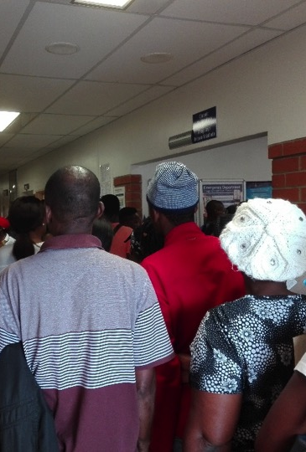
A whole systems approach
Ventilation, congregation and PPE approached as separate elements in IPC assessments, with an emphasis on the material infrastructures
A whole systems analysis shows the interconnections in practice between factors determining the extent of ventilation and congregation
The social and material infrastructures associated with clinics are closely interconnected
The interactions of both of these elements affect risk of transmission and what is possible to achieve in terms of an enabling/disabling environment for IPC
Notes:
· Thus whilst ventilation, congregation and the use of PPE are usually approached as separate elements in IPC assessments - a whole systems analysis shows the interconnections in practice between factors determining the extent of ventilation and congregation
· The social and material infrastructures associated with clinics emerge as closely interconnected
For example, a clinic design involving large windows which can be opened to the outside can be rejected as undesirable by nurses who see these windows as affecting privacy in the room, or compromising security or covering files in dust.
A new clinic with open courtyard gardens and a state of the art stack ventilation system positioned in a large central waiting area might attract large numbers of patients who perceive the quality of care to be better, thus straining building capacity.
Moreover, if care is organised so that people need to wait outside the doors of small rooms for routine activities such as vital sign measurement, this can cause crowding of patients in narrow corridors away from beautifully designed waiting areas as people are afraid to miss their names being called when their turn comes, in the absence of a queue management system.
· The interactions of both of these social and material elements affects the risk of TB transmission and what is possible to achieve in terms of an enabling/disabling environment for IPC

Slide 20
Re-thinking the ‘enabling environment’ for IPC
Metrics and targets (and measurement thereof) make certain practices more visible at expense of implicit, intangible infrastructure
A wider understanding of social infrastructure against the backdrop of inherited infrastructural inequalities is necessary
Synergy/tensions with policies such as Ideal Clinic can enable/disable wider change e.g. in appointment systems, queue management, organisation of care into patients streams or differentiation of care
Material and social infrastructure are mutually constituted
Notes:
· Our project thus suggests that a rethinking is necessary to widen the understanding of an ‘enabling environment’ in order to appreciate that material and social infrastructures are mutually constituted).
· Thinking about the social infrastructures also entails examining clinic cultures, power dynamics and leadership.
Factors affecting IPC also have to be analysed against the backdrop of inherited infrastructural inequalities in South Africa.
· Finally, the policy environment has to be considered. Policies such as the Ideal Clinic Initiative can enable/disable wider change such as in appointment systems, queue management, organisation of care into patients streams or differentiation of care

Slide 21
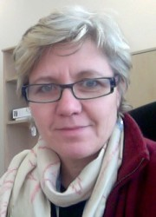
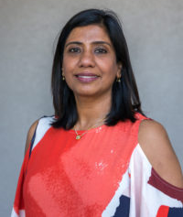
Helen Schneider
University of the Western Cape, Cape Town, South Africa
Thilo Govender
King Dininzulu Hospital, Durban, South Africa
Janet Seeley
London School of Hygiene & Tropical Medicine and Africa Health Research Institute
Discussants
Facilitator

Slide 22
Discussion
Unravelling complexity in a complex system

Slide 23
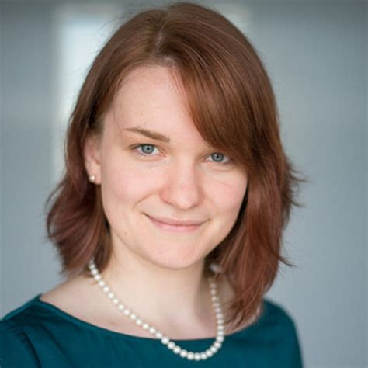
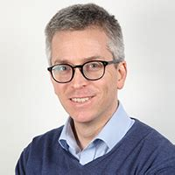
Using System Dynamics Modelling in Umoya omuhle
Potential gains and losses for whole system framings
Karin Diaconu
Queen Margaret University
Justin Parkhurst
The London School of Economics and Political Science

Slide 24
Application in HPSR
Recognition that current modelling approaches are not capturing sufficient complexity:
Focus principally on one intervention
Depict minimal interaction among health system components
If we agree that more complexity needs to be captured, we agree to move towards “health system modelling” → SDM is one method that can help with that
Complexity science approaches
Self-organization
Non-linearity
Networks
Complex adaptive systems
“System Dynamics is a computer-aided approach for strategy and policy design. It uses simulation modeling based on feedback systems theory and is an analytical approach that complements systems thinking. It applies to dynamic problems arising in complex social, managerial, economic, or ecological systems — literally any dynamic systems characterized by interdependence, mutual interaction, information feedback, and circular causality.” (SDM Society)
Invented by Jay Forrester in the 1950s but further refined by others: Sterman, Vennix, Rouwette, Hovmand, Homer
Notes:
Starting off, it is important to reflect on why SDM may be used for health policy and systems research. Increasingly there have been publications acknowledging that current approaches to HPSR and particularly intervention development/evaluation do not capture sufficient complexity. This can play out in two ways: focusing either on only one intervention mechanism at the cost of others, or not questioning how an intervention interacts with the health system more broadly. If we accept the move to capturing more complexity is valuable, then the field of ‘health system modelling’ emerges, and SDM is one of many complexity science methods that may be useful. It focuses on modelling a specific problem, capturing relevant perspectives to that problem and forces us to think about how problems emerge/play out over time, what pathways and feedback loops are critical to it.

Slide 25
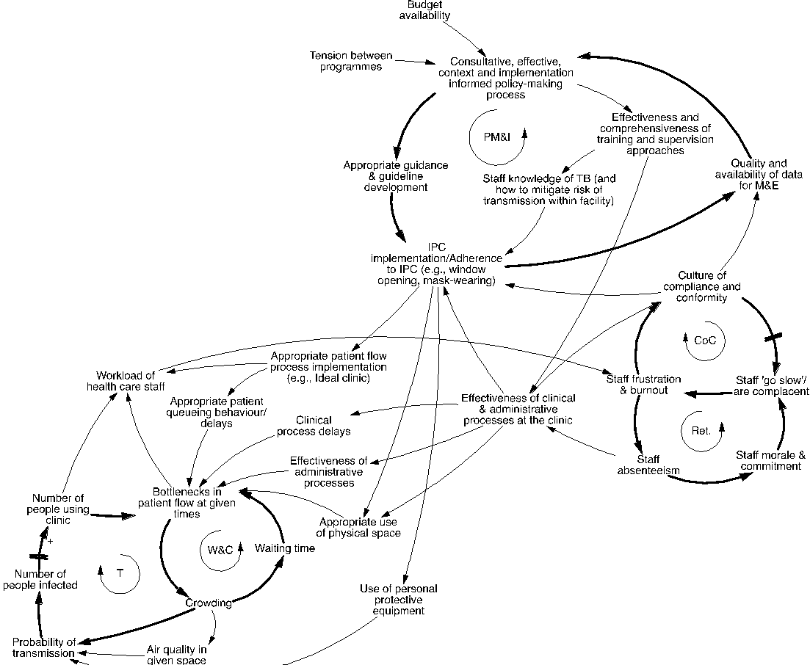
Application within the project
Two workshops (Durban, 2019) with staff from National and Provincial levels (Western Cape and KwaZulu-Natal)
Policy workshop (n = 9) : policy-makers with expertise in TB, primary care, financing, information systems, medicine availability
Practitioner workshop (n = 15): patient advocates, health care staff and managers, program leadership, architecture and infrastructure specialists
Notes:
In Umoya, we hosted two participatory GMB sessions, where we elaborated causal loop diagrams which reflect the underlying feedback loops driving transmission of Mtb at facility level. Briefly they relate to high waiting times and crowding of clinics as influenced by an organizational culture wherein staff are overwhelmed by competing programme and policy demands which over time have created a conforming/compliant clinic environment wherein IPC implementation is not a priority; at policy level, there is limited consultation and learning from implementation challenges associated with IPC and no sense of urgency surrounding this.

Slide 26
Intervention targets and mechanism considerations
Intervention targets and core mechanisms
Other parts of the mechanism
Consultations: Ensuring buy-in of patients and stakeholders at different system levels
Alignment and coordination: Integrating mechanisms within existing systems as far as possible, e.g., for M&E and training and supervision
Feasibility consideration: Including elements which address clinic or system level constraints to implementation and scale-up
Number of people using the clinic
Medication distribution outside clinics for chronic illness, queue management systems, appointment systems
Ventilation or safety of clinic spaces
3 interventions focused on window/door opening, retrofitting spaces, installation of UVGI
Personal protection measures
Surgical mask wearing for patients & N95 respirators wearing for staff
Notes:
Our GMB participants voted on the specific areas to intervene and highlighted core intervention mechanisms (e.g. retrofits) but also emphasised the need to incorporate broader elements addressing above feedback loops (e.g. ensuring consultations with diverse stakeholders).

Slide 27
Reflections and application in Umoya omuhle
Tension over what is modelled
Boundary: IPC only or broader system? Participants: whose views are included and what are their goals and views? Time-horizon: both retrospective and prospective
SDM is not purely objective or mechanical - tension with other methods and approaches
Modelling health system
Modelling team and participants negotiate where to focus for intervention targets and mechanisms and this is simulated: Assumptions bring tensions about what level of detail is relevant or not
Critically interrogate and simulate system behavior
Capture diverse perspectives and evidence around boundary object
Group model building workshops with policy makers, practitioners, advocates and researchers; GMB forces bounding of problem
Identify system dynamics and intervention strategies
Unpack and understand interactions
Modelers distilled information from primary RQ1-4 data and GMB, but bias may be introduced: SD modelers have to move from complex and very detailed models to key dynamics in line with goals of exercise
Evidence input by presentations from Umoya to participant group – and embedded researchers into groups to probe and challenge, but model is negotiated
Notes:
Some reflections on process highlighted on this slide as per each of the points here which are more or less a typical model development cycle (note slide says health system but we do mean the problem and its interaction with the system).
Challenge here was that Umoya was adopting both a retrospective design but also wanting to identify future interventions. E.g. what is being modelled, over what time horizon and who participates?
SDM and GMBs force a bounding of the problem – we need to identify core dynamics and not get lost in all potential details, but that implies losses
Evidence use facilitated by researcers providing inputs into process, but the model is eventually negotiated so there is tension between this and a more traditional top-down dissemination of evidence
Modellers themselves may bias the process as well of course and there’s overarching emphasis

Slide 28
Evidence use for policy in relation to SDM
SDM as a ‘knowledge translation’ device
As a tool to manage complexity and provide insight into policy actions
Can provide insights from existing research felt to be policy relevant – exploring how it serves complex needs;
Can follow a more exploratory process by which evidence is sought and considered in terms of how it serves policy needs and goals.
Constructivist perspective – SDM as a tool that can be formalized within planning processes.
Planning processes (and tools utilised) can shape or define:
The problematisations that are seen as relevant;
The solution sets held to be options;
The meaning and values of elements of the policy;
The representation of particular stakeholders and concerns.
Notes:
We considered how the use of SDM might affect the utilisation of evidence to inform policy given the complexity of public policymaking
Looked at the broader conceptual literature and then reflected on its use within the project
Broadly speaking there are two ways SDM in relation to evidence use can been conceptualised:
As a knowledge translation tool – providing a mechanism to provide research findings to relevant decision makers, and providing ways for decision makers to understand how pieces of information serve their decision making needs
From a constructivist position, to consider how formalised planning processes can affect the construction and selection of problems and solution sets, and can formalise or prioritise particular social values in decision space
We see examples of both of these in our work
The process was clearly one where research findings linked to decision makers
And we have examples of decision makers reflecting on how they had gaps in knowledge that SDM helped to fill
Also see the constructed nature of evidence application and utilisation too

Slide 29
Policy scholars’ perspectives on evidence use
Bounded rationality – applies to decision makers and to producers of evidence
Decision makers – limited time, incomplete information, unclear competing agendas;
Evidence providers – Fleck (1935)’s concepts of ‘thought collectives’ - impose artificial simplification of scientific knowledge in attempts to summarise and provide evidence to others. (see Botterill and Hindmoor 2012 Policy Studies)
Construction of problem and solution sets
Evidence utilisation can formalise how problems are understood, which solutions are seen (and seen to be relevant), and which goals are pursued
Representation and accountability
Those who participate in the processes of evidence use will have particular priorities and understandings – can reflect on representation and accountability within processes.
Notes:
This includes the idea of bounded rationality – that both decision makers and users may have constraints on how they conceptualise problems, on data availability or other limitations. So, for instance we can see how decision makers thinking about the problem as one of health and health systems might shape which information they take to be relevant, potentially at the expense of other complex social or systems issues highlighted in previous talks
We can see examples where respondents took on the language of SDM – referring to processes, flows, double loop systems etc
We see Participation and concern over who was involved to also be an important reflection point for those taking part.
So overall to reiterate we see elements of both SDM serving as a knowledge translation tool but also illustrating some of the many ways evidence use and processes followed to use information and data can work to construct or delineate particular policy choices and decision directions.

Slide 30
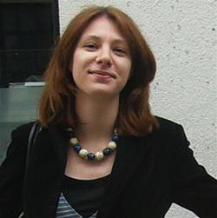
Using a participatory approach to design and cost complex interventions
Fiammetta Bozzani
London School of Hygiene & Tropical Medicine

Slide 31
A novel approach to costing
Costing framework developed alongside SDM, recognising that:
interventions in our package are already variously implemented in some form because benefits are established (e.g. opening windows, wearing masks)
current implementation is suboptimal and costing ‘business as usual’ activities is not going to achieve intended effectiveness targets
relevant behaviours have to be contextualised within broader organisational culture, processes and system constraints, but no standard method to synthesise this information alongside economic analyses
What is new?
Enablers (contextual factors) identified with experts and practitioners during SDM workshops
Package of interventions and enablers included in economic analysis reflects full opportunity cost of achieving control of TB transmission in clinics
Notes:
As explained in previous presentations, the interventions we considered are already variously implemented in the South African health system in some form, because the benefits of doing things like opening windows or wearing masks are established. However, implementation is suboptimal and the literature usually explains this in terms of compliance or non/compliance with the individual behaviours. Our approach, instead, tries to look at those behaviours as linked and contextualised within broader organisational culture, processes and system constraints
At the moment, this type of information is not systematically integrated within or alongside economic evaluation results as there is no standard elicitation and synthesis method to do this. In the past, we have tried for example to parametrise economic models using qualitative evidence from key informants and walked away with information on a few proximal constraints to scaling up TB services, such as human resource and diagnostic shortages, but this did not give us an understanding of the broader health system and its complexity.
For this reason, through the social science work and SDM modelling in this project, we aimed to identify the contextual factors (or enablers) that can be put in place to improve the feasibility of interventions. These enablers were costed together with the core intervention activities. The costs included in the economic model using this novel approach are a closer representation of the full opportunity costs of controlling TB transmission in clinics.

Slide 32
Economic evaluation methods
SDM workshop 1
Identify interventions (impact + feasibility) and specific activities to cost
Identify enablers (improve feasibility)
Micro-costing – identify input prices and quantities
Core intervention activities, enablers, consequential TB and HIV care
Sources: Published literature, current research, quotes from suppliers
Cost model parameters validation
Monthly ‘drop-in’ calls with SDM workshop participants
SDM workshop 2 – present preliminary results, make changes for final estimates
Attach unit costs to TB transmission model outputs to generate cost-effectiveness ratios
Notes:
As described by Karin and Justin, the intervention activities and related enablers to cost were identified in collaboration with policymakers and practitioners during the first SDM workshop. We then built a cost model of the intervention activities, enablers and the consequential costs of TB treatment and ART using costs and quantities of inputs gathered from the literature, ongoing research and quotes from local suppliers. The costs assumptions were validated iteratively with SDM participants at the monthly check-ins and, finally, during the second SDM workshop.
The ultimate objective of this analysis was to attach the unit costs of TB and ART care to the outputs from a community TB transmission model, to generate cost-effectiveness ratios under different intervention scenarios.

Slide 33
Process outcomes and limitations
Enablers can represent >90% of total costs (e.g. introducing appointments)
Regular contact with GMB participants helps validate assumptions
although participants may have ‘self-selected’ on drop-in validation calls
Enablers tend to be above service level
high-level activities, difficult to allocate to specific interventions
activities that fall outside the remit of the health sector
SDM-informed costing can highlight trade-offs between interventions that are more or less reliant on enablers (and at what level these operate)
It provides information on intervention feasibility quantitatively within the ICER
It provides qualitative evidence on enablers that are difficult to measure
It is not best suited inform the choice of a cost function for modelling costs at scale
Notes:
We found that including enablers in this way does make a difference! For some of the interventions in our model, such as introducing appointment systems to avoid crowding in clinics, enabler costs represented more than 90% of total costs. Not including them would greatly underestimate the investment required.
By providing several occasions for interaction between TB-IPC stakeholders and researchers, SDM-informed costing enabled a thorough process for validating and refining model assumptions, including on the details of intervention and enabler design. This was generally superior to the standard, less participatory elicitation methods used in economic analyses. The process is not immune to potential bias in terms of participants selection and power dynamics at play. While this was mitigated in our application by casting a wide net and having separate workshops and breakout groups, our reliance on drop-in calls for validating the steps of the synthesis process might have led to a biased sample of participants ‘self-selecting’ at this stage.
Given its lens on the wider health system, SDM is by definition well-suited to identifying high-level factors affecting intervention implementation and outcomes. Our framework for reaching consensus around the leverage points in the system and interventions design was the narrower ‘IPC system’ described by Anna and Hayley. The expectation was that this focus would be conducive to identifying a combination of service and above-service level (meaning both provincial and national level) activities and enablers that would be costed. In practice, while the core activities were all at the facility level, the vast majority of the enablers identified were high-level (for example redesigning training formats and materials using data from routine m&e). This creates issues for costing, as gross costing methods for allocating above-service costs to specific interventions may become less accurate the higher the level of the health system at which costs are incurred. Moreover, some of the activities identified were outside the remit of the health sector (for example improving transportation links to clinic to support the roll out of appointments systems).
To conclude, from our application, the biggest draw of SDM-informed costing for priority setting is that, once enablers are included on the cost side, then we can present to policy-makers information on the trade-offs between interventions that require more or less upfront investment on enablers. Another way to put this is that we can calculate incremental cost-effectiveness ratios that rank intervention options based not only on their relative efficiency but also on their feasibility. We can also present qualitative evidence alongside the ICERs on enablers that cannot be measured but are critical for successfully embed the interventions in the system (e.g. working culture, or leadership and management issues). These enablers that are difficult to quantify might, however, also be difficult to implement and sustain.
The main potential limitation of our application is that, given geographical differences in routine IPC practices at the facility level and given the high level health system interactions, we could not identify a uniform intervention design that could be scaled up at the national level. From a costing perspective, then, the approach might not be best suited for describing the relationship between unit costs and intervention coverage (i.e. the cost function). Despite these limitations, the approach in our experience proved to be a considerable improvement on other available alternatives.

Slide 34
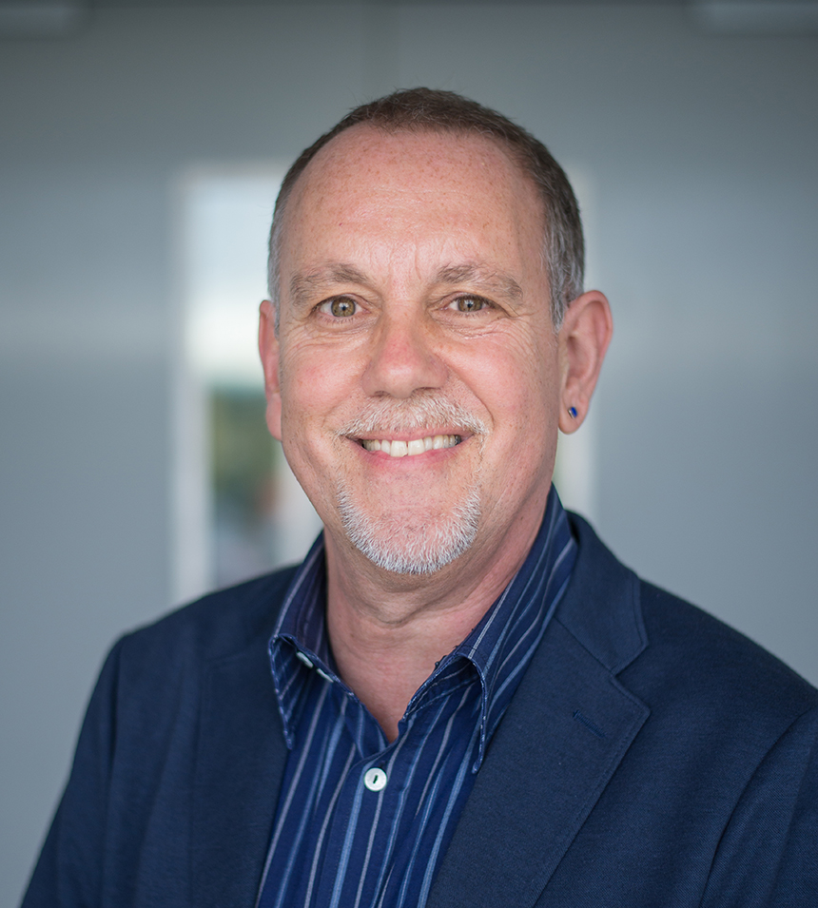
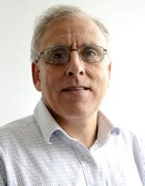
Alastair Ager
Institute of Global Health and Development, Queen Margaret University
Gerald Bloom
Institute of Development Studies, University of Sussex
Anna Vassall
London School of Hygiene & Tropical Medicine
Discussants
Facilitator

Slide 35
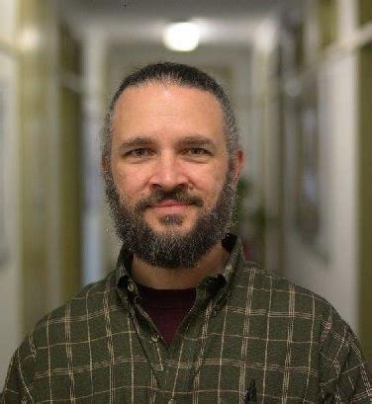
Situating interventions in the policy context
Chris Colvin
University of Cape Town

Slide 36
Policy study main findings
Ownership: Many people felt that TB-IPC was seen as “everybody’s business and [therefore] nobody’s business”.
Advocacy: A general lack of TB activism, or any broader civil society mobilization to address TB concerns.
Evidence: A lack of new, clear and compelling effectiveness or cost-effectiveness evidence for TB-IPC interventions might make policy advocacy difficult
Implementation context: TB programmes were described as highly institutionalized and routinized and as stigmatized by HCWs (rigid professional hierarchies varied TB risk perceptions, persistent blind spot around where the real TB risk is located).
Key role of system level change: Success stories were only described at the clinic level, sub-district or district levels. TB-IPC is a problem that cannot be solved (only) by individuals or by national government.

Slide 37
Discussion
Incorporating complexity into intervention design

Slide 38
Summary
Chris Colvin
University of Cape Town
Karina Kielmann
Queen Margaret University

Slide 39
Thanks & close
Alison Grant
London School of Hygiene & Tropical Medicine and Africa Health Research Institute

Slide 40
Our thanks to
The nearly 7,000 people who participated: patients, clinic visitors, health care workers, policymakers and other government staff, engineers, architects, activists, researchers, …
Managers and staff at the 12 participating clinics
Participants at System Dynamics and Patient Flow workshops
Colleagues in Western Cape Department of Health: Andrew Boulle, Arne von Delft, Gavin Reagon, Bart Willems
Our project oversight group: Thilo Govender, Graeme Meintjes, Vanessa Mudaly, Lindiwe Mvusi, Jacqui Ngozo, Helen Schneider
Ethics committees at LSHTM, UCT, UKZN, and QMU

Slide 41
The extended team
Investigators and core team: Kathy Baisley, Peter Beckwith, Adrienne Burrough, Chris Colvin, Karin Diaconu, Indira Govender, Alison Grant, Idriss Kallon, Aaron Karat, Karina Kielmann, Hayley MacGregor, Nicky McCreesh, Janet Seeley, Alison Swartz, Amy Thomas, Anna Vassall, Anna Voce, Richard White, Tom Yates, Gimenne Zwama
University of KwaZulu-Natal: Bavashni Govender, Zama Khanyile, Nokuthula Lushaba, Nonhlanhla Maphumulo, Sharmila Rugbeer, Thandeka Smith
Africa Health Research Institute: Nkosingiphile Buthelezi, Njabulo Dayi, Siphephelo Dlamini, Yutu Dlamini, Anita Edwards, Dickman Gareta, Patrick Gabela, Emmerencia Gumede, Sashin Harilall, Kobus Herbst, Mandla Khoza, Nozi Khumalo, Zilethile Khumalo, Nondumiso Kumalo, Richard Lessells, Sithembiso Luthuli, Sinethemba Mabuyakhulu, Nonhlanhla Madlopha, Thabile Mkhize, Duduzile Mkhwanazi, Zinhle Mkhwanazi, Zodwa Mkhwanazi, Sashen Moodley, Sihle Mthethwa, Xolile Mpofana, Sphiwe Mthethwa, Nozipho Mthethwa, Silindile Mthembu, Sanele Mthiyane, Vanisha Munsamy, Tevania Naidoo, Nompilo Ndlela, Thandekile Nene, Sabelo Ntuli, Nompumulelo Nyawo, The PIP CRAs, Anand Ramnanan, Aruna Sevakram, Sizwe Sikhakane, Zizile Sikhosana, Theresa Smit, Marlise Venter, Precious Zulu
University of Cape Town: Amy Burdzik, Ruvimbo Chigwanda, Suzanne Key, Aphiwe Makalima, Godfrey Manuel, Phumzile Nywagi, Anathi Mngxekeza, Awethu Gawulekapa, Precious Mathenjwa, Samantha Moyo, Seonaid Kabiah, Sinead Murphy, Siphokazi Adonisi, Siphosethu Titise, Tamia Jansen, Yolanda Qeja
Queen Margaret University: Jenny Falconer, Kitty Flynn, Claire McLellan
London School of Hygiene & Tropical Medicine: Arminder Deol, Naomi Stewart

Slide 42
Funders
Notes:
Economic and Social Research Council (ESRC) working in partnership with the Department of Health, partly funded by The Antimicrobial Resistance Cross Council Initiative supported by the seven UK research councils in partnership with other funders.

Slide 43
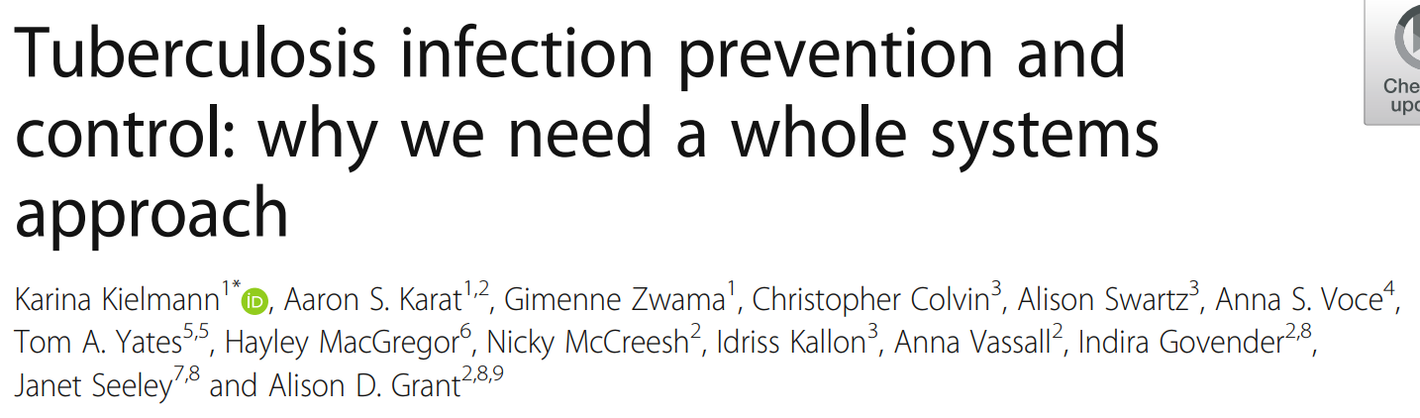
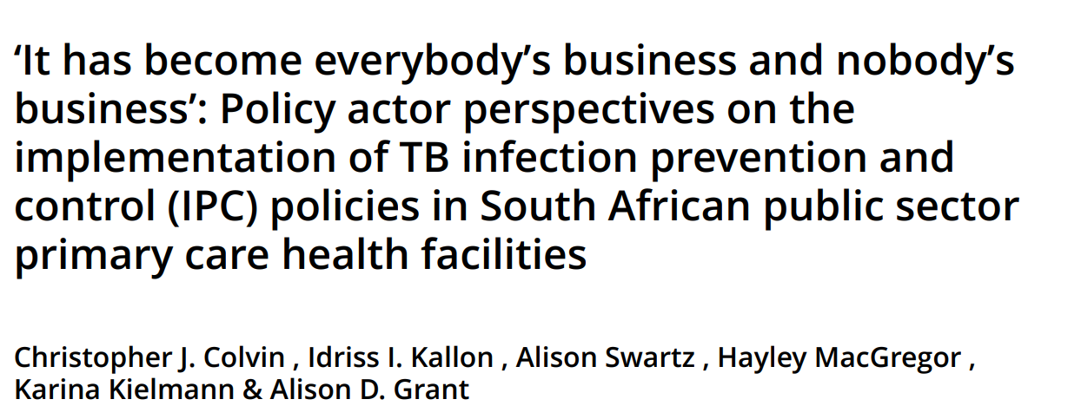
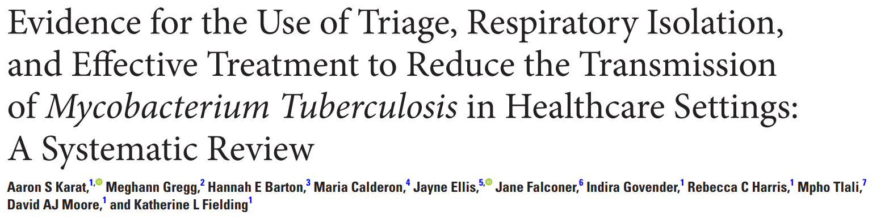
Further information is on our website: search for “Umoya omuhle”
To access publications, please visit https://www.lshtm.ac.uk/research/centres-projects-groups/uo#publications
These slides and the session recording will also be on the website

