Slide 1
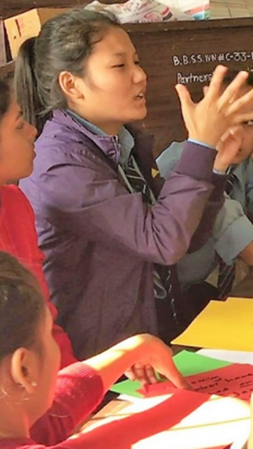
Participation of persons with disabilities in research
Reflection on
Processes &
Lessons Learnt
Maria Zuurmond
Weds 21st July 2021
Notes:
We wanted to place the young people at the centre of this research

Slide 2
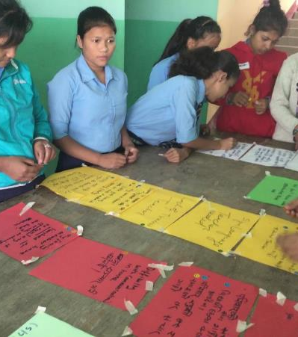
Agenda
Youth research project in Nepal
Working with younger children – the Feeling Dice
Working with OPDs in Research
Notes:
Check who has worked with youth researchers, conducted research with youth with disabilities?
Brainstorm the challenges and opportunities in using this approach for- keep this in mind throughout the presentation:
The Participants
The Research
The Youth researchers themselves

Slide 3
Strengthening the voices of young people with disabilities in Nepal - aims
To identify key factors which impact upon the wellbeing of older adolescents of 14-19 years with disabilities in Nepal
To explore the contribution of peer-focused research with adolescents with disabilities

Slide 4


Youth Researcher Participation process
Open recruitment process
5 day training
½ day refresher
Feedback on draft report
Field work
in 4 sites
Co-facilitation/
mentoring with experienced reseacher
Analysis workshop
2 days
Dissemination

Slide 5
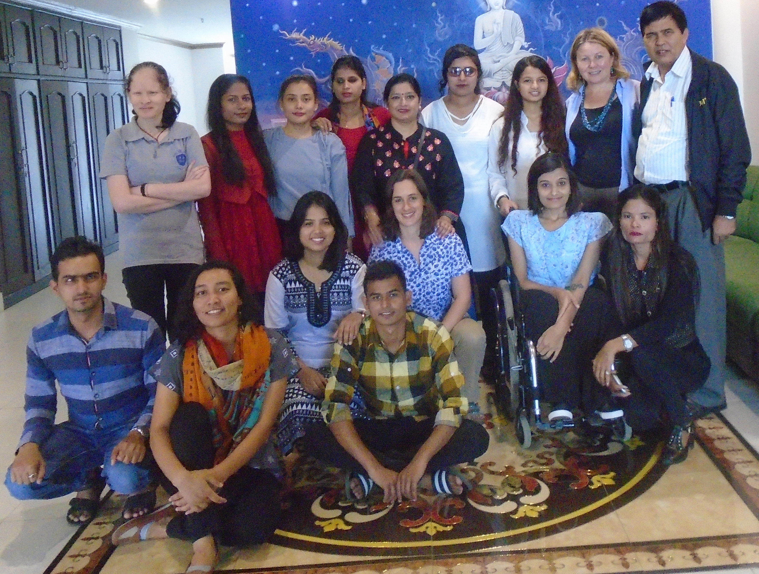



Youth with disabilities as co-researchers
Research training workshop – Nepal
(28 August – 1 September, 2017)
Building the capacity of youth researchers
For young people living with a disability
Report for participants
Team of 7 youth (22-26 years) with disabilities
Local national experienced lead researcher
Notes:
Criteria not adhered to – CBM selected older and more educationally qualified young people – MSC or degree level – but they had no experience of working in the field of disability and no experience of peer to peer work
Plan in contrast chose slightly younger, had not had tertiary education – 3 young people who were deaf & 1 yp person with albinism who was working in a very junior role in a disability organisation – had never been to Kathmandu!
<number>

Slide 6
TOR Youth Research Associate
Young person, 18-26 years, with a disability
Excluded people with an intellectual impairment
– flexibility about age – ‘My big Sister’ – emphasis on
Experience
• Experience of working with young people, for example in the peer education project.
• Experience of conducting research, although this is not essential
• Experience of working with people with disabilities,
Skills
• Excellent communication and interpersonal skills with an ability to develop relationships and respectfully interact with people from all backgrounds
• Excellent teamwork skills
• Strong ‘can do’ attitude
• Interest in building their research and evaluation skills.
Notes:
Lead researcher plays multiple roles
We had an additional researcher for interviews with the deaf and she was much less experienced ; complexities of working through 2 layers of language an interpretation – from sign language into Nepali, and then from Nepali into English (for some of the interviews). Suggested approach : filming and debriefing.
When young people have limited sign language then need to be much more creative

Slide 7
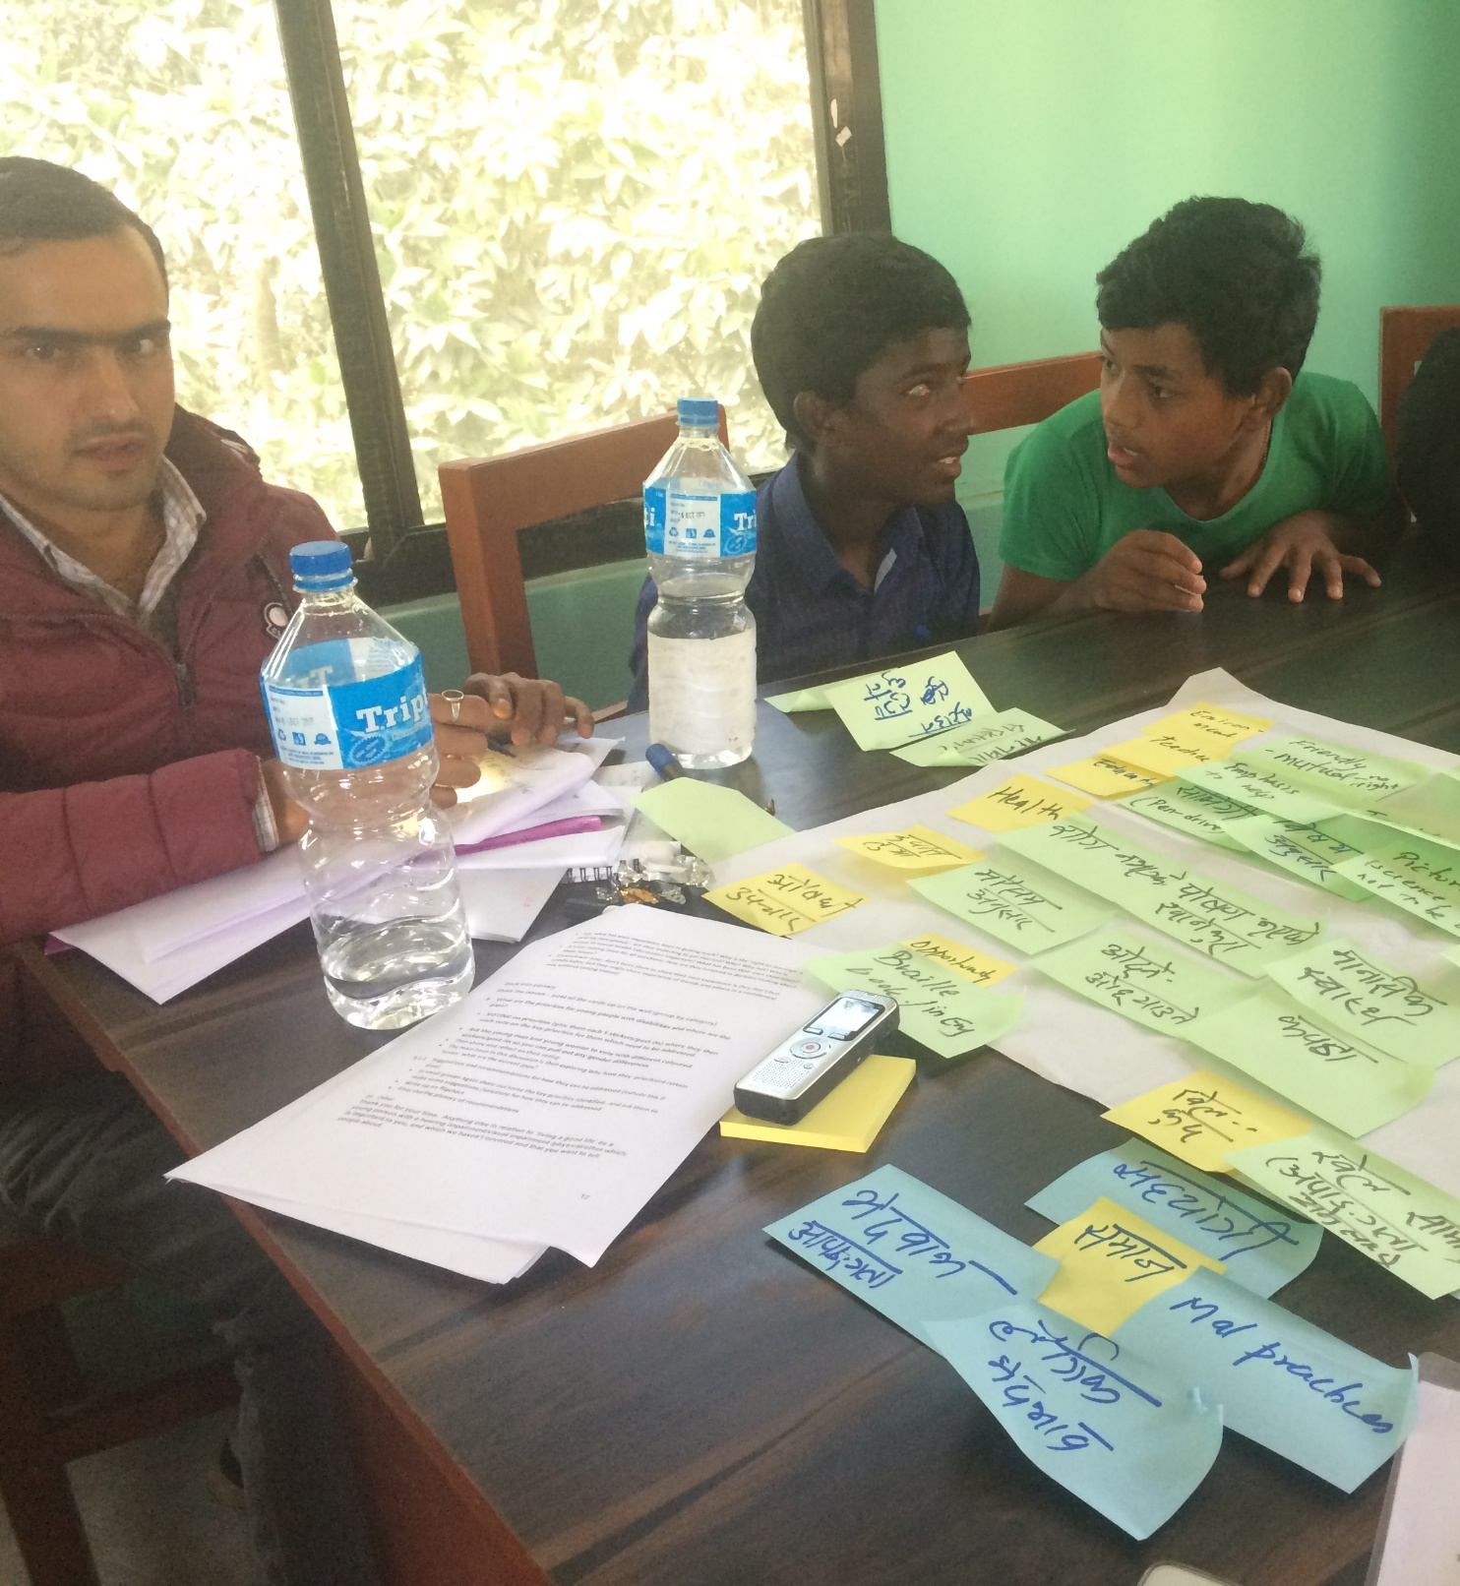
Research methods
Qualitative design
Semi-structured interviews with young people - 26
3 participatory workshops - 26
Semi-structured interviews with key informants – 12
Notes:
Could have been more participatory – especially need to re-view how we conduct meaningful research with young people , will touch on some of the tools

Slide 8
Co-facilitated research
Buddying of researchers- some interviews led by youth researchers & some by the lead researcher
Sometimes interviews ‘shared’
Learning from observation & feedback was key- daily
Ongoing feedback loop to review interviews & youth research associate’s roles
      One size does not fit all – see your youth researchers as a team
E.g. Participatory workshops with different roles, as scribes, as key informants, leading one element, in analysis workshop
Notes:
Are we clear what that mean? Not every youth researcher led and interview how much do you ‘let go’, what is ‘good enough’ ?
How were decisions made on who led the research and did this change over the course of the data collection

Slide 9
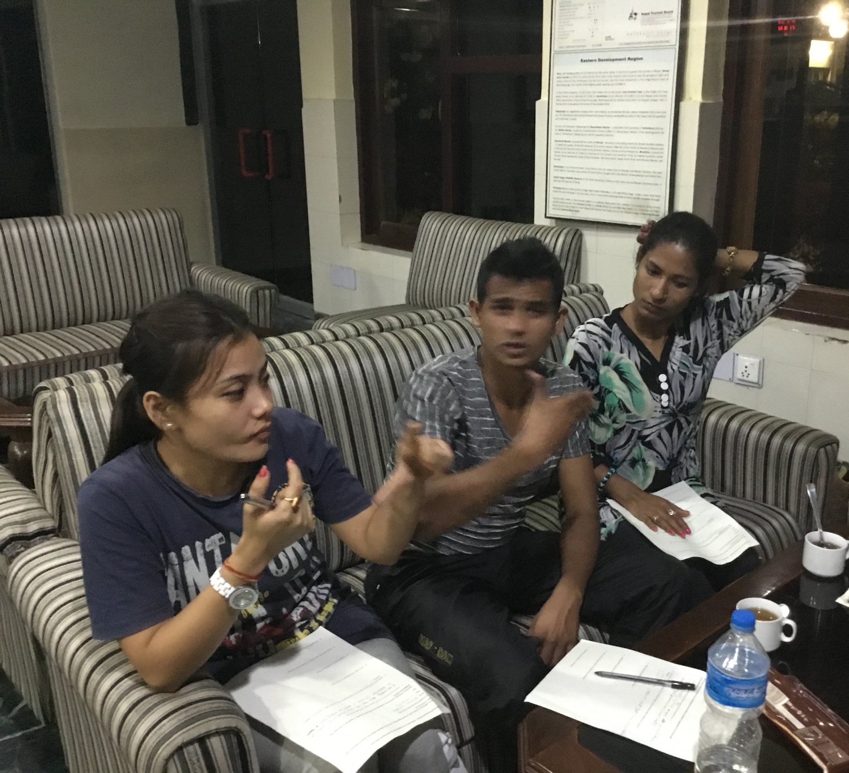
Debriefing and feedback every evening
Team of deaf young researchers in Biratnagar discussing the key issues emerging from the day.

Slide 10
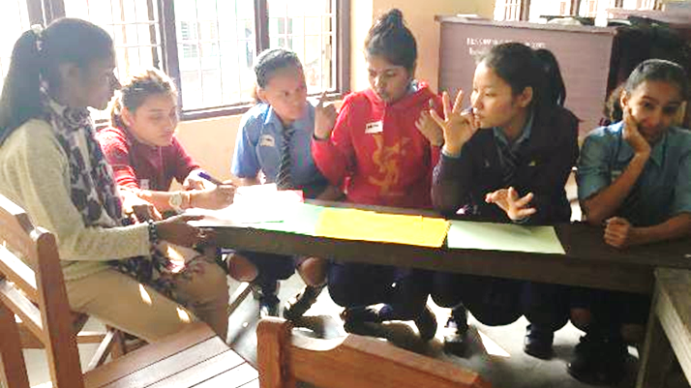
Selection of findings
Notes:
NOT planning to share – only one related to livelihods

Slide 11
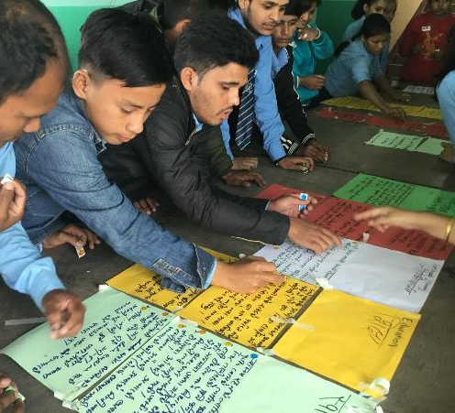
Transitioning to the workplace
Being able to work and have a good job were seen as important for a good life
Young people were aspirational
Very limited work opportunities
Very limited skills training
Notes:
Example of ranking and prioritising the key issues

Slide 12
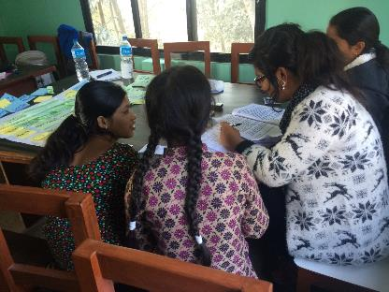
What do the youth researchers bring to the research & impact upon them?
Notes:
On-going analysis of data and films
Don’t make any assumptions – example of the collage to explore your experience of disability – we are also learning from thgis about how to make our research approach even more inclusive
A different perspective – it is like having a team of key informants ‘on tap’
From their perspective

Slide 13
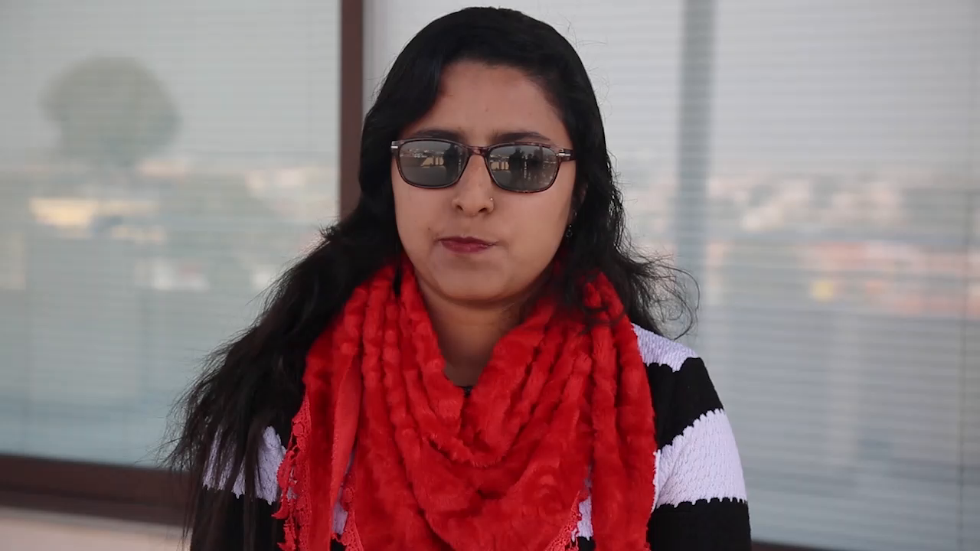
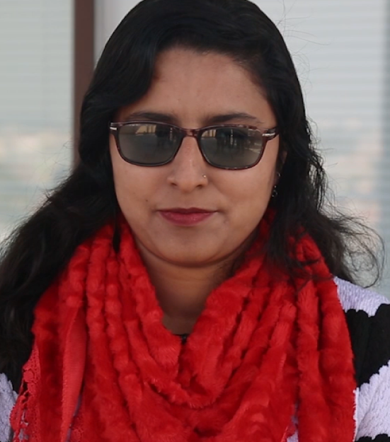
Maria - video_Trimmed.mp4

Slide 14
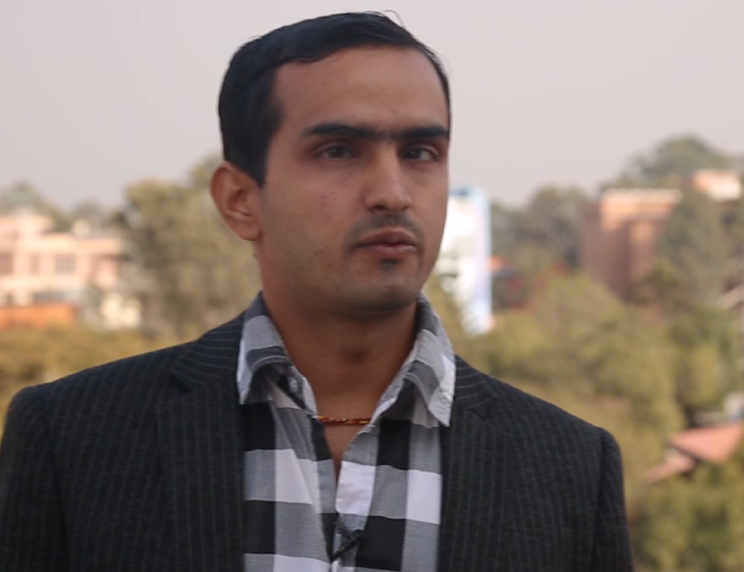
You are seeing disability as a homogenous issue? Why?
Their own valuable perspective on the research and Key issues
Notes:
Important role in the analysis workshop , valuable role of having the youth researchers as key informants – not always a positive

Slide 15
Some lessons learnt & questions
We definitely didn’t get it all right! Lots of learning!
How can you make the training as inclusive as possible
Very Participatory. Having an inclusive focal point person
What makes a good youth researcher?
Value of a ‘team’ approach where team members bring different strengths
The lead researcher also had to provide mentorship in the field- which can be challenging & very time consuming – build in extra time
Negotiation of roles and how best to ‘co-facilitate’ research- how do you find the balance? Clarity of roles from the start
Notes:
Where does it lead? How can it be built on? What are the expectations of what it is achieving/ where it could lead? Are they the right age- a 26 year old youth researcher might be interviewing a 14 year old? What did the young people think about it/ ie the participants?

Slide 16
Some lessons learnt and questions
Child protection/vulnerable young person issues; there were issues for the youth researchers as well as those being researched?
Value of involving them in all aspects of the research – analysis workshop was one of the highlights
What is the ‘added value’ of working with young people with disabilities as co-researchers?
We are still unpacking this
Is the process more important than the outcome of the research?
Data is ‘co-produced’ so what is the impact of working with the youth researchers on the research findings?
                Need to understand the impact on the youth researchers themselves? And any impact on the participants?

Slide 17
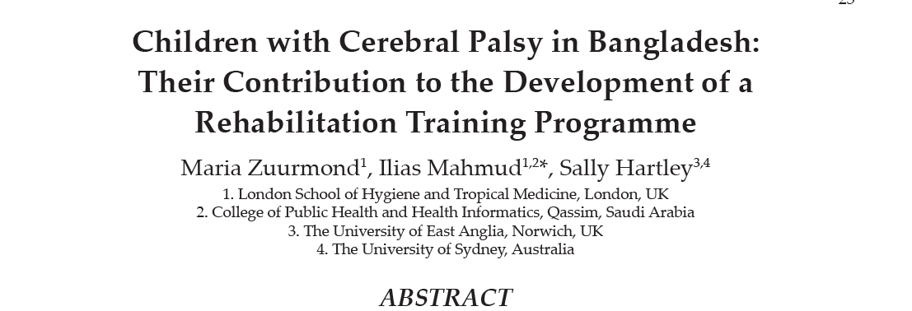
Working with younger children

Slide 18
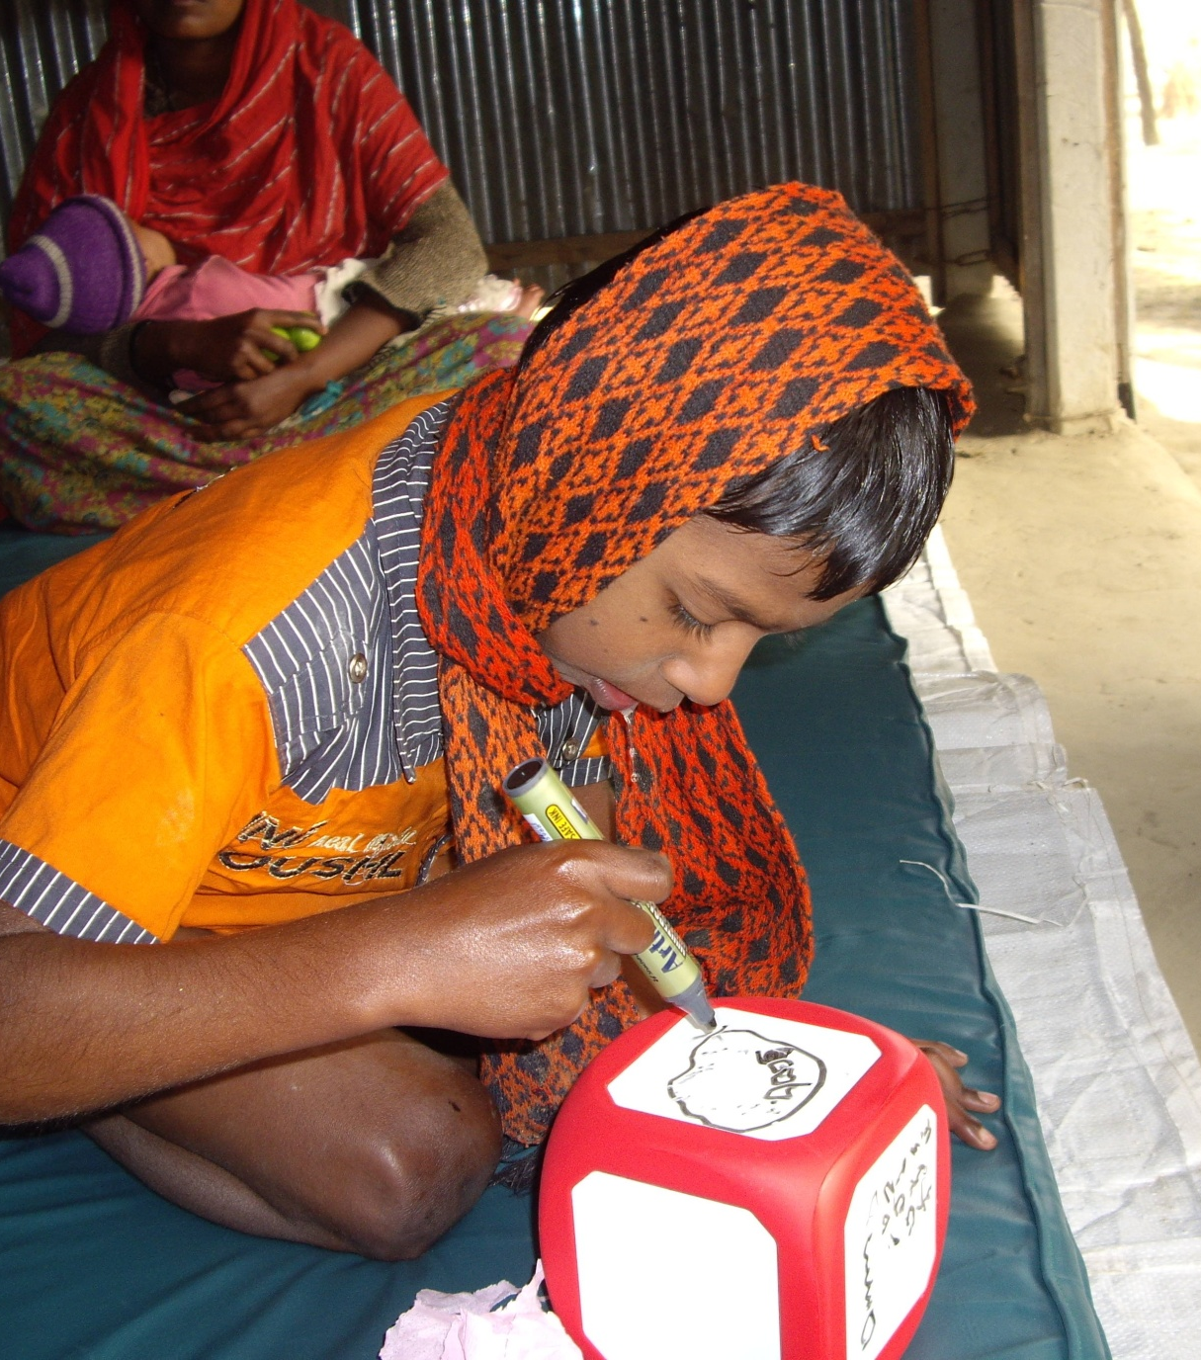
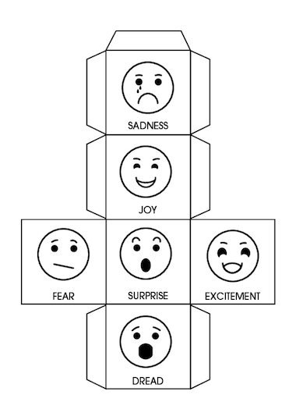
Use of participatory methods with younger children
Example: Use of the ‘Feeling Dice’
Notes:
For all children, not just children with disabilities then participatory approaches can be useful. They can have lots of advantages and One way of trying to address this power imbalance, and also to choose a method that a child can relate to is to choose participatory methods. There are a whole range of participatory methods out there and we are going to give a couple of examples only from our research. 1) the feeling Dice – Messou K Encouraging children in more inclusive ways. Brit J Spec Ed, 2008. 35(1): p. 26-32. This picture here is of a young child in Bangladesh who is making his own feeling dice, and then talking about his feelings at home, in a training programme

Slide 19


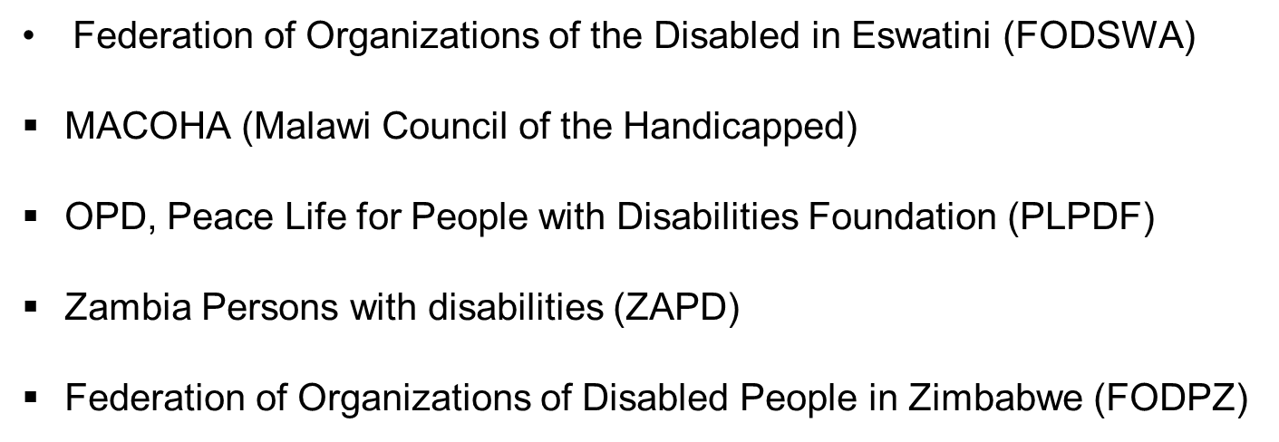
Working in partnership with OPDs for research

Slide 20
Process of Participation
OPD focal point per country
Budget for their role
Building in training
Co-facilitation of research
On-tap advisory role
Primed for involvement in next steps

Slide 21
Thank you
Questions & shared experience

