Slide 1


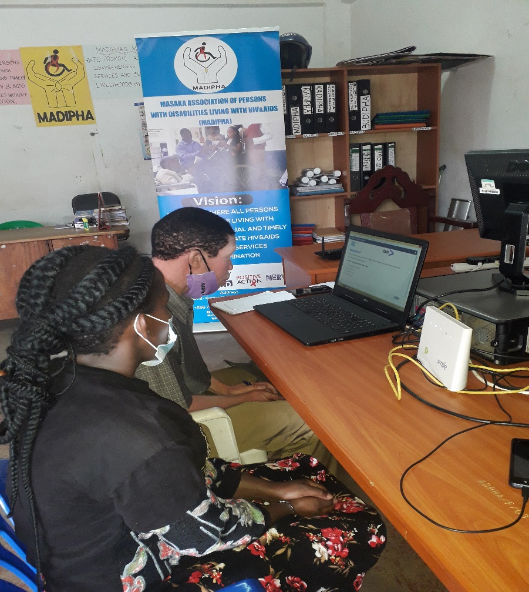
Masaka Association of Persons with Disabilities living with HIV&AIDS - MADIPHA
Engagements with Employers and Policy Actors in inclusive Employment
SOURCE, DEP and PENDA Disability Evidence Event
21 July 2021
By Musisi Richard

Slide 2
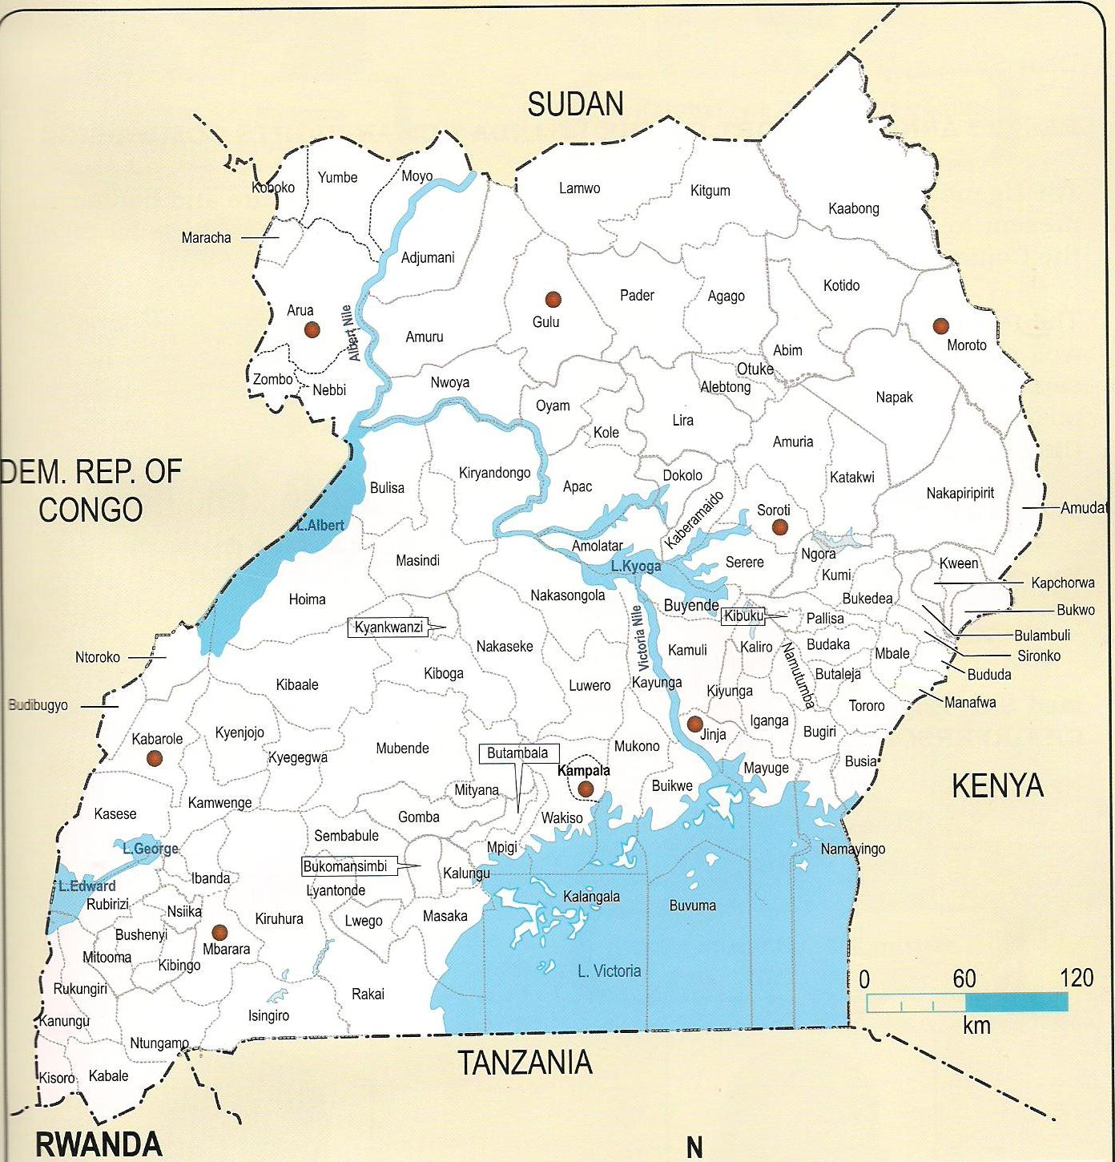
Introduction
Intersectionality of Disability, HIV/AIDS and TB in Masaka (Uganda*)
Healthcare, social and economic barriers.
Peer support approach to reduce stigma & discrimination

Slide 3
MADIPHA’s ROLE IN INCLUSION WORKS
Empowering job seekers
Building employers’ disability confidence
Advocacy with Government
Supporting partnership strengthening

Slide 4
MADIPHA’s Approach to Employers’ Engagements
Employers to put in place disability-friendly environment and policies
Use community influential people (cultural and religious leaders)
Encourage PWDs to participate in community development and social activities
Organize site visits for experience-sharing with companies employing PWDs.
Established a facility at our office for on-line support
Involve parents of job seekers in job search process

Slide 5
MADIPHA’s Approach to Engaging Government Officials
Use of Disability laws as a foundation for discussions
Ensure Constant engagements /Meetings
Use of Political leaders of persons with disabilities
Create Links with Influential leaders/ Cultural leaders & Politicians

Slide 6
Challenges /Learnings/ Gaps
Attitudinal barriers.
Charity mentality/Model.
Limited awareness on policies, laws & Disability legal framework.
Need for job and skills matching for job seekers e.g. in informal sector.
Overwhelming demand for services by persons with disabilities.
More capacity support needed for grassroots OPDs.
Covid19 has impacted on the positive progress made.

