Slide 1
Inclusion Works
The role of OPDs in promoting inclusive employment
Yeasmin Ara Juthi, Treasurer at the
Bandhob Organization of Person with Disabilities
Notes:
<number>

Slide 2
Ways the OPDs in Bangladesh identify and support jobseekers
Inform all OPD members through OPD’s monthly meeting and in other common gathering and prepare a list of potential jobseekers through mutual discussion.
After a Primary Survey, OPD leaders select those identified for relevant training (e.g. soft-skill, hard-skills) and provide training with assistance of ADD Bangladesh.
Before any training, OPD leaders assess the center to for any accessibility issues (i.e. washrooms, ground floor)
When jobseekers are called for interview, OPD leaders follow-up to ensure proper preparation and to raise confidence
Over the last year, through Inclusion Work, 103 men and women with disabilities have been employed in different sectors, and approximately 750 (F 325, M 425) potential jobseekers enrolled under 18 OPDs in Bangladesh with the support of the consortium.
Notes:
<number>

Slide 3
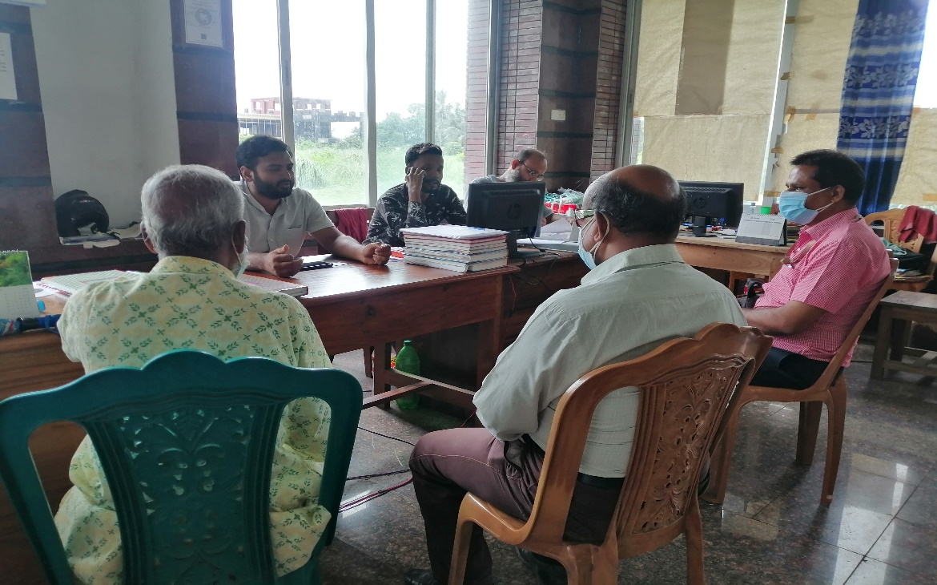
Ways to Lobby with Employers
Before visiting an employer, OPD leaders do some internal preparation (e.g. where will they go, relevant employer, how/who will speak, consulting Employment laws, are there any links which can be made).
Creating a good relationship with local government.
Inclusive Futures
Notes:
Overview of the types of capacity support provided to the OPDs across IW.
<number>

