Slide 1



Journey of Vulnerability: A Mixed-Methods Study
Prof Dame Tina Lavender

Slide 2

NIHR Global Health Research Group on stillbirth prevention and management in sub-Saharan Africa, The University of Manchester

Slide 3
Background
The 3-delays model, historically used when researching maternal mortality
  Thaddeus & Maine; 1994
Enables exploration of delays in decision-making (delay 1), delays in a woman accessing care (delay 2) and delays in receiving timely, appropriate care/treatment (delay 3)
Studies focussing on the 3-delays model identified the importance of ‘supply’ and ‘demand’ interventions to improve outcomes
  Tunçalp et al. 2015
Proposed as a framework for understanding complexities related to intrapartum referral and supporting insight into perinatal deaths.
  Bapat et al. 2012
  Musafili et al. 2017

Slide 4
3 Delays Model
Delay 1
Identifying and reaching a facility
Delay 3
Receiving timely and appropriate care
Delay 2
Deciding to seek care
Socio-economic, cultural, access, quality of care factors

Slide 5
Aim
To gain understanding of the complexities surrounding delays in effective intrapartum care in Tanzania and Zambia and to use this knowledge to develop and implement appropriate interventions to reduce stillbirths.

Slide 6
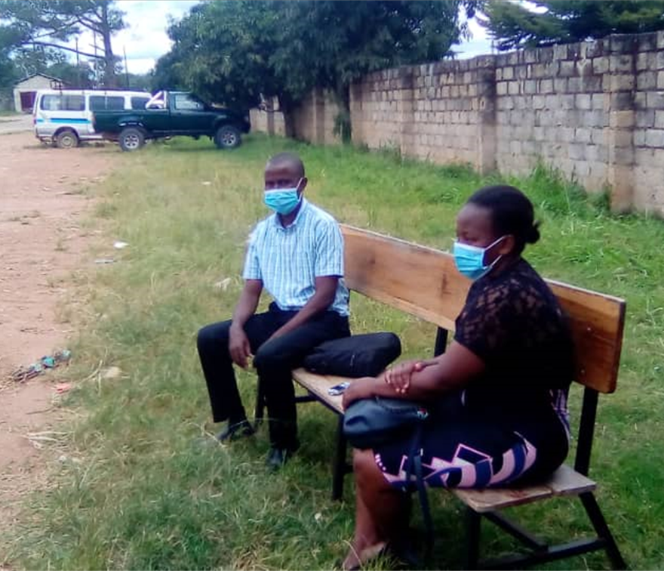
Methods
Mixed-method study, guided by pragmatism
Rural and urban facilities in Tanzania and Zambia
A convergent parallel design
Data collection by;
  Retrospective case note review (n=2000)
  In-depth interviews (n=166)
  Non-participant observations (n=36).
Analysis
  Quantitative data: descriptive statistics and binary logistic regression.
  Qualitative analysis: followed grounded theory principles.

Slide 7
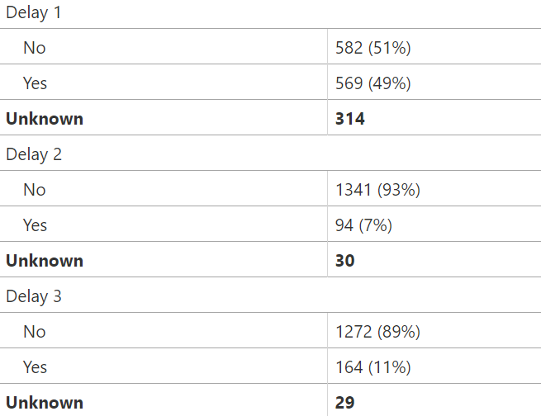
Combined Findings

Slide 8
Reasons for Delay 1: Inadequate Birth Preparedness
‘The clinic health education class motivated us because during this class we are taught about the important of preparing in advance…such as buying baby layettes.’ [Woman, >1 stillbirth, Tanzania]

Slide 9
Reason for delay 1: Accessing antenatal care
‘There was no AIDS in the past, pregnant women did not have to take medicines so they get scared and decide to remain at home…some it is because they are not married…some because of distances, they can’t afford transport…husband refuses to give money’ [TBA, Tanzania]
‘Some tribes think it is a taboo to attend clinic…some are prevented to attend by husbands and/or old parents who say for example, ‘we have delivered you all without clinics why now do you want to go for clinics?” [Health worker, Tanzania]

Slide 10
Reason for Delay 1: Disrespectful Care
You might find harsh nurse and you even ask God why you made me to meet this being. You even start creating fear during delivery….You find harsh nurse says why you women have come with dirty clothes without knowing other people don’t have soap to wash clothes…..you feel humiliated [Woman, Tanzania, live birth].

Slide 11
Reasons for Delay 1: Financial Deprivation
When a pregnant woman is referred not in labour, you have to find your transport to the referral Hospital. But when you are in labour, an ambulance is called to take you to the referral hospital. So most of the times, when a woman is referred, they wait to be in labour then go to the health centre so that transport can be provided. [Zambia, near-miss, live birth]

Slide 12
Reasons for Delay 2: Financial deprivation
I was told the baby wasn’t breathing and that she had been referred to [facility]. We were told to wait because the fuel in the ambulance wasn’t enough. We waited for a day. Then we were told to wait for other patients so that we can be taken together, that was bad. [Zambia, partner, stillbirth]

Slide 13
Reason for Delay 2: Geographical location
My experience was bad, we suffered moving from [name] rural health Centre to [name] rural health Centre, we struggled at night on a bicycle, it was a difficult journey. I feel bad ….. [Zambia, partner, live birth]
You can be allocated to collect a patient, you even start off but half way to the health facility you are called back to go and collect a more critical condition from a health facility in a different direction…. Most health facilities are in the remote areas and roads sometimes become impassable especially during the rainy season. Sometimes we get stuck due to bad roads and you just have to rely on help from the nearby villages. [Zambia, ambulance driver]

Slide 14
Reason for Delay 3: Availability of services
The delay started from the health facility…..another delay was with the ambulance it came after 14:00hrs when the ambulance was called around 12:00hrs but the biggest delay was the delay to be taken to theatre. Had it not been for these delays I was going to have my baby. [Zambia, woman, stillbirth]

Slide 15
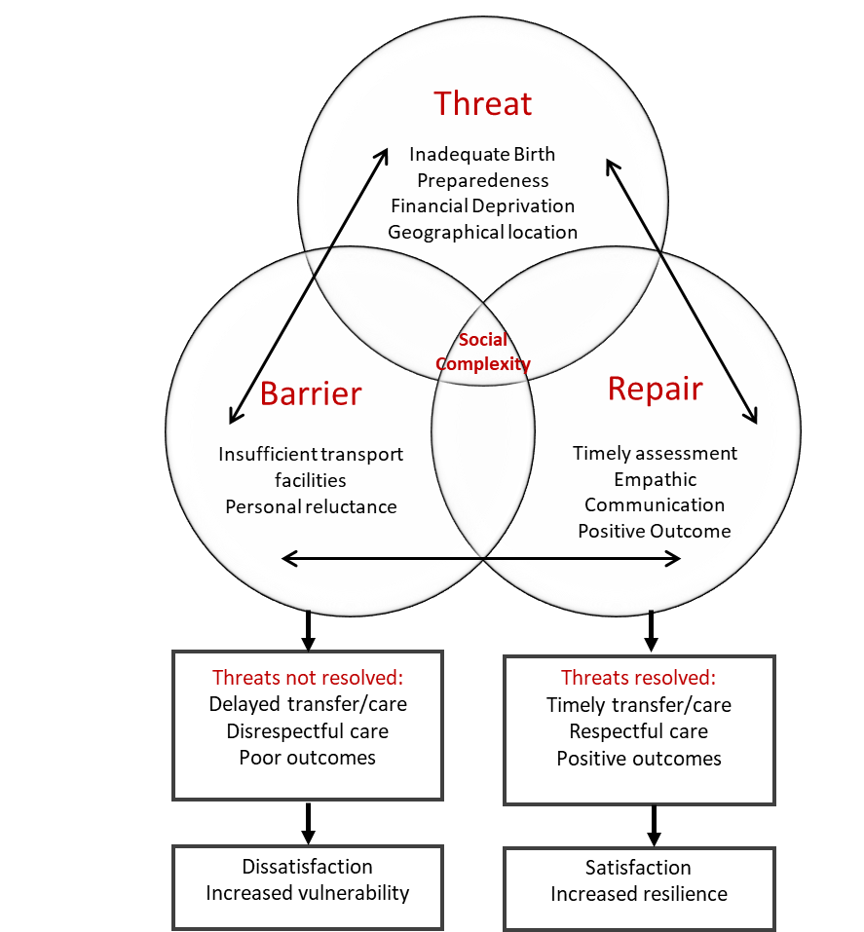
Journey of Vulnerability
Reparative influences
I found a nurse who was attending to some patients. Immediately the stretcher I was on entered labour ward, she stopped attending to them and came to me. She greeted me with a smile…. [Tanzania, woman, live birth]
I felt good because I got help where I was referred. I learned to always go forward and not turning back. I feel stronger and will do things differently next time [Tanzania, woman, stillbirth]
We were greeted when we just arrived. I was offered a seat and my wife was taken in the labour room to be examined. Later, I was explained the finding. I was also assured that my wife was in good hands, which was the most comforting thing….I was so scared when I was told about the referral, but the assurance I got when I arrived made my anxiety go. I’m still very grateful… [Zambia, partner, live birth]
[Adapted from Briscoe et al. 2016]

Slide 16
What does this mean?
Reparative interventions could reduce women’s vulnerability
  timely assessment, empathic communication and a positive outcome/experience.
Small actions made big differences
  being welcomed with a smile, being included in decision-making and having family members acknowledged.
Having a good experience and birthing a stillborn baby were not necessarily mutually exclusive;
  women who birthed a stillborn baby suggested that their positive experience gave them a renewed strength to continue.

Slide 17
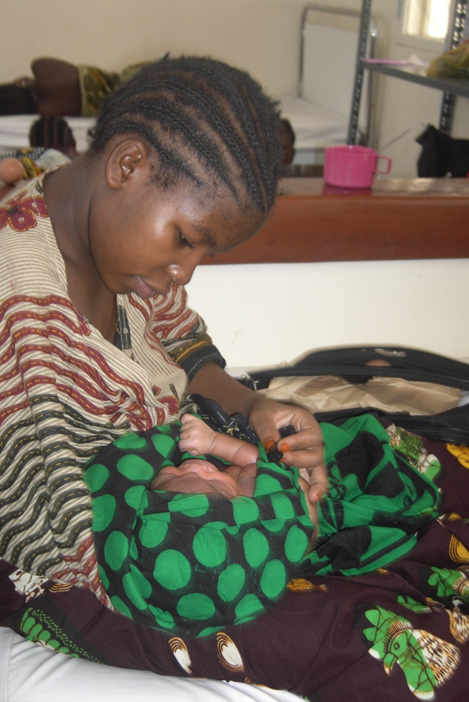
Conclusion
Prevention of poor outcomes is reliant on women receiving timely care
Using the 3 delays model is a useful way of exploring modifiable factors and intervention trigger points retrospectively
Can it be more useful for planning future care strategies and individualised care or is there something better?

Slide 18


Slide 19
Supporting a solution-based approach to accessing intrapartum care:
A Qualitative Evidence Synthesis
Valentina Actis Danna

Slide 20


Background
Wide used and applicability
Holistic approach
Responsibility at household, community and health system levels
Identify context-specific challenges
Targeting users and providers
Sharma et al, 2017
Pagalday-Olivares et al.,2017
Simplistic and sequential
Bohren et al., 2014
D’Ambruoso et al., 2010
Assuming delays happen when complications occur
Combs Thorsen et al., 2012
Limited attention to preventive and postnatal care
Pacagnella et al., 2012
Used retrospectively
No action-oriented approach

Slide 21
Aim
To determine if the Model is still appropriate in contemporary care and whether it can assist in the formulation of solutions which go beyond addressing the 3-delays barriers.

Slide 22
Methods
Qualitative Evidence Synthesis
Best fit framework synthesis (Carrol et al, 2013; Flemming et al, 2019)
Search strategy
SPIDER tool for Qualitative Evidence Synthesis (Cooke et al, 2012) to identify key terms
Datasets support by librarian: MEDLINE, CINAHL Plus and Social Science Full text, Web of Science, Science Direct, Psych INFO, EMBASE, the Cochrane Library, the WHO Library for WHO databases, the African Journal Online, PROQUEST for dissertation and Thesis, Open Grey and Ethos for grey literature + hand checking reference list of included papers.

Slide 23
Methods
Inclusion criteria
Exclusion criteria
Use of the 3DM as a guiding framework
Use of the Model’s categories to present findings
Studies with qualitative findings
Publication timeframe 1994 - 2019
Studies published in any language
Papers reporting only quantitative findings
Paper not using the Model to assess access barriers to obstetric care
Studies not conducted in LMICs based on the World Bank classification
Quality appraisal: Hawker’s checklist (Hawker et al, 2002) used with different paradigms and research signs.
Four point scale: Good=4, Fair=3, Poor=2, Very poor=1. Only ‘good’ and ‘fair’ included.

Slide 24
Methods
Extraction and synthesis of data
Matrix
Compare each study against the 3DM categories
Re-organised extracted data around the Three Delays
Compare and contrast to highlight similarities and differences
Re-grouping according to changes proposed
Country | Study Type | Population and sample size | Methods of data collection | Factors contributing to each delay | Changes proposed to 3DM

Slide 25
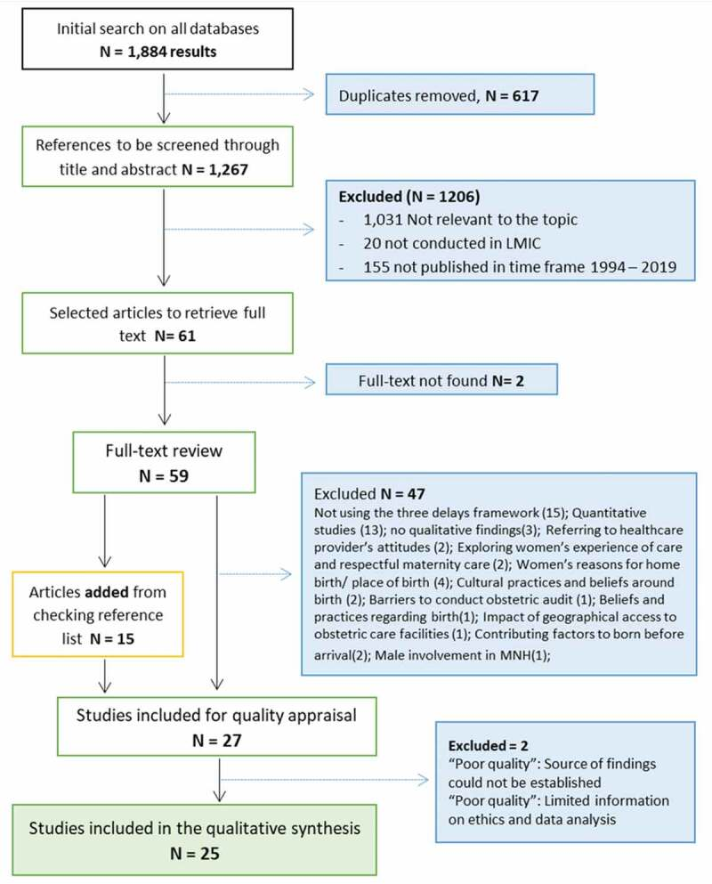
Results
Settings
Sub-Saharan Africa: 15
Asia: 4
Latina America and the Caribbean: 4
Multi-country studies (Africa and Asia): 2
Population
Maternal deaths
Women who were near-misses
Women who had obstetric complications
Women with various reproductive history

Slide 26
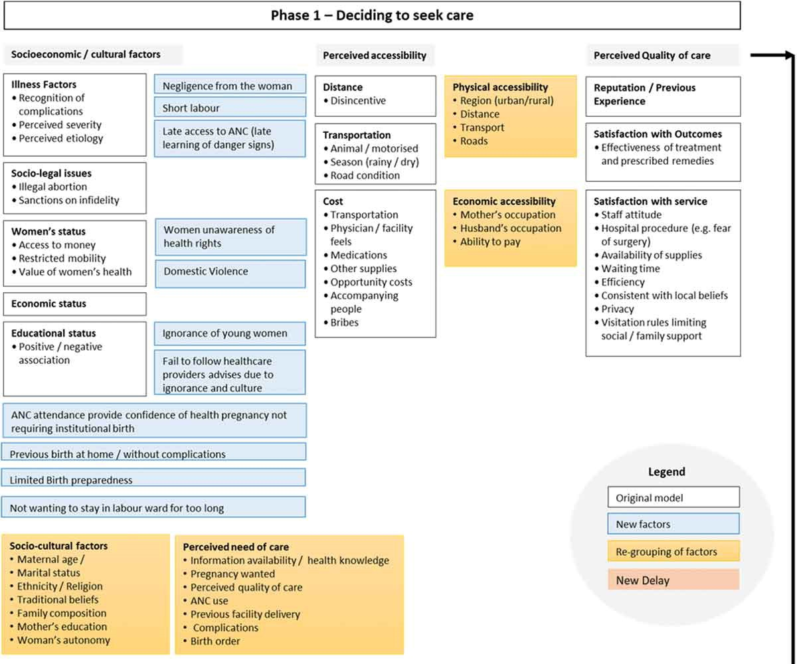
Results
New contributing factors and re-grouping proposed
Delay 1

Slide 27
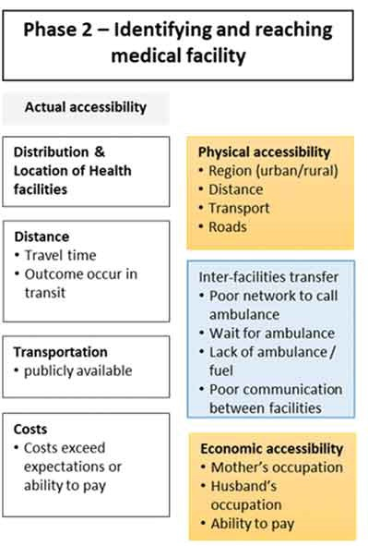

Results
Delay 2
Source: https://www.kambia.org.uk/projects/motorbike-ambulances/

Slide 28
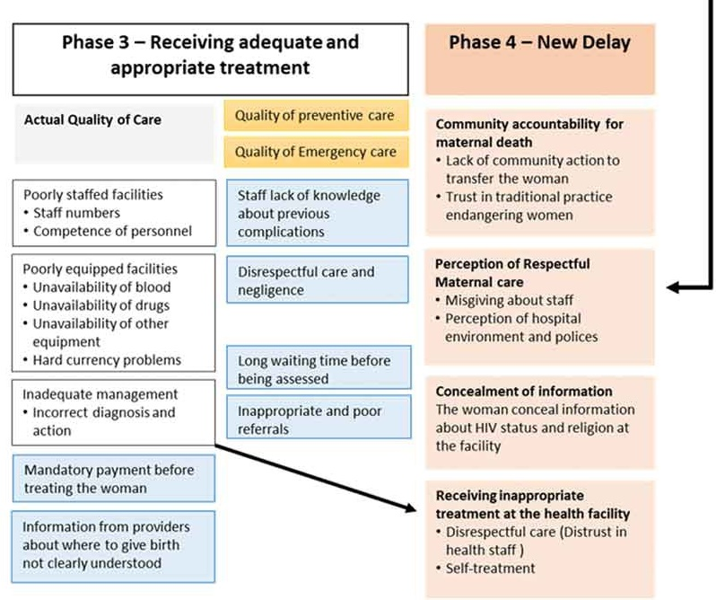
Results
Delay 3 and 4

Slide 29
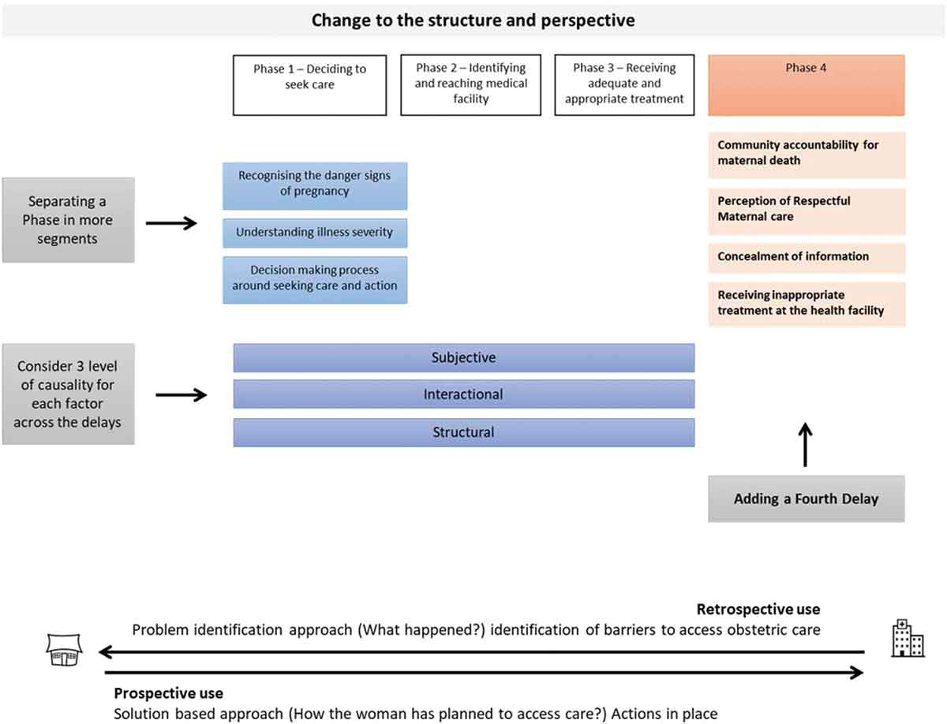
Results
Changes proposed to the structure of the three delays model.

Slide 30
Discussion
20 studies adapted / changed the 3DM to account for context-specific elements not previously identified
Gaps:
Individual dimension
Woman’s personal decision and individual role in contributing / preventing the delays
Limited investigation of the journey from the woman’s perspective
Limited attention to women’s preparation for childbirth, few details in the results

Slide 31
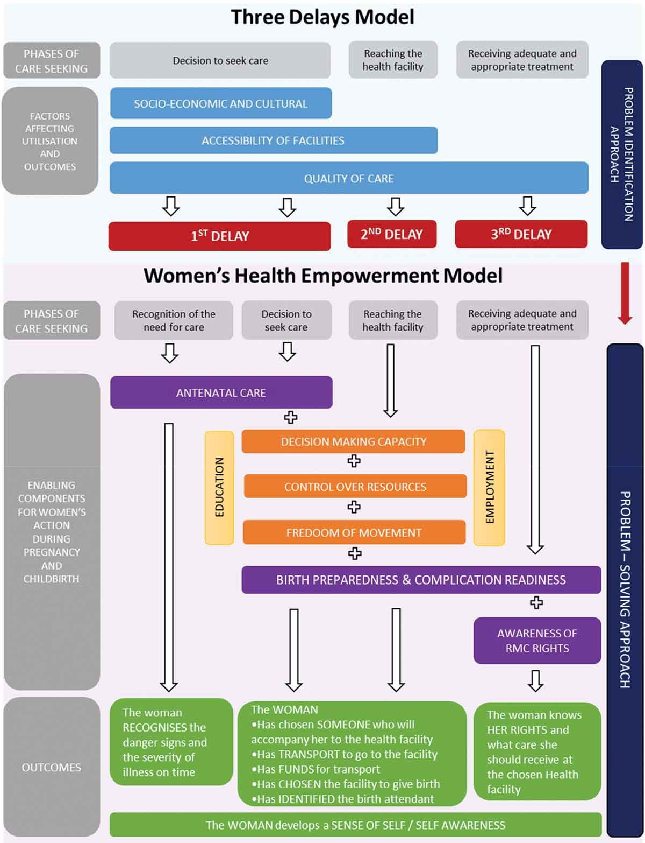
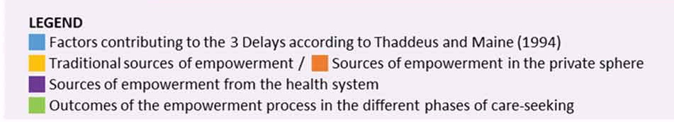
The Women’s Heath Empowerment Model

Slide 32
The Women’s Heath Empowerment Model
Recognition of the need for care
Decision to seek care
Previous birth without complications
Previous experience of care
Unclear perception of severity
Power dynamics within the family
Woman’ socio-economic status traditionally assessed
Recognising the need for care may not turned into action. It depends on socio-economic situation and….
Antenatal care
Education
Employment
No sufficient about the degree of control of personal life

Slide 33
WHEM: Sources of empowerment
Power within the family and level of independence in the personal sphere:
Health system
Antenatal Care
Decision-making capacity
Birth Preparedness and Complication Readiness
Control over resources
Freedom of movement
Awareness respectful care rights
Outcome
Individualised plan
Self-awareness

Slide 34
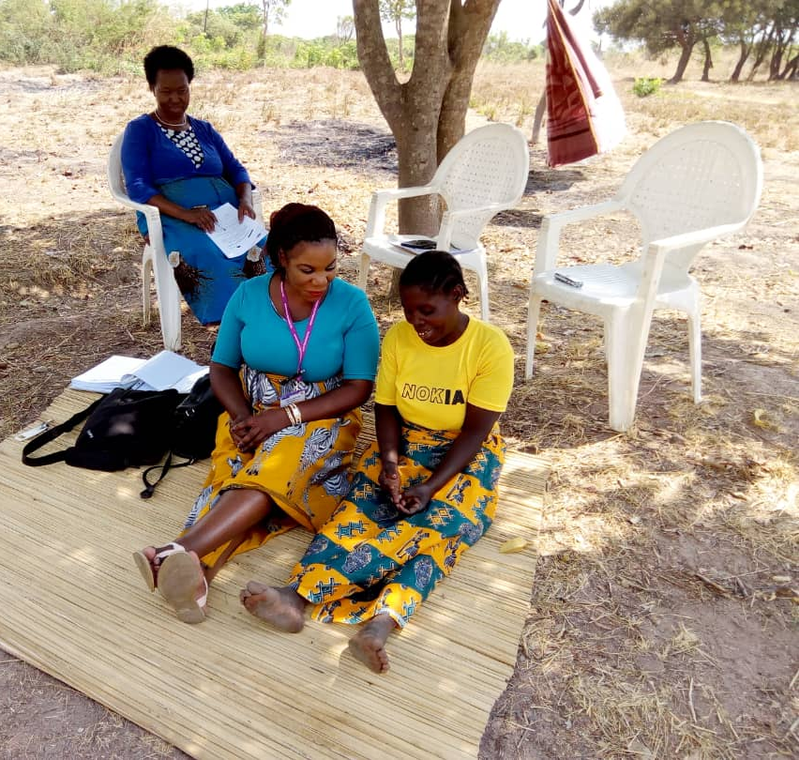
WHEM: Implication for practice
Multidimensional tool to support women in planning for their childbirth
Understand personal situations based on women’s status and power
Anticipate and counteract the occurrence of delay
Basis for discussion with each woman
Develop tailor made plan (no simple checklist)
Way forward
Gain feedback around the tool and refine
Piloting the tool in LMICs
Source: NIHR Group on Stillbirth

Slide 35
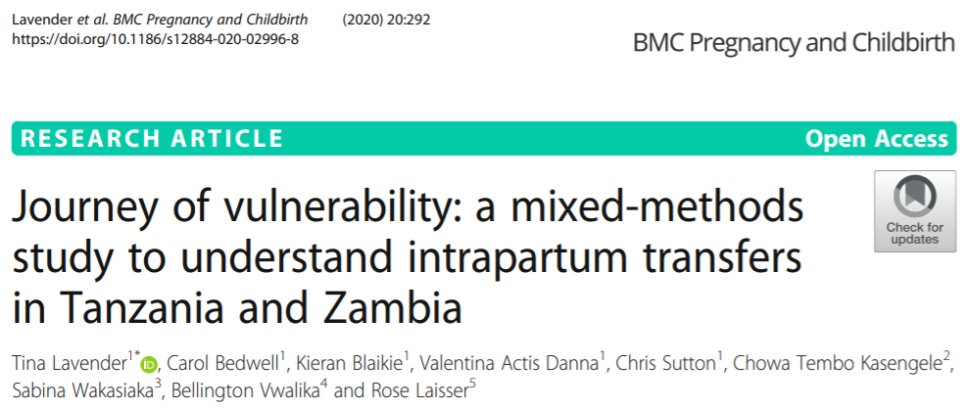

Slide 36
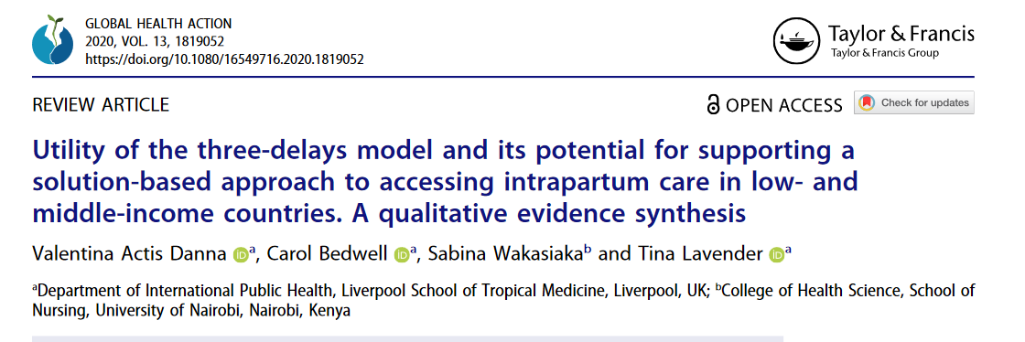

Slide 37
References
Bapat U, Alcock G, More MS, Das S, Joshi W, Osrin D. Stillbirths and newborn deaths in slum settlements in Mumbai, India: a prospective verbal autopsy study. BMC Pregnancy Childbirth. 2012;12:39.
Briscoe L, Lavender T, McGowan L. A concept analysis of women's vulnerability during pregnancy, birth and the postnatal period. J Adv Nurs. 2016;72(10):2330–45
Musafili A, Persson L, Baribwira C, Påfs J, Mulindwa PA, Essén B. Case review of perinatal deaths at hospitals in Kigali, Rwanda: perinatal audit with application of a three-delays analysis. BMC Pregnancy Childbirth. 2017;17:85
Tunçalp Ӧ, Were WM, MacLennan C, Oladapo OT, Gülmezoglu AM, Bahl R, Daelmans B, Mathai M, Say L, Kristensen F, Temmerman M, Bustreo F. Quality of care for pregnant women and newborns– the WHO vision. Br J Obstet Gynaecol. 2015;122(8):1045–9
Thaddeus S, Maine D. Too far to walk: maternal mortality in context. Soc Sci Med. 1994;38:1091–110

Slide 38
References
Bohren MA, Hunter EC, Munthe-Kaas HM, et al. Facilitators and barriers to facility-based delivery in low- and middle-income countries: A qualitative evidence synthesis. Reprod Health. 2014 Sept;11:71.
Carroll C, Booth A, Leaviss J, et al. “Best fit” framework synthesis: refining the method. BMC Med Res Methodol. 2013 Mar 13;13:37.
Combs Thorsen V, Sundby J, Malata A. Piecing together the maternal death puzzle through narratives: the three delays model revisited. PLoS One. 2012 Dec 19;7:e52090–e52090.
Cooke A, Smith D, Booth A. Beyond PICO:the SPIDER tool for qualitative evidence synthesis. Qual Health Res. 2012;22:1435–1443.
D’Ambruoso L, Byass P, Qomariyah SN, et al. A lost cause? Extending verbal autopsy to investigate biomedical and socio-cultural causes of maternal death in Burkina Faso and Indonesia. Soc Sci Med. 2010;71:1728–1738Pagalday-Olivares P, Sjoqvist BA, Adjordor-van de Beek J, et al. Exploring the feasibility of eHealth solutions to decrease delays in maternal healthcare in remote communities of Ghana. BMC Med Inform Decis Mak. 2017 Dec 2;17:156.
Flemming K, Booth A, Garside R, et al. Qualitative evidence synthesis for complex interventions and guideline development: clarification of the purpose, designs and relevant methods. BMJ Glob Health. 2019;4:e000882.
Hawker S, Payne S, Kerr C, et al. Appraising the evidence: reviewing disparate data systematically. Qual Health Res. 2002;12:1284–1299.
Pacagnella RC, Cecatti JG, Osis MJ, et al. The role of delays in severe maternal morbidity and mortality: expanding the conceptual framework. Reprod Health Matters. 2012;20:155–163.
Sharma V, Leight J, AbdulAziz F, et al. Illness recognition, decision-making, and care-seeking for maternal and newborn complications: a qualitative study in Jigawa State, Northern Nigeria. J Health Popul Nutr. 2017;36:46.

Slide 39

Thank you!
Disclaimer: This research was funded by the National Institute for Health Research (NIHR) (16/137/53) using UK aid from the UK Government to support global health research. The views expressed in this publication are those of the author(s) and not necessarily those of the NIHR or the UK Department of Health and Social Care.”

