Slide 1


Mycoplasma genitalium
- the 'silent' emerging super-bug
STIRIG Meeting
11th December 2018
Associate Prof. Jason Ong
Jason.Ong@lshtm.ac.uk
Notes:
I will be speaking to you today about an economic evaluation of a trial looking at discontinuation of a cotrimoxazole preventive therapy in Uganda.

Slide 2
GUM Specialist
Infectious Disease modelling
Epidemiology
Health Preference Research
Health economics

Slide 3
Outline
Background
MG proctitis in MSM (Australia)
Is this a real entity?
MG in women living with HIV (South Africa)
Contributing to limited LMIC data
MG among sexual contacts (Australia)
How transmissible is MG?
Cost-effectiveness of MG screening (work in progress)
Is it valuable to screen asymptomatic individuals?

Slide 4
Outline
For each paper
Motivation
Aim
Methods
Results
Implications for policy or clinical practice

Slide 5
Background

Slide 6
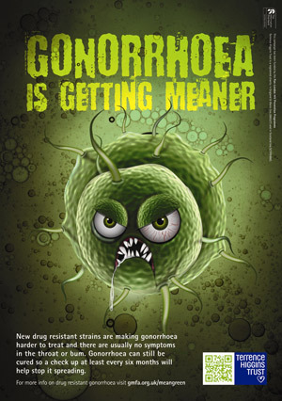

Slide 7
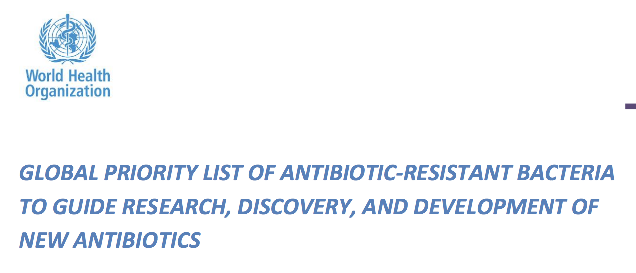
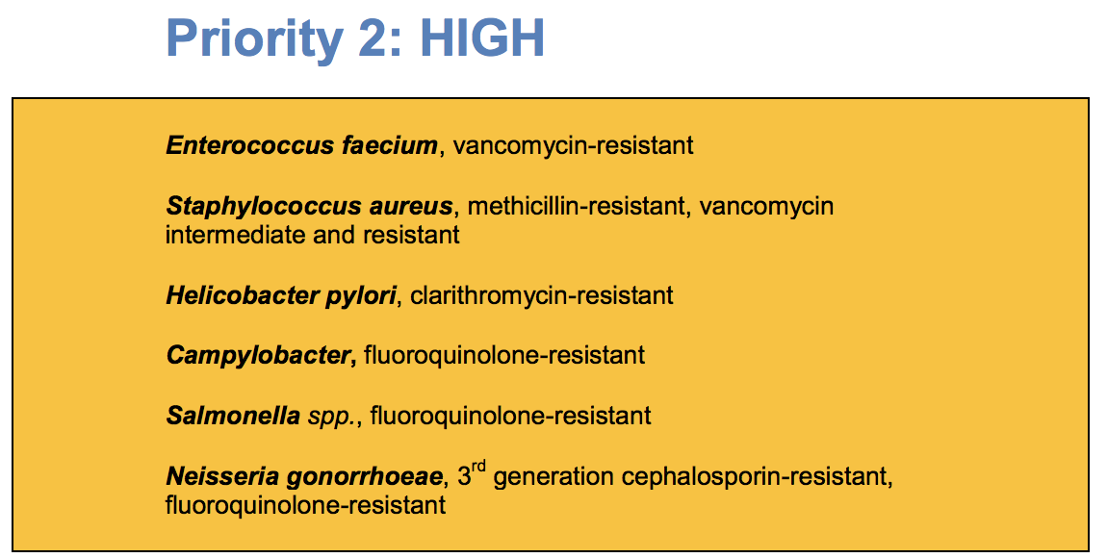

Slide 8
MG

Slide 9
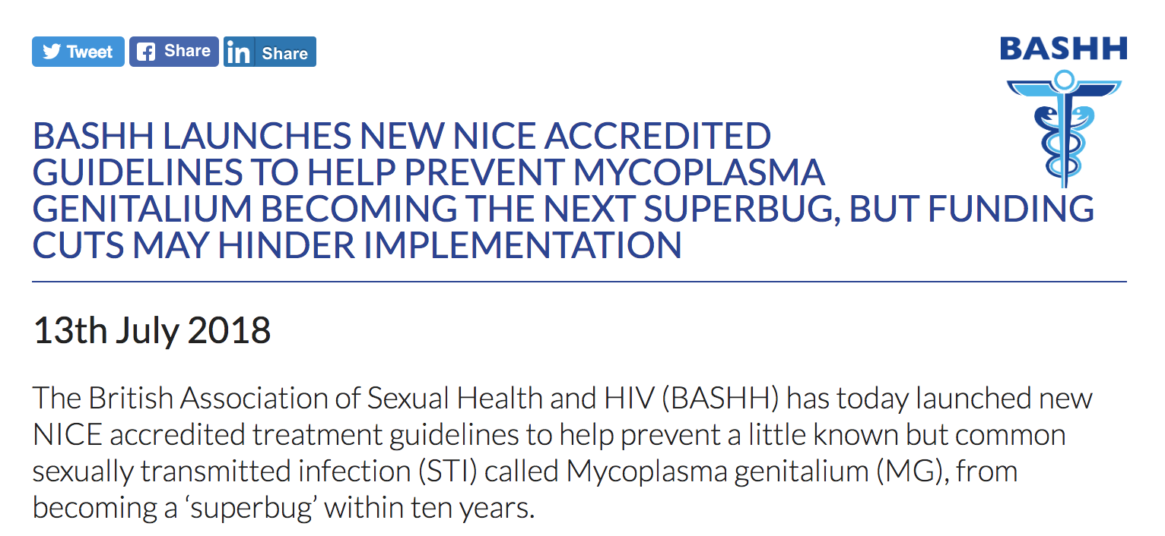

Slide 10
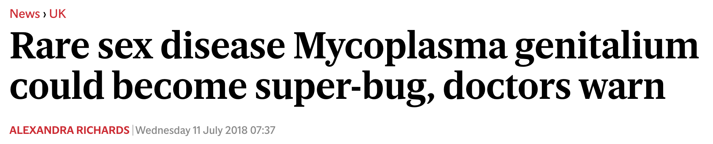

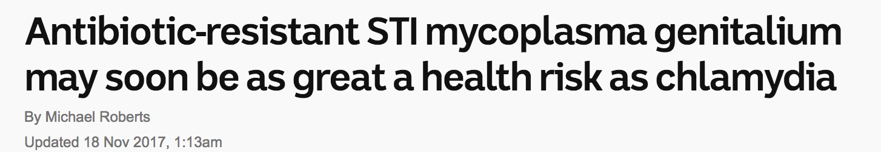



Slide 11
What is MG?
Mycoplasma
Smallest prokaryote capable of self-replication
Most are commensals in respiratory or urogenital tracts
Mycoplasma genitalium
Smallest genome (580 kb)
Lack cell wall
Fastidious in growth requirements
Sexually transmitted pathogen
Discovered in 1980
Urethral swabs from 13 men with NGU attending St Mary’s Hospital, London
Transported by David Taylor-Robinson to US NIH to look for spiroplasmas
No spiroplasmas -> but after a month, two strains of mycoplasmas were isolated that were serologically different from other mycoplasmas
Notes:
Mycoplasmataceae = family
Genera = mycoplasma and ureaplasma
Urethral swabs from 13 men with NGU attending St Mary’s Hospital, London
Transported by David Taylor-Robinson to US NIH to look for spiroplasmas
No spiroplasmas -> but after a month, two strains of mycoplasmas were isolated that were serologically different from other mycoplasmas

Slide 12
How common is it?
Limited global prevalence estimates
We do not test for MG routinely
Natsal-3 = 4,507 urine specimens
Prevalence 1.2% in men and 1.3% in women. ¹
Systematic review ²
MSM (x5 studies, 3.2% prevalence)
Female sex workers (x4 studies, 15.9% prevalence)
Sonnenberg P. Int J Epidemiol, 44 (2015), pp. 1982-1994
Baumann L . Sex Transm Infect 2018:94(4):255-262
Notes:
NATSAL 3 - Urine from 4507 sexually-experienced participants, aged 16–44 years, was tested for MG.

Slide 13
Does MG cause disease?
Association with increased HIV acquisition¹
15%–20% of nongonococcal urethritis (NGU) cases, 20%–25% of nonchlamydial NGU, and approximately 30% of persistent or recurrent urethritis²
Cervicitis, pelvic inflammatory disease³
Proctitis?
Taylor-Robinson D. Clin Microbiol Rev 2011;24:498–514
Vandepitte J. Sex Transm Infect 2014;90:545-549
Lis. Clin Inf Dis 2015;61:418-26

Slide 14
How do we treat MG?
First line: Azithromycin 500mg orally as a single dose followed by 250mg orally od for 4 days
Second line: Moxifloxacin 400mg orally od for 10 days
Notes:
Doxycycline has poor efficacy (cure rates 30-40%)

Slide 15
Houston we have a problem…
Azithromycin resistance
15% in 2005-2007 ¹
39% in 2012-2013 ²
68% in 2016-2017 ³
Moxifloxacin treatment failure (60–70% in Japan).⁴
Streptogramin (Pristinamycin) – 25% failure rate in macrolide-resistant MG ⁵
~ 9% dual markers for macrolide/fluoroquinolone resistance, potentially not treatable ⁶
1 Bradshaw C. Plos One. 2008;3:e3618
2 Bissessor M. Clin Inf Dis. 2015;60(80):1228-36
3 Read T. Clin Inf Dis. 2018 (early online)
4 Deguchi T. Lancet Infect Dis 2017;17:1121-1122
5 Read T. Emerg Inf Dis. 2018;24:328-35
6 Murray G. Emerg Infect Dis. 2017;23(5):809-812

Slide 16
Why should we care?
Lack of routine testing in clinical practice
Poor surveillance = true magnitude of epidemic is underestimated
Rising AMR
Lack of antimicrobials in the pipeline
Limited screening and treatment guidelines
Notes:
To wrap up the background section…

Slide 17
MG Proctitis

Slide 18
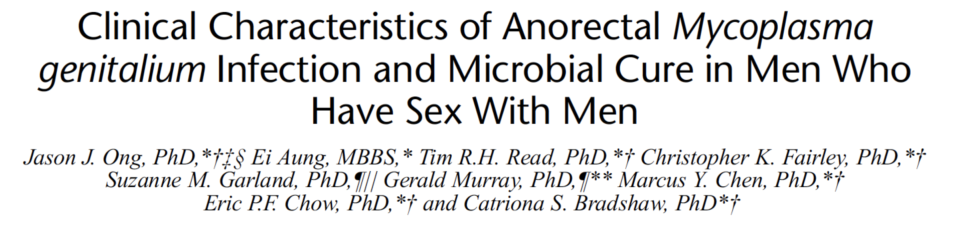

Slide 19
Motivation
No STI guidelines recommend a treatment regimen specifically for MG-proctitis
As macrolide-resistance in urogenital MG has increased over the last decade, little is known about AMR among anorectal cases
Opportunity = MSHC testing for MG in all proctitis cases since 2012

Slide 20
Aims
Examine clinical characteristics of proctitis where MG was detected compared to chlamydial and gonococcal proctitis
Proportions cured with azithromycin (first-line) and moxifloxacin or pristinamycin (second-line)

Slide 21
Methods
Retrospective analysis
MSM 18 years and older
Attended MSHC 2012-2016
MG – PCR assay targeting 16s rRNA gene

Slide 22
Key results
201 MSM with 212 episodes of proctitis
54% gonorrhoea
38% chlamydia
31% MG
(4% LGV)

Slide 23
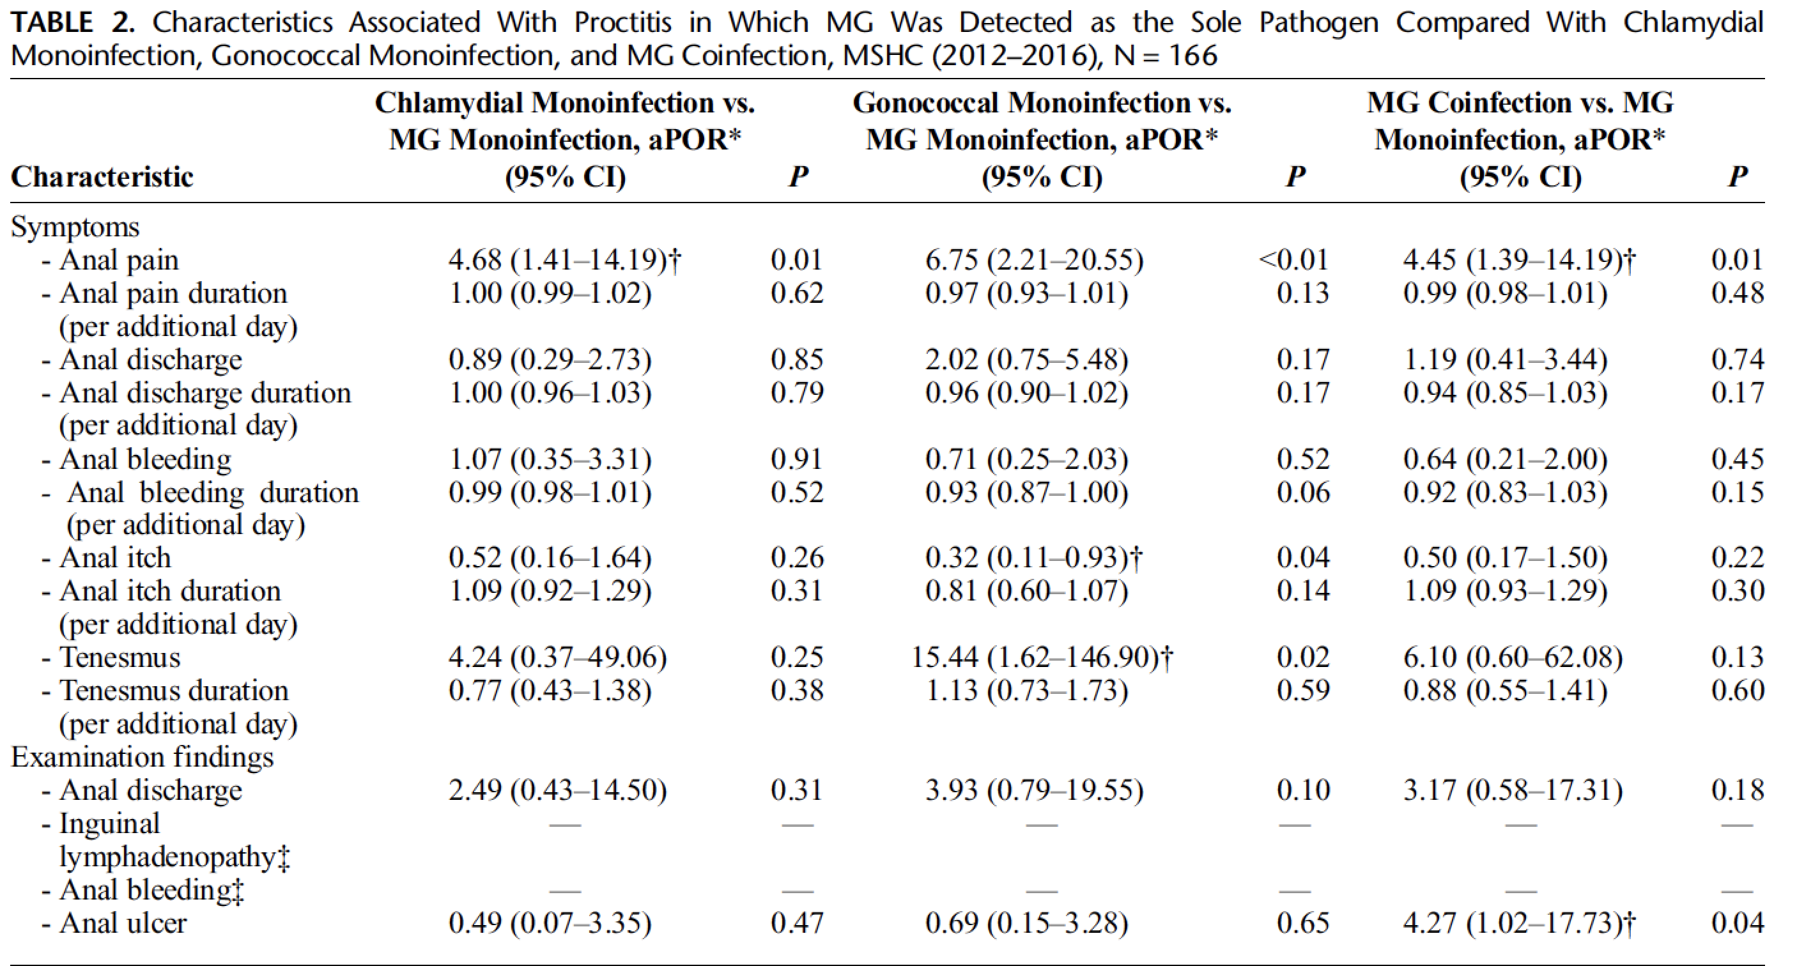

Slide 28
Results
Overall microbiological cure to azithromycin was low (35%, 95% CI: 22-50)
Moxifloxacin (92%, 95% CI: 64-100)
Pristinamycin (79%, 95% CI: 54-94)

Slide 29
Implications
Anorectal MG was as common as anorectal chlamydia in MSM presenting with proctitis
Among self-presenting individuals attending sexual health clinic
Not generalizable to ALL proctitis
MG a/w less anal pain, but similar with other features of proctitis
Larger sample sizes may have power to detect differences
High rates of resistance of anorectal MG
In parallel with urogenital MG

Slide 30
Implications
Does MG causes proctitis?
Background rate – MG in asymptomatic men = 5% (95% CI: 3.1-7.6%)
31% MG detected in proctitis
17/31% were monoinfection -> presented with clinical proctitis

Slide 31
Implications
Does MG causes proctitis?
Background rate – MG in asymptomatic men = 5% (95% CI: 3.1-7.6%)
31% MG detected in proctitis
17/31% were monoinfection -> presented with clinical proctitis
Extremely difficult to prove causality
Still some work to be done
“Association…” rather than “causal”
Bradford Hill criteria

Slide 32
Implications
(i) testing for MG in men presenting with symptoms of proctitis,
(ii) use of combined diagnostic-resistance assays to facilitate early selection of appropriate antimicrobials, and
(iii) routine test of cure after antimicrobials

Slide 33


Slide 34
MG in South African women living with HIV

Slide 35
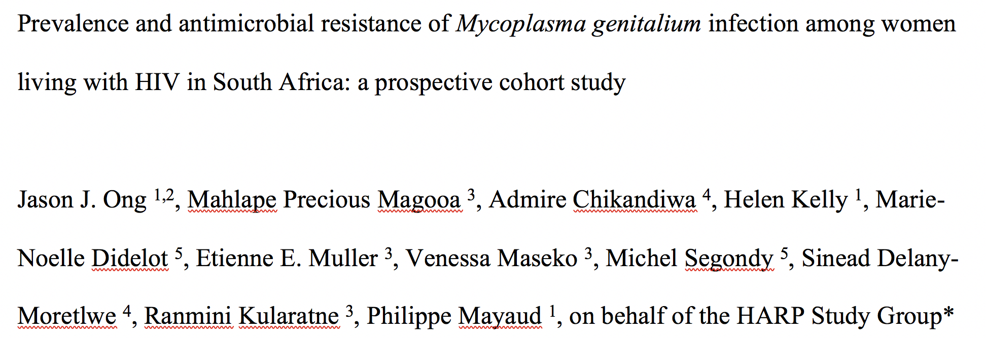

Slide 36
Motivation for study
Epidemiological studies of MG in LMIC is limited, particularly sub-Saharan Africa
Estimates mainly in sex workers, very limited studies in WLHIV
131 WLHIV Zimbabwe – 10.5% ¹
362 WLHIV (sex workers) Uganda – 18% ²
Scarce data on MG-AMR in WLHIV
One paper in South Africa (31% WLHIV) – 10% macrolide resistance ³
601 women, 2012.
Did not distinguish AMR rates in WLHIV from women without HIV
Detailed symptomatology of MG in WLHIV not previously described.
Women NOT living with HIV more likely to have post-coital bleeding, abnormal vaginal discharge
¹ Napierala MS. The Journal of infectious diseases 2015; 211(9): 1388-98.
² Vandepitte J. Sexually transmitted diseases 2012; 39(6): 487-91.
³ Hay B. Sexually transmitted diseases 2015; 42(3): 140-2.

Slide 37
Aims
For women living with HIV in South Africa
MG prevalence
Clinical correlates
AMR profile

Slide 38
Method
Secondary analysis of HARP study (HPV in Africa Research Partnership)
Included 622 WLHIV, aged 25-50 years, living in Johannesburg in 2012.
ALL examined by a trained study nurse and the following examination findings were recorded
At baseline and endline, a cervical swab was collected to detect Chlamydia trachomatis, Neisseria gonorrhoeae, MG, and Trichomonas vaginalis

Slide 39
Results
Prevalence
MG 7.4% (95% CI:5.5-9.7)
46% asymptomatic
CT 5.0% (95% CI:3.4-7.0)
NG 2.3% (95% CI:1.2-3.7)
TV 16.2% (95% CI:13.4-19.4)
BV 41.6% (95% CI:37.6-45.6)
Candida spp. 8.5% (95% CI:6.4-11.0)

Slide 40
Results
Detection of MG was more likely in
women with lower CD4 counts (AOR 1.02 per 10 cells/uL decrease, 95%CI:1.00-1.03)
higher plasma HIV-1 RNA (AOR 1.15 per log copies/mL increase, 95%CI:1.03-1.27).

Slide 41
Results
No statistically significant factors on history or examination that distinguished women with MG monoinfection compared to women with no infection.
Macrolide resistance-associated mutations were not detected in any of the specimens analysed(0/43, 95%CI:0-8.2%).
Mutations in the QRDR of the gyrA gene were not detected while mutations in the QRDR of the parC gene were detected in 19/43 (44.2%, 95%CI:29.1-60.1%) specimens.
No evidence of association with treatment failure

Slide 42
Implications
MG is common
As common as other cervical STIs, associated with lower CD4 counts and elevated HIV viral load.
We need diagnostics!
Without laboratory tests, half of women with MG may be underdiagnosed.
MG-AMR was extremely low in 2012
BUT with change in guidelines 2016 to use macrolides as empirical treatment for STI in South Africa warrants monitoring.

Slide 44
MG in sexual contacts

Slide 45

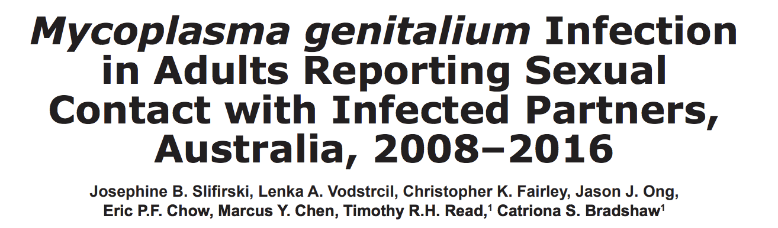

Slide 46
Motivation
Treatment guidelines are inconsistent about the need for presumptive treatment of sexual contacts of M. genitalium–infected patients;
United States and United Kingdom do not recommend presumptive treatment
Australia – YES to presumptive treatment!
Limited data on proportion of persons infected after contact with an infected sex partner (none for MSM)

Slide 47
Motivation
Should I give presumptive treatment to
sexual contacts of MG?
cost
unnecessary use of antimicrobial drugs
risk for adverse effects
prevent reinfection of the index patient prevent transmission to others
prevent sequelae

Slide 48
Motivation
The higher the likelihood of infection in a contact of a person with confirmed infection, the stronger the argument for presumptive treatment.
Presumptive treatment for chlamydial infection is recommended
36%–68% among contacts of sex partners with confirmed chlamydial infection

Slide 49
Aim
Determine the proportion of cases with M. genitalium and the factors associated with infection in women, heterosexual men, and MSM.

Slide 50
Method
Cross-sectional analysis of patients attending a sexual health clinic in Melbourne, 2008–2016.
Men
Predominantly tested by using a first-pass urine sample (rarely urethral swab)
Anorectal swab if anal sex was reported.
Women
High vaginal swab or cervical swab, but a first-pass urine sample was used if patients preferred
Anorectal swab was taken if anal sex was reported.

Slide 51
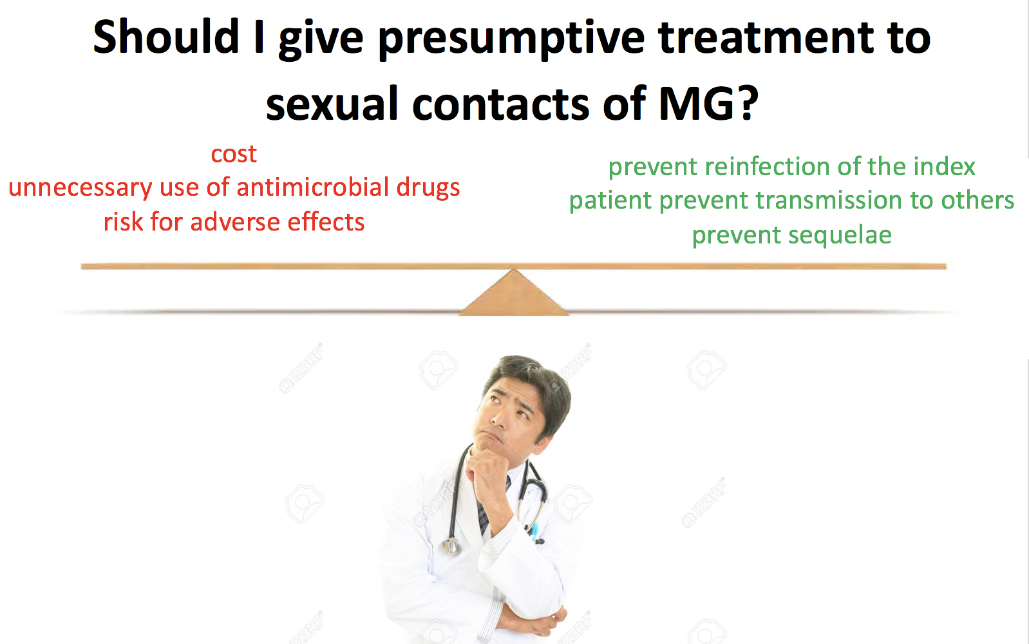
Results
441 patients reported sexual contact with a person with M. genitalium infection
MG detected in:
48.2% of women
31.0% of heterosexual men
41.7% of MSM were infected

Slide 52
Results
Other interesting findings
Among heterosexual contacts, women were twice as likely to be infected
Among MSM, rectal infection was more common than urethral infection
?Biological differences in anatomical sites
?Types of sexual practice
?Bacterial load

Slide 53
Implications
Inform guidelines for the management of sexual contacts of M. genitalium
Strengthened evidence-base for Australian guidelines
Some evidence for presumptive treatment BUT
Clinicians should consider antimicrobial drug resistance and toxicity of quinolones.
Provide an evidence base for informed discussion between clinicians and their patients regarding the appropriateness of presumptive treatment for contacts of infected patients or recommending testing and return for treatment.

Slide 55
Cost-effectiveness of MG screening

Slide 56
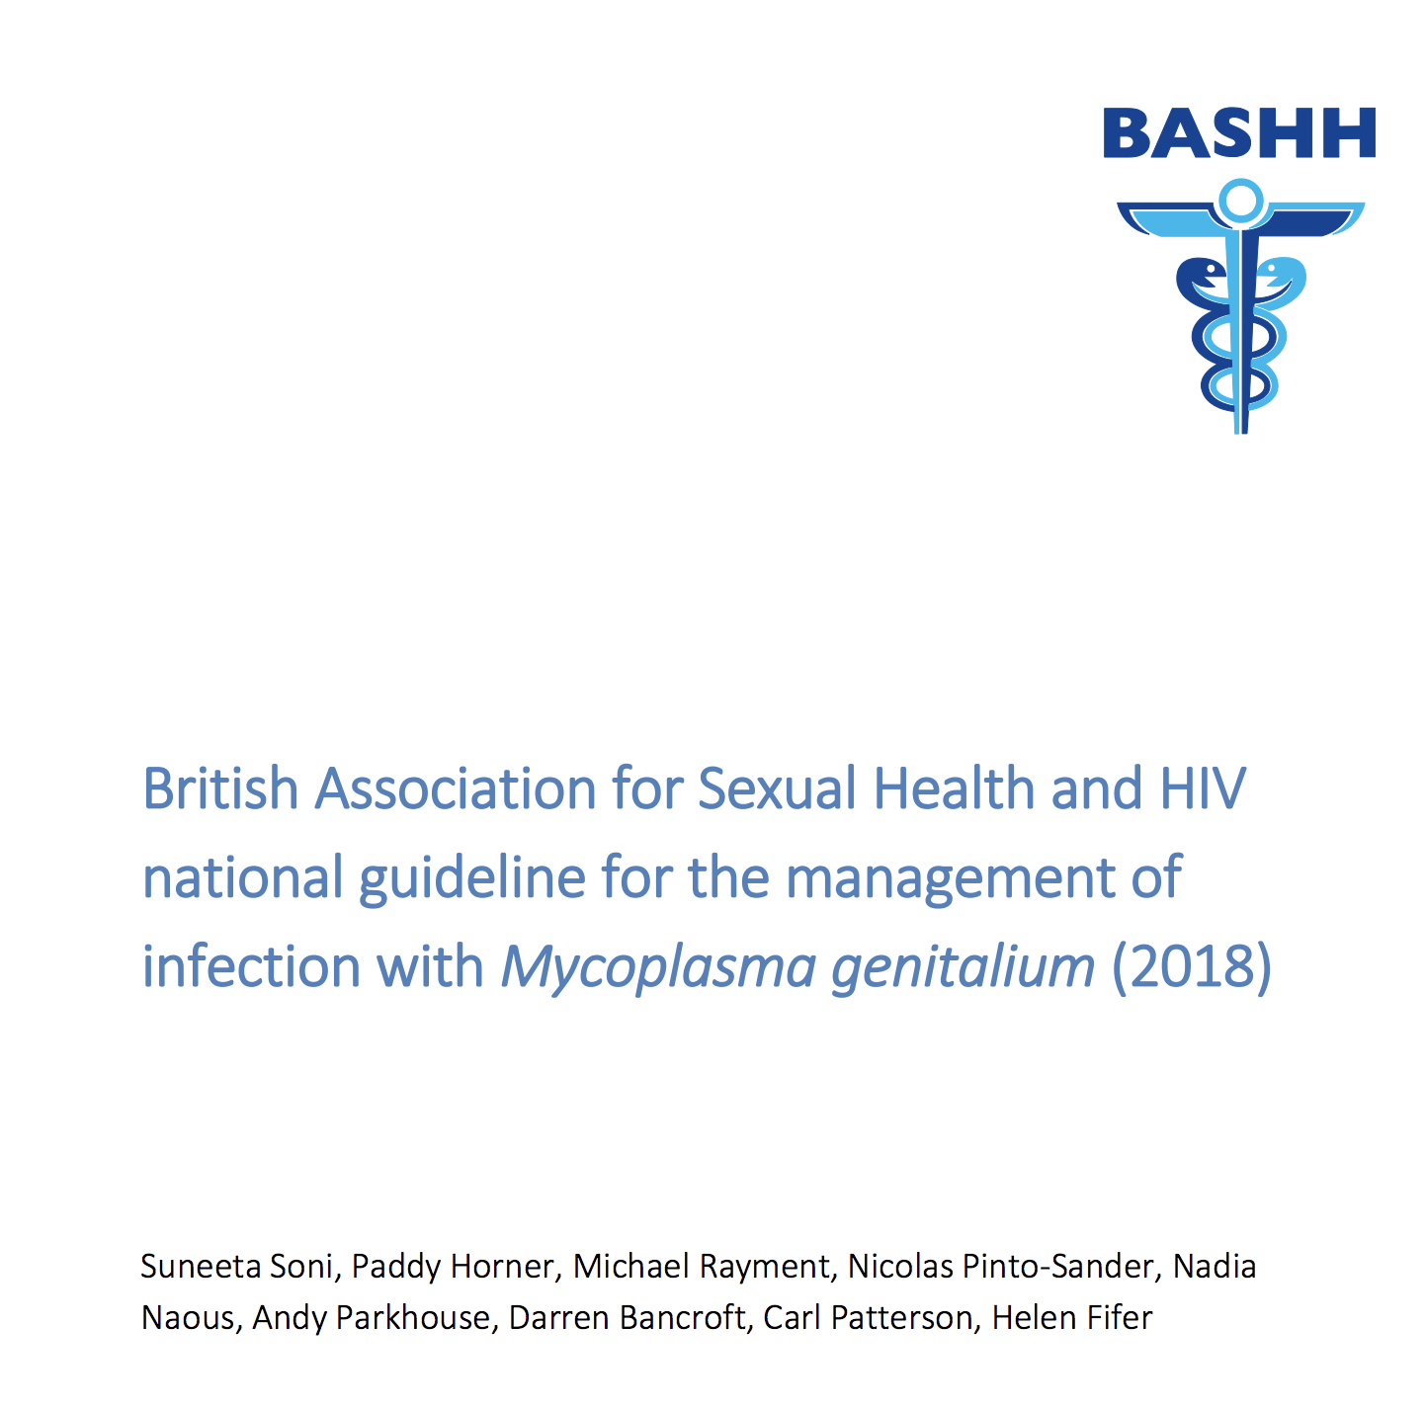
Motivation
BASHH Guidelines
Do NOT recommend screening asymptomatic populations – even if high-risk

Slide 57
Motivation
BASHH Guidelines
Do NOT recommend screening asymptomatic populations – even if high-risk
WHY NOT???
We do it for chlamydia (similar prevalence)
Majority are asymptomatic
Effect on MG-AMR?

Slide 58
Aims
Build a population-level, dynamic, deterministic, compartmental model for MG
Assess impact of screening scenarios on prevalence of MG and MG-AMR
Cost-effectiveness of screening for MG

Slide 59
Methods
Variant of SIS-type model
Model Population
Australian MSM
Asymptomatic vs. symptomatic
High-risk vs. low-risk
> 10 sexual partners in last 6 months

Slide 60
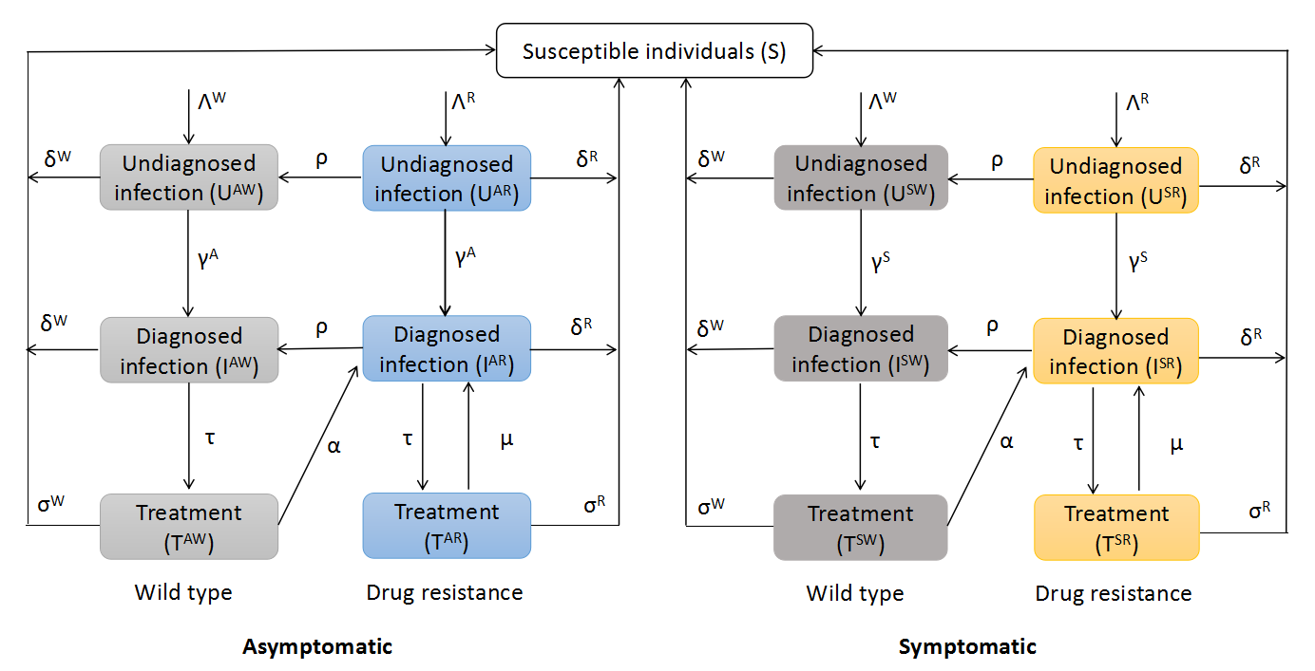

Slide 62
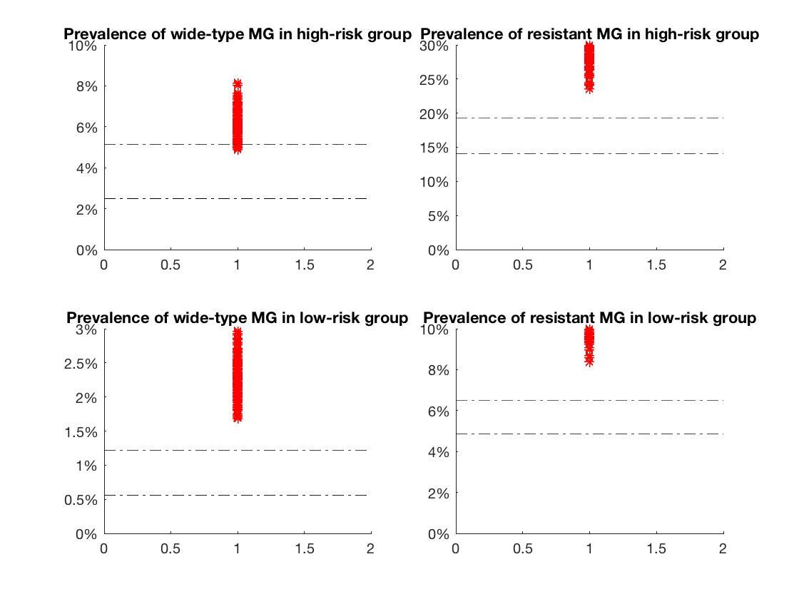
No screening at all
Test rate in symptomatic high-risk MSM = Test rate in symptomatic low-risk MSM
= Test rate in asymptomatic high-risk MSM = Test rate in asymptomatic low-risk MSM : 0%
Higher prevalence of both wild type and resistant MG

Slide 63
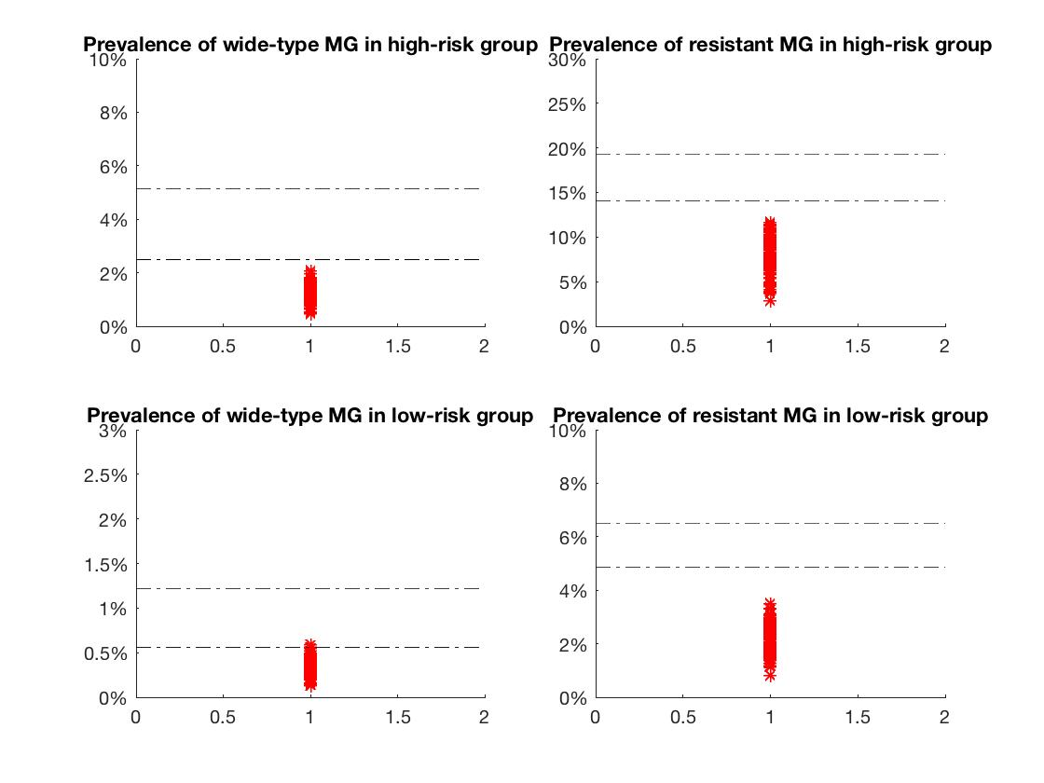
Universal screening (70% uptake)
Test rate in symptomatic high-risk MSM = Test rate in symptomatic low-risk MSM
= Test rate in asymptomatic high-risk MSM = Test rate in asymptomatic low-risk MSM : 70%
Reduce MG prevalence (both wildtype and resistant MG)

Slide 64
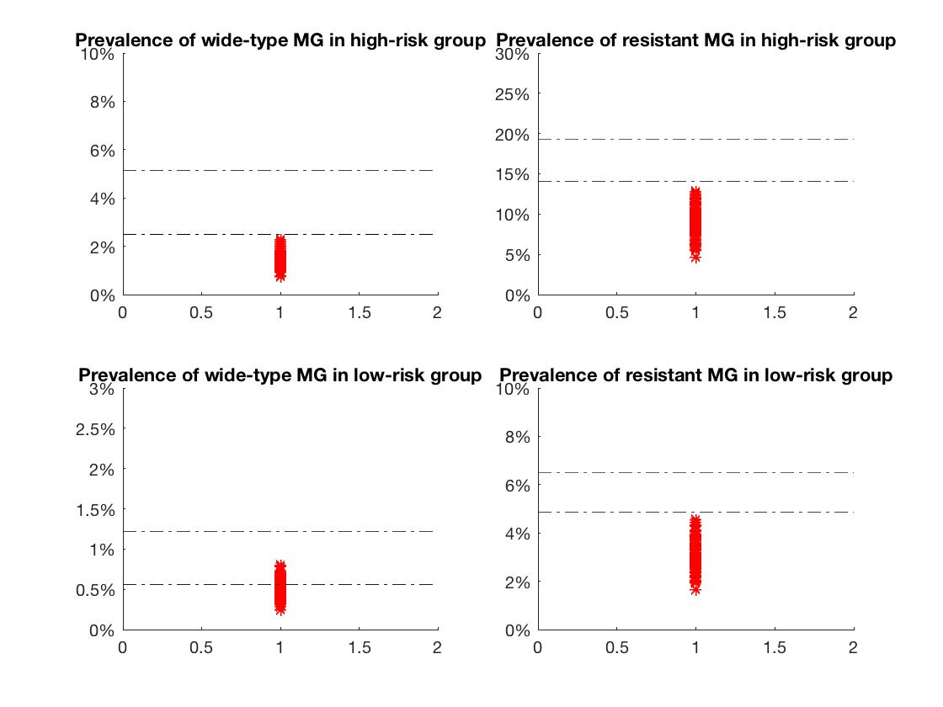
Targeted screening – symptomatics PLUS high-risk asymptomatics
Test rate in symptomatic high-risk MSM = Test rate in symptomatic low-risk MSM
= Test rate in asymptomatic high-risk MSM: 70%
Test rate in asymptomatic low-risk MSM : 0%
Might be worth considering screening high risk asymptomatics, it will be interesting to check the cost-effectiveness for this though.

Slide 65
Implications
MAY BE a role for screening asymptomatic MSM
Reduces MG prevalence
Reduces MG-AMR prevalence
Is it cost-effective… ?

Slide 67
Summary
MG proctitis in MSM (Australia)
Is this a real entity? -> likely
MG in women living with HIV (South Africa)
Contributing to limited LMIC data -> MG is common, MG-AMR is low
MG among sexual contacts (Australia)
How transmissible is MG? -> Comparable with CT. Informed discussion needed.
Cost-effectiveness of MG screening (work in progress)
Is it valuable to screen asymptomatic individuals? -> sorry… you have to wait a bit longer

Slide 68

Thank you
Notes:
Finally I want to thank you for your attention.

