Slide 1
Notes:
Test

Slide 2
Analytical Team
Writing Team
Faye Cleary
Lois Kim
Dr Sally Hull
Dr Ben Caplin
Professor Dorothea Nitsch
Kathleen Mudie
Faye Cleary
Dr Ben Caplin
Professor David Wheeler
Dr Sally Hull
Professor Dorothea Nitsch

Slide 3
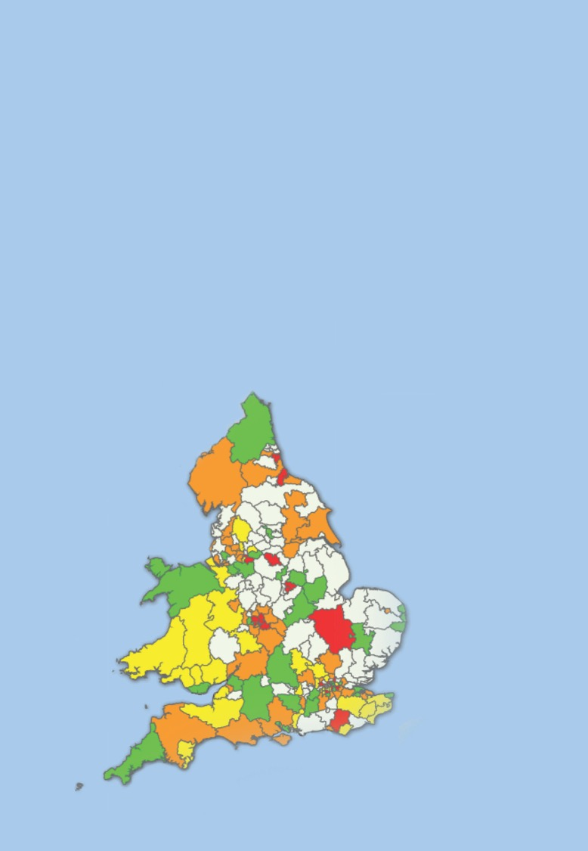
Aims
Map of coverage of NCKDA within practices using Informatic Audit Plus software
>75% of possible
Aims:
To review identification and management of CKD in primary care
To describe patient outcomes
50 – 75%
25 – 50%
<25 %
No possible participants
Measures:
Performance against NICE quality standards
Variation

Slide 4
Aims
Map of coverage of NCKDA within practices using Informatic Audit Plus software
>75% of possible
Aims:
To review identification and management of CKD in primary care
To describe patient outcomes
50 – 75%
25 – 50%
<25 %
No possible participants
Measures:
Performance against NICE quality standards
Variation
The National Chronic Kidney Disease (CKD) Audit provides a snapshot of performance in primary care against agreed evidence based targets

Slide 5
Aims
Map of coverage of NCKDA within practices using Informatic Audit Plus software
>75% of possible
Aims:
To review identification and management of CKD in primary care
To describe patient outcomes
50 – 75%
25 – 50%
<25 %
No possible participants
Measures:
Performance against NICE quality standards
Variation
The first part of the National Report, published in January 2017, focussed on the identification and management of CKD in primary care

Slide 6
Aims
Map of coverage of NCKDA within practices using Informatic Audit Plus software
>75% of possible
Aims:
To review identification and management of CKD in primary care
To describe patient outcomes
50 – 75%
25 – 50%
<25 %
No possible participants
Measures:
Performance against NICE quality standards
Variation
The second part of the report has a focus on the outcomes for people with CKD, including all referrals from GPs to nephrologists, hospital admissions, and rates of death

Slide 7
Aims
Map of coverage of NCKDA within practices using Informatic Audit Plus software
>75% of possible
Aims:
To review identification and management of CKD in primary care
To describe patient outcomes
50 – 75%
25 – 50%
<25 %
No possible participants
Measures:
Performance against NICE quality standards
Variation
To do this, we linked data from the GP records with the Hospital Episode Statistics database for England and NHS Informatics Statistics for Wales for admissions, and the Office for National Statistics for information on deaths

Slide 8
Aims
Map of coverage of NCKDA within practices using Informatic Audit Plus software
>75% of possible
Aims:
To review identification and management of CKD in primary care
To describe patient outcomes
50 – 75%
25 – 50%
<25 %
No possible participants
Measures:
Performance against NICE quality standards
Variation
It was originally designed to achieve full national coverage of general practices across England and Wales but

Slide 9
Aims
Map of coverage of NCKDA within practices using Informatic Audit Plus software
>75% of possible
Aims:
To review identification and management of CKD in primary care
To describe patient outcomes
50 – 75%
25 – 50%
<25 %
No possible participants
Measures:
Performance against NICE quality standards
Variation
Due to technical challenges accessing primary care data, we include data from 911 practices representing approximately 74% of all Welsh practices and 8% of those in England

Slide 10
Aims
Map of coverage of NCKDA within practices using Informatic Audit Plus software
>75% of possible
Aims:
To review identification and management of CKD in primary care
To describe patient outcomes
50 – 75%
25 – 50%
<25 %
No possible participants
Measures:
Performance against NICE quality standards
Variation
Still, this reflects the worldwide largest dataset addressing patients with CKD in primary care and provides insights into processes of care and data collection

Slide 11
Methods
Prognosis of CKD by eGFR and proteinuria categories
 |  |  | Kidney damage stage albumin/creatinine ratio Description and range
 |  |  | A1 | A2 | A3
Kidney function stage eGFR (ml/min/1.73m) Description and range |  |  | Normal to mild increase <30mg/g | Moderate increase 30-300mg/g | Severe increase >300mg/g
G1 | Normal or high | ≥90
G2 | Mild decrease | 60-89
G3a | Mild to moderate decrease | 45-59
G3b | Moderate to severe decrease | 30-44
G4 | Severe decrease | 15-29
G5 | Kidney failure | <15
Kidney Disease: Improving Global Outcomes (KDIGO) CKD Work Group. KDIGO 2012 Clinical Practice Guideline for the Evaluation and Management of Chronic Kidney Disease. Kidney Int Suppl. 2013;3(1):1–150

Slide 12
Methods
Prognosis of CKD by eGFR and proteinuria categories
 |  |  | Kidney damage stage albumin/creatinine ratio Description and range
 |  |  | A1 | A2 | A3
Kidney function stage eGFR (ml/min/1.73m) Description and range |  |  | Normal to mild increase <30mg/g | Moderate increase 30-300mg/g | Severe increase >300mg/g
G1 | Normal or high | ≥90
G2 | Mild decrease | 60-89
G3a | Mild to moderate decrease | 45-59
G3b | Moderate to severe decrease | 30-44
G4 | Severe decrease | 15-29
G5 | Kidney failure | <15
Kidney Disease: Improving Global Outcomes (KDIGO) CKD Work Group. KDIGO 2012 Clinical Practice Guideline for the Evaluation and Management of Chronic Kidney Disease. Kidney Int Suppl. 2013;3(1):1–150
CKD is often without symptoms until later stages and is only picked up by performing tests on blood and urine:

Slide 13
Methods
Prognosis of CKD by eGFR and proteinuria categories
 |  |  | Kidney damage stage albumin/creatinine ratio Description and range
 |  |  | A1 | A2 | A3
Kidney function stage eGFR (ml/min/1.73m) Description and range |  |  | Normal to mild increase <30mg/g | Moderate increase 30-300mg/g | Severe increase >300mg/g
G1 | Normal or high | ≥90
G2 | Mild decrease | 60-89
G3a | Mild to moderate decrease | 45-59
G3b | Moderate to severe decrease | 30-44
G4 | Severe decrease | 15-29
G5 | Kidney failure | <15
Kidney Disease: Improving Global Outcomes (KDIGO) CKD Work Group. KDIGO 2012 Clinical Practice Guideline for the Evaluation and Management of Chronic Kidney Disease. Kidney Int Suppl. 2013;3(1):1–150
Estimated glomerular filtration rate: is the estimate of the rate at which the kidneys filter the blood of creatinine (blood test)

Slide 14
Methods
Prognosis of CKD by eGFR and proteinuria categories
 |  |  | Kidney damage stage albumin/creatinine ratio Description and range
 |  |  | A1 | A2 | A3
Kidney function stage eGFR (ml/min/1.73m) Description and range |  |  | Normal to mild increase <30mg/g | Moderate increase 30-300mg/g | Severe increase >300mg/g
G1 | Normal or high | ≥90
G2 | Mild decrease | 60-89
G3a | Mild to moderate decrease | 45-59
G3b | Moderate to severe decrease | 30-44
G4 | Severe decrease | 15-29
G5 | Kidney failure | <15
Kidney Disease: Improving Global Outcomes (KDIGO) CKD Work Group. KDIGO 2012 Clinical Practice Guideline for the Evaluation and Management of Chronic Kidney Disease. Kidney Int Suppl. 2013;3(1):1–150
Albumin to creatinine ratio: is the measure of albumin leaked into the urine (urine test)

Slide 15
Methods
Prognosis of CKD by eGFR and proteinuria categories
 |  |  | Kidney damage stage albumin/creatinine ratio Description and range
 |  |  | A1 | A2 | A3
Kidney function stage eGFR (ml/min/1.73m) Description and range |  |  | Normal to mild increase <30mg/g | Moderate increase 30-300mg/g | Severe increase >300mg/g
G1 | Normal or high | ≥90
G2 | Mild decrease | 60-89
G3a | Mild to moderate decrease | 45-59
G3b | Moderate to severe decrease | 30-44
G4 | Severe decrease | 15-29
G5 | Kidney failure | <15
Kidney Disease: Improving Global Outcomes (KDIGO) CKD Work Group. KDIGO 2012 Clinical Practice Guideline for the Evaluation and Management of Chronic Kidney Disease. Kidney Int Suppl. 2013;3(1):1–150
KDIGO recommends CKD be classified using a combination of blood and urine test results, and the severity of CKD is stratified into stages 1-5

Slide 16
Methods
Prognosis of CKD by eGFR and proteinuria categories
 |  |  | Kidney damage stage albumin/creatinine ratio Description and range
 |  |  | A1 | A2 | A3
Kidney function stage eGFR (ml/min/1.73m) Description and range |  |  | Normal to mild increase <30mg/g | Moderate increase 30-300mg/g | Severe increase >300mg/g
G1 | Normal or high | ≥90
G2 | Mild decrease | 60-89
G3a | Mild to moderate decrease | 45-59
G3b | Moderate to severe decrease | 30-44
G4 | Severe decrease | 15-29
G5 | Kidney failure | <15
Kidney Disease: Improving Global Outcomes (KDIGO) CKD Work Group. KDIGO 2012 Clinical Practice Guideline for the Evaluation and Management of Chronic Kidney Disease. Kidney Int Suppl. 2013;3(1):1–150
KDIGO also suggests testing people who are at a high risk of developing CKD and so we looked at people with risk factors for such as diabetes or hypertension

Slide 17
Methods
Prognosis of CKD by eGFR and proteinuria categories
 |  |  | Kidney damage stage albumin/creatinine ratio Description and range
 |  |  | A1 | A2 | A3
Kidney function stage eGFR (ml/min/1.73m) Description and range |  |  | Normal to mild increase <30mg/g | Moderate increase 30-300mg/g | Severe increase >300mg/g
G1 | Normal or high | ≥90
G2 | Mild decrease | 60-89
G3a | Mild to moderate decrease | 45-59
G3b | Moderate to severe decrease | 30-44
G4 | Severe decrease | 15-29
G5 | Kidney failure | <15
Kidney Disease: Improving Global Outcomes (KDIGO) CKD Work Group. KDIGO 2012 Clinical Practice Guideline for the Evaluation and Management of Chronic Kidney Disease. Kidney Int Suppl. 2013;3(1):1–150
We extracted data only from people with a CKD Read code, with risk factors for CKD, or with kidney function tests (represented approximately a quarter of the registered adult patient records) and separated the patients into two populations

Slide 18
Methods
Prognosis of CKD by eGFR and proteinuria categories
 |  |  | Kidney damage stage albumin/creatinine ratio Description and range
 |  |  | A1 | A2 | A3
Kidney function stage eGFR (ml/min/1.73m) Description and range |  |  | Normal to mild increase <30mg/g | Moderate increase 30-300mg/g | Severe increase >300mg/g
G1 | Normal or high | ≥90
G2 | Mild decrease | 60-89
G3a | Mild to moderate decrease | 45-59
G3b | Moderate to severe decrease | 30-44
G4 | Severe decrease | 15-29
G5 | Kidney failure | <15
Kidney Disease: Improving Global Outcomes (KDIGO) CKD Work Group. KDIGO 2012 Clinical Practice Guideline for the Evaluation and Management of Chronic Kidney Disease. Kidney Int Suppl. 2013;3(1):1–150

Slide 19
Methods
Prognosis of CKD by eGFR and proteinuria categories
 |  |  | Kidney damage stage albumin/creatinine ratio Description and range
 |  |  | A1 | A2 | A3
Kidney function stage eGFR (ml/min/1.73m) Description and range |  |  | Normal to mild increase <30mg/g | Moderate increase 30-300mg/g | Severe increase >300mg/g
G1 | Normal or high | ≥90
G2 | Mild decrease | 60-89
G3a | Mild to moderate decrease | 45-59
G3b | Moderate to severe decrease | 30-44
G4 | Severe decrease | 15-29
G5 | Kidney failure | <15
Kidney Disease: Improving Global Outcomes (KDIGO) CKD Work Group. KDIGO 2012 Clinical Practice Guideline for the Evaluation and Management of Chronic Kidney Disease. Kidney Int Suppl. 2013;3(1):1–150
We concentrate on the patient population identified as having CKD stages 3-5
Regardless of their Read coding status
And regardless of whether they had proteinuria

Slide 20
Methods
Prognosis of CKD by eGFR and proteinuria categories
 |  |  | Kidney damage stage albumin/creatinine ratio Description and range
 |  |  | A1 | A2 | A3
Kidney function stage eGFR (ml/min/1.73m) Description and range |  |  | Normal to mild increase <30mg/g | Moderate increase 30-300mg/g | Severe increase >300mg/g
G1 | Normal or high | ≥90
G2 | Mild decrease | 60-89
G3a | Mild to moderate decrease | 45-59
G3b | Moderate to severe decrease | 30-44
G4 | Severe decrease | 15-29
G5 | Kidney failure | <15
We also identified some people that would be in the top two rows-> patients who have “normal” eGFR but have evidence of kidney damage (i.e. have other renal codes, i.e. a diagnosis of kidney disease, e.g. a Read code for CKD stage1-2, or evidence of proteinuria, but not an eGFR<60ml/min)
Kidney Disease: Improving Global Outcomes (KDIGO) CKD Work Group. KDIGO 2012 Clinical Practice Guideline for the Evaluation and Management of Chronic Kidney Disease. Kidney Int Suppl. 2013;3(1):1–150

Slide 21
Methods
Prognosis of CKD by eGFR and proteinuria categories
 |  |  | Kidney damage stage albumin/creatinine ratio Description and range
 |  |  | A1 | A2 | A3
Kidney function stage eGFR (ml/min/1.73m) Description and range |  |  | Normal to mild increase <30mg/g | Moderate increase 30-300mg/g | Severe increase >300mg/g
G1 | Normal or high | ≥90
G2 | Mild decrease | 60-89
G3a | Mild to moderate decrease | 45-59
G3b | Moderate to severe decrease | 30-44
G4 | Severe decrease | 15-29
G5 | Kidney failure | <15
Kidney Disease: Improving Global Outcomes (KDIGO) CKD Work Group. KDIGO 2012 Clinical Practice Guideline for the Evaluation and Management of Chronic Kidney Disease. Kidney Int Suppl. 2013;3(1):1–150
Amongst patients with CKD stages 1-2, those with proteinuria have highest risk.

Slide 22
Methods
Prognosis of CKD by eGFR and proteinuria categories
 |  |  | Kidney damage stage albumin/creatinine ratio Description and range
 |  |  | A1 | A2 | A3
Kidney function stage eGFR (ml/min/1.73m) Description and range |  |  | Normal to mild increase <30mg/g | Moderate increase 30-300mg/g | Severe increase >300mg/g
G1 | Normal or high | ≥90
G2 | Mild decrease | 60-89
G3a | Mild to moderate decrease | 45-59
G3b | Moderate to severe decrease | 30-44
G4 | Severe decrease | 15-29
G5 | Kidney failure | <15
Kidney Disease: Improving Global Outcomes (KDIGO) CKD Work Group. KDIGO 2012 Clinical Practice Guideline for the Evaluation and Management of Chronic Kidney Disease. Kidney Int Suppl. 2013;3(1):1–150
However, testing for proteinuria (i.e. testing for albumin/creatinine ratios in the urine) is not incentivised and so the size of this population is likely to be underestimated by the audit

Slide 23
Methods
Prognosis of CKD by eGFR and proteinuria categories
 |  |  | Kidney damage stage albumin/creatinine ratio Description and range
 |  |  | A1 | A2 | A3
Kidney function stage eGFR (ml/min/1.73m) Description and range |  |  | Normal to mild increase <30mg/g | Moderate increase 30-300mg/g | Severe increase >300mg/g
G1 | Normal or high | ≥90
G2 | Mild decrease | 60-89
G3a | Mild to moderate decrease | 45-59
G3b | Moderate to severe decrease | 30-44
G4 | Severe decrease | 15-29
G5 | Kidney failure | <15
Kidney Disease: Improving Global Outcomes (KDIGO) CKD Work Group. KDIGO 2012 Clinical Practice Guideline for the Evaluation and Management of Chronic Kidney Disease. Kidney Int Suppl. 2013;3(1):1–150
Most likely due to the low frequency of proteinuria testing in those at risk of CKD (as will be discussed later)

Slide 24
Methods
Prognosis of CKD by eGFR and proteinuria categories
 |  |  | Kidney damage stage albumin/creatinine ratio Description and range
 |  |  | A1 | A2 | A3
Kidney function stage eGFR (ml/min/1.73m) Description and range |  |  | Normal to mild increase <30mg/g | Moderate increase 30-300mg/g | Severe increase >300mg/g
G1 | Normal or high | ≥90
G2 | Mild decrease | 60-89
G3a | Mild to moderate decrease | 45-59
G3b | Moderate to severe decrease | 30-44
G4 | Severe decrease | 15-29
G5 | Kidney failure | <15
Kidney Disease: Improving Global Outcomes (KDIGO) CKD Work Group. KDIGO 2012 Clinical Practice Guideline for the Evaluation and Management of Chronic Kidney Disease. Kidney Int Suppl. 2013;3(1):1–150
There are people in the top right hand corner of the heat map that we are ‘missing’

Slide 25
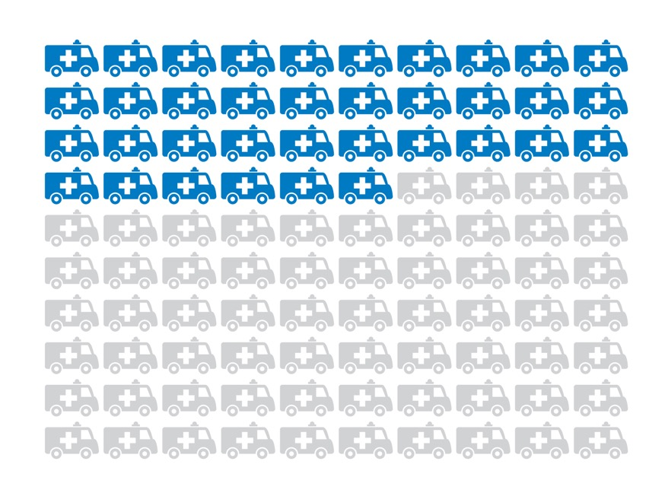
Findings
Findings for every
100 Patients
With CKD Stage 3:
36 unplanned admissions annually

Slide 26
Findings
Findings for every
100 Patients
With CKD Stage 3:
36 unplanned admissions annually
People with more severe CKD are more likely to have an unplanned admission to hospital.

Slide 27
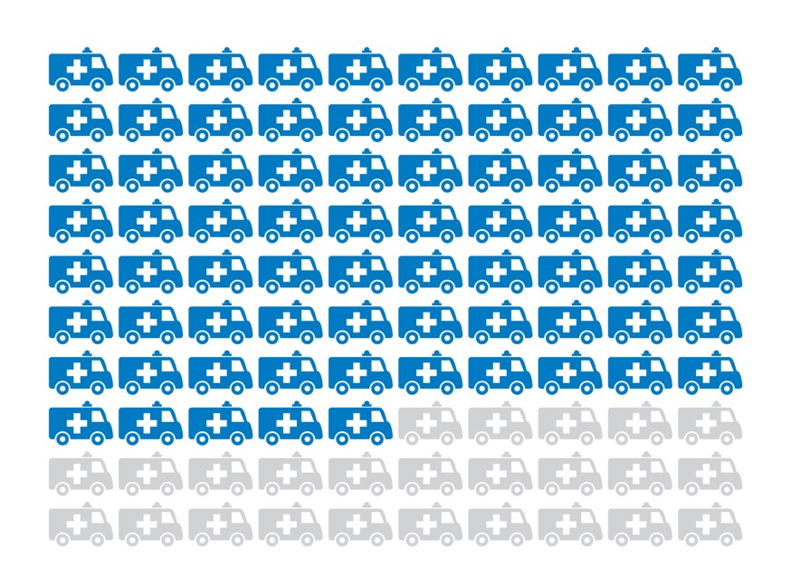
Findings
Findings for every
100 Patients
With CKD Stage 4:
75 unplanned admissions annually

Slide 28
Findings
Findings for every
100 Patients
With CKD Stage 4:
75 unplanned admissions annually
Every year, 36 unplanned admissions occur for every 100 people with CKD stages 3A and 3B. Twice as many unplanned admissions occur for every 100 people with CKD stage 4.

Slide 29
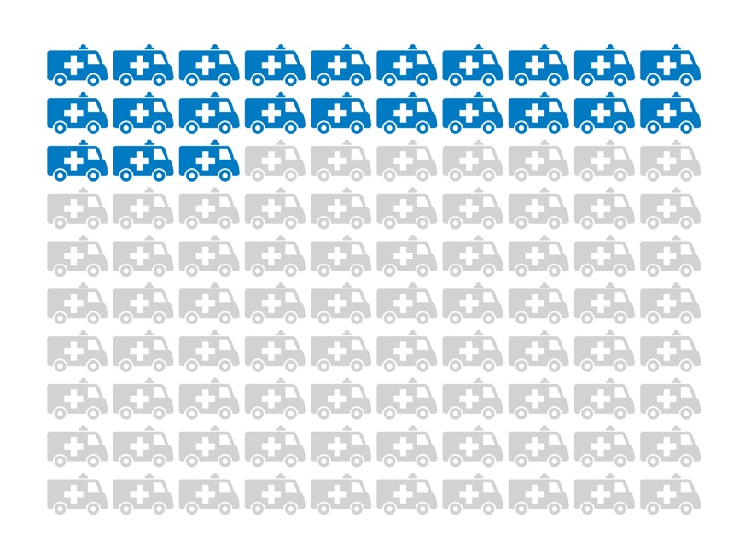
Findings
Findings for every
100 Patients
With other renal codes:
23 unplanned admissions annually

Slide 30
Findings
Findings for every
100 Patients
With other renal codes:
23 unplanned admissions annually
Here we see that people with CKD have high rates of unplanned admissions and people with other renal codes (including stages 1-2 CKD with proteinuria) are being admitted at comparable rates

Slide 31
Findings
Findings for every
100 Patients
With other renal codes:
23 unplanned admissions annually
This may be due to patients in this group having “normal” eGFR but proteinuria which is a significant risk factor for renal complications

Slide 32
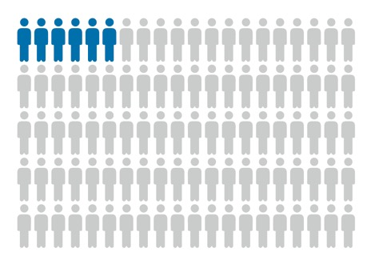
Findings
Findings for every
100 Patients
With CKD Stage 3:
6 patients
die annually

Slide 33
Findings
Findings for every
100 Patients
With CKD Stage 3:
6 patients
die annually
Death is more common in people with more severe CKD which supports the KDIGO recommendations that risk of admission and death increases with reduced eGFR

Slide 34
Findings
Findings for every
100 Patients
With CKD Stage 3:
6 patients
die annually
Every year, 6 deaths occur for every 100 people with CKD stages 3A and 3B

Slide 35
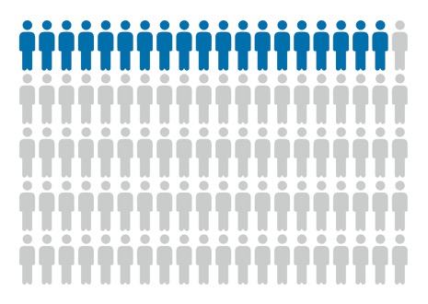
Findings
Findings for every
100 Patients
With CKD Stage 3:
With CKD Stage 4:
6 patients
die annually
19 patients
die annually
19 deaths occur for every 100 people with CKD stages 4

Slide 36
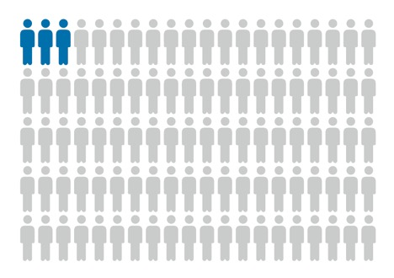
Findings
Findings for every
100 Patients
With CKD Stage 3:
With CKD Stage 4:
With other renal codes:
6 patients
die annually
19 patients
die annually
3 patients
die annually
Meanwhile, 3 deaths occur for every 100 people with other renal codes. When death rates were age/sex standardised these were comparable to age/sex standardised death rates seen for those with CKD stages 3-5.

Slide 37
Findings
Findings for every
100 Patients
With CKD Stage 3:
With CKD Stage 4:
With other renal codes:
6 patients
die annually
19 patients
die annually
3 patients
die annually
This supports the notion that people without eGFR<60 ml/min/1.73m² but with severe proteinuria or structural renal problems, such as renal cancer, have also an increased risk of death as has been previously shown by others.

Slide 38
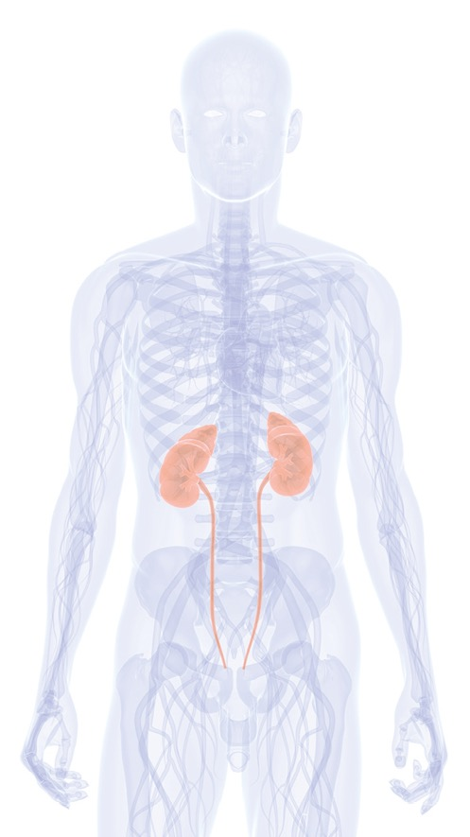
Recommendation 1
Clinical commissioning groups should put in place quality improvement tools and incentives, to support the identification and regular clinical review of patients with CKD

Slide 39
Recommendation 1
Clinical commissioning groups should put in place quality improvement tools and incentives, to support the identification and regular clinical review of patients with CKD
People with CKD have an above average burden of morbidity and hospitalisation,

Slide 40
Recommendation 1
Clinical commissioning groups should put in place quality improvement tools and incentives, to support the identification and regular clinical review of patients with CKD
With the disappearance of the quality and outcomes framework which previously incentivised management of those with CKD, CCGs need to ensure that local indicators for the identification, coding and management of CKD are in place.

Slide 41
Recommendation 1
Clinical commissioning groups should put in place quality improvement tools and incentives, to support the identification and regular clinical review of patients with CKD
We recommend CCGs maintain local incentives to encourage regular testing for kidney markers and to reduce the variation of quality of kidney care between practices which contributes to health inequalities

Slide 42
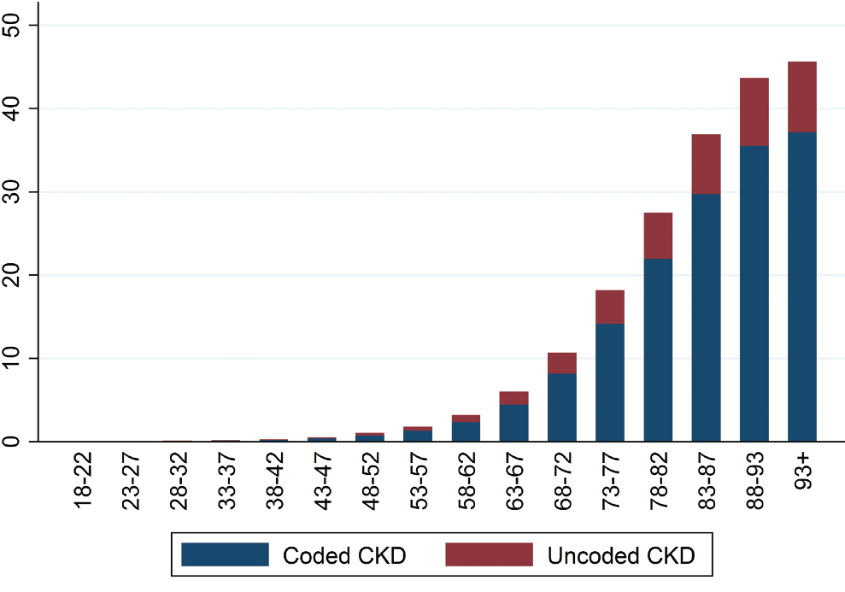
Findings 2
Total CKD Prevalence, by Age Group
Age-Stratified Total CKD Prevalence (%)

Slide 43
Findings 2
Total CKD Prevalence, by Age Group
Age-Stratified Total CKD Prevalence (%)
This chart shows the number of people with CKD stages 3-5 (i.e. those <60 ml/min/1.73m2) in each age group.

Slide 44
Findings 2
Total CKD Prevalence, by Age Group
Age-Stratified Total CKD Prevalence (%)
The blue bars show those coded with CKD by their GP and the red bars are an estimate of those that remain uncoded

Slide 45
Findings 2
Total CKD Prevalence, by Age Group
Age-Stratified Total CKD Prevalence (%)
70% of biochemically confirmed cases of CKD (i.e. having twice a measurement of eGFR< 60 ml/min/1.73m2 more than 3 months apart) were given an appropriate Read code by their GP

Slide 46
Findings 2
Total CKD Prevalence, by Age Group
Age-Stratified Total CKD Prevalence (%)
There was huge variation in coding, the proportion of CKD cases that were uncoded ranged from 0% to 80%, indicating that there is a wide variation in practice performance

Slide 47
Findings 2
Total CKD Prevalence, by Age Group
Age-Stratified Total CKD Prevalence (%)
There was also variation of care by coding status, i.e. those who were coded were more likely to have their blood pressure controlled, their urine monitored, more likely to receive a statin, and to have vaccinations (e.g. flu) than those who were not coded but who had the same level of kidney function.

Slide 48
Findings 2
Total CKD Prevalence, by Age Group
Age-Stratified Total CKD Prevalence (%)
Amongst those with CKD who were Read-coded by their GP, there was considerable practice variation in the quality of the management of care, i.e. huge variation on whether urinary ACR tests were done, and whether blood pressure was treated to recommended targets. For example, many younger people with CKD appeared to not have been offered statin prescriptions even though this group might have most to gain.

Slide 49
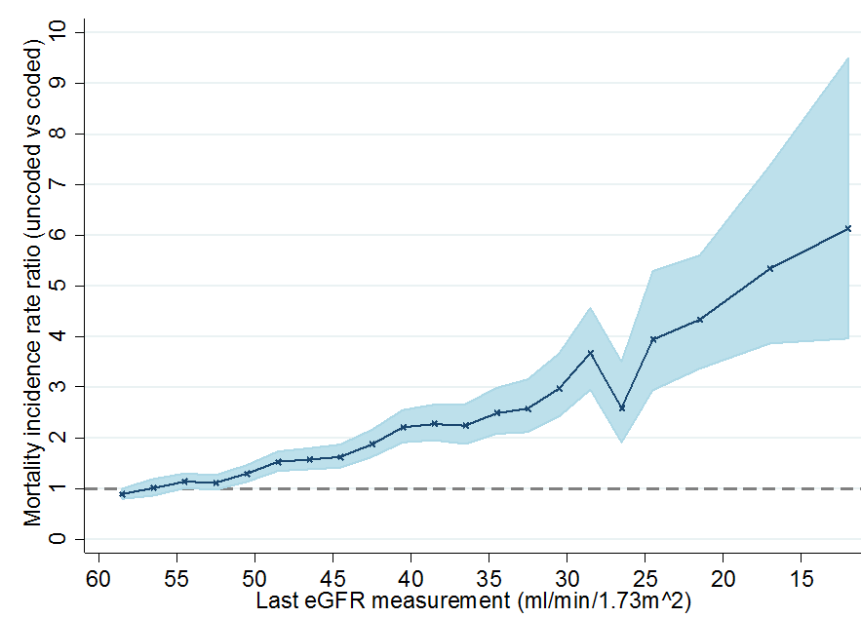
Findings
Comparison of death rates between uncoded and coded patients with biochemical CKD stages 3-5
Relative mortality risk comparing
uncoded to coded CKD cases

Slide 50
Findings
Comparison of death rates between uncoded and coded patients with biochemical CKD stages 3-5
Relative mortality risk comparing
uncoded to coded CKD cases
We also compared coded and uncoded patients of the same age with similar comorbidities, and it became apparent that patients who are not coded have worse outcomes than those with the same level of kidney function but who are coded by their GP.

Slide 51
Findings
Comparison of death rates between uncoded and coded patients with biochemical CKD stages 3-5
Relative mortality risk comparing
uncoded to coded CKD cases
This effect is observed whether we examined death, AKI events, CVD events, and overall emergency admission rates.

Slide 52
Findings
Comparison of death rates between uncoded and coded patients with biochemical CKD stages 3-5
Relative mortality risk comparing
uncoded to coded CKD cases
This figure demonstrates that death rates are approximately twice as high among people with CKD who have not been coded for CKD in primary care compared with those who have been coded

Slide 53
Findings
Comparison of death rates between uncoded and coded patients with biochemical CKD stages 3-5
Relative mortality risk comparing
uncoded to coded CKD cases
In patients with confirmed biochemical CKD stages 3-5, the rate ratios are approximately 1.0 (no difference) until about eGFR 50

Slide 54
Findings
Comparison of death rates between uncoded and coded patients with biochemical CKD stages 3-5
Relative mortality risk comparing
uncoded to coded CKD cases
At about eGFR 40 (roughly CKD stages 3a-4), patients who are not coded for CKD are twice as likely to die than patients who are coded for CKD

Slide 55
Findings
Comparison of death rates between uncoded and coded patients with biochemical CKD stages 3-5
Relative mortality risk comparing
uncoded to coded CKD cases
Data may be confounded by other reasons that lead to GPs not Read coding those with CKD.

Slide 56
Recommendation 2
GPs should review their practice to improve the coding of people with CKD.
Read-coding of those with CKD enables automated identification of these patients in practice records allowing regular follow-up and care. Coding of people with CKD is a proxy for better clinical scrutiny and management.

Slide 57
Recommendation 2
GPs should review their practice to improve the coding of people with CKD.
Read-coding of those with CKD enables automated identification of these patients in practice records allowing regular follow-up and care. Coding of people with CKD is a proxy for better clinical scrutiny and management.
The linked GP hospital data in this audit provides preliminary evidence that people with uncoded CKD have higher rates of unplanned admission, as well as higher rates of all-cause mortality.

Slide 58
Recommendation 2
GPs should review their practice to improve the coding of people with CKD.
Read-coding of those with CKD enables automated identification of these patients in practice records allowing regular follow-up and care. Coding of people with CKD is a proxy for better clinical scrutiny and management.
And suggests that coding may be associated with increased clinical scrutiny of patients who often have a range of other comorbidities.

Slide 59
Recommendation 2
GPs should review their practice to improve the coding of people with CKD.
Read-coding of those with CKD enables automated identification of these patients in practice records allowing regular follow-up and care. Coding of people with CKD is a proxy for better clinical scrutiny and management.
There is good evidence that coding is associated with improved performances in CKD management activity such as

Slide 60
Recommendation 2
GPs should review their practice to improve the coding of people with CKD.
Read-coding of those with CKD enables automated identification of these patients in practice records allowing regular follow-up and care. Coding of people with CKD is a proxy for better clinical scrutiny and management.
Reducing blood pressure
Offering statins for cardiovascular disease protection
Urinary testing for albumin/creatinine ratio

Slide 61
Recommendation 2
GPs should review their practice to improve the coding of people with CKD.
Read-coding of those with CKD enables automated identification of these patients in practice records allowing regular follow-up and care. Coding of people with CKD is a proxy for better clinical scrutiny and management.
We recommend that GPs should review the practices in place to identify patients who have evidence of CKD stages 3-5 in order to improve the coding and associated regular review of these patients.

Slide 62
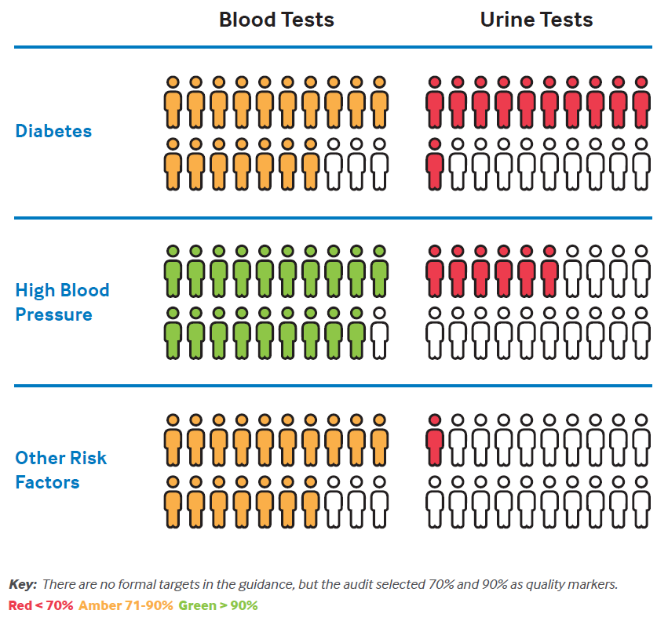
Findings
Proportion of patients with different risk factors for CKD who have had blood and urine tests
Testing for CKD:
NICE Clinical Guidelines suggest annual blood and urine testing for CKD in those who are at risk to develop CKD, i.e. those with diabetes, hypertension and cardiovascular disease.
Nitsch D, Caplin B, Hull S, Wheeler D. National Chronic Kidney Disease Audit - National Report (Part 1). 2017

Slide 63
Findings
Proportion of patients with different risk factors for CKD who have had blood and urine tests
We measured whether those at risk but without any evidence of kidney disease had undergone blood and urine testing
Nitsch D, Caplin B, Hull S, Wheeler D. National Chronic Kidney Disease Audit - National Report (Part 1). 2017

Slide 64
Findings 3
Proportion of patients with different risk factors for CKD who have had blood and urine tests
Nitsch D, Caplin B, Hull S, Wheeler D. National Chronic Kidney Disease Audit - National Report (Part 1). 2017
We found that practices perform very well at providing annual eGFR tests for CKD among people with risk factors

Slide 65
Findings
Proportion of patients with different risk factors for CKD who have had blood and urine tests
Nitsch D, Caplin B, Hull S, Wheeler D. National Chronic Kidney Disease Audit - National Report (Part 1). 2017
On average GPs test 86% of people with diabetes for CKD

Slide 66
Findings
Proportion of patients with different risk factors for CKD who have had blood and urine tests
When it came to urine testing, only 54% of those people with diabetes have relevant annual urine tests and less than 30% of patients with hypertension have relevant annual urine tests
Nitsch D, Caplin B, Hull S, Wheeler D. National Chronic Kidney Disease Audit - National Report (Part 1). 2017

Slide 67
Findings
Proportion of patients with different risk factors for CKD who have had blood and urine tests
This could possibly be because the Quality and Outcomes Framework incentivises urinary albumin/creatinine ratio (ACR) testing in diabetes but not for those with hypertension and because the NICE guidance on the frequency of testing in this group is unclear
Nitsch D, Caplin B, Hull S, Wheeler D. National Chronic Kidney Disease Audit - National Report (Part 1). 2017

Slide 68
Recommendation 3
For people at high risk of CKD (particularly diabetes and hypertension) GPs should ensure they include BOTH blood tests for eGFR and urine tests for ACR

Slide 69
Recommendation 3
For people at high risk of CKD (particularly diabetes and hypertension) GPs should ensure they include BOTH blood tests for eGFR and urine tests for ACR
The accurate diagnosis and disease classification of CKD requires both blood and urine tests

Slide 70
Recommendation 3
For people at high risk of CKD (particularly diabetes and hypertension) GPs should ensure they include BOTH blood tests for eGFR and urine tests for ACR
We saw low rates of proteinuria testing, especially among hypertensive patients.

Slide 71
Recommendation 3
For people at high risk of CKD (particularly diabetes and hypertension) GPs should ensure they include BOTH blood tests for eGFR and urine tests for ACR
These are missed opportunities to optimise renal care, particularly among hypertensive patients. If people with high blood pressure do not have urinary testing, then they will not receive the appropriate blood pressure treatment as those with proteinuria require different drugs (e.g. ACE-inhibitors) and different treatment targets than those without.

Slide 72
Recommendation 3
For people at high risk of CKD (particularly diabetes and hypertension) GPs should ensure they include BOTH blood tests for eGFR and urine tests for ACR
Those with elevated urinary ACR ratios are those who have the highest risk to progress to dialysis. We know for people who have diabetes that early detection of albuminuria and aggressive blood pressure lowering in this group will delay the need from dialysis.

Slide 73
Recommendation 4
Further research is needed to establish whether there is a causal link between CKD coding (as a proxy for clinical recognition and care) and hospital admissions/all-cause mortality

Slide 74
Recommendation 4
Further research is needed to establish whether there is a causal link between CKD coding (as a proxy for clinical recognition and care) and hospital admissions/all-cause mortality
The unplanned hospital admission and mortality data analysed for this report provides evidence that an association exists between CKD coding in the electronic health record and increased rates of adverse patient outcomes

Slide 75
Recommendation 4
Further research is needed to establish whether there is a causal link between CKD coding (as a proxy for clinical recognition and care) and hospital admissions/all-cause mortality
However, at the time we cannot be sure of two things:

Slide 76
Recommendation 4
Further research is needed to establish whether there is a causal link between CKD coding (as a proxy for clinical recognition and care) and hospital admissions/all-cause mortality
The strength of this association: we used a limited primary care dataset for the analysis that was extracted for audit purposes – there may be additional important coded comorbidities which reduce this association (for example cancer or serious mental illness) or uncoded factors such as frailty or adverse social circumstances which we did not have available within the Audit

Slide 77
Recommendation 4
Further research is needed to establish whether there is a causal link between CKD coding (as a proxy for clinical recognition and care) and hospital admissions/all-cause mortality
2. Whether there is a causal link between coding and adverse health outcomes

Slide 78
References
Nitsch D, Caplin B, Hull S, Wheeler D. National Chronic Kidney Disease Audit - National Report (Part 1). 2017
Kidney Disease: Improving Global Outcomes (KDIGO) CKD Work Group. KDIGO 2012 Clinical Practice Guideline for the Evaluation and Management of Chronic Kidney Disease. Kidney Int Suppl [Internet]. 2013;3(1):1–150. Available from: http://www.kdigo.org/clinical_practice_guidelines/pdf/CKD/KDIGO CKD-MBD GL KI Suppl 113.pdf%5Cnhttp://www.nature.com/doifinder/10.1038/kisup.2012.73%5Cnhttp://www.nature.com/doifinder/10.1038/kisup.2012.76
NICE. Chronic kidney disease in adults: quality standard. 2011;(March). Available from: nice.org.uk/guidance/gs5

