Slide 1
Notes:
Test

Slide 2
Analytical Team
Writing Team
Faye Cleary
Lois Kim
Dr Sally Hull
Dr Ben Caplin
Professor Dorothea Nitsch
Kathleen Mudie
Faye Cleary
Dr Ben Caplin
Professor David Wheeler
Dr Sally Hull
Professor Dorothea Nitsch

Slide 3
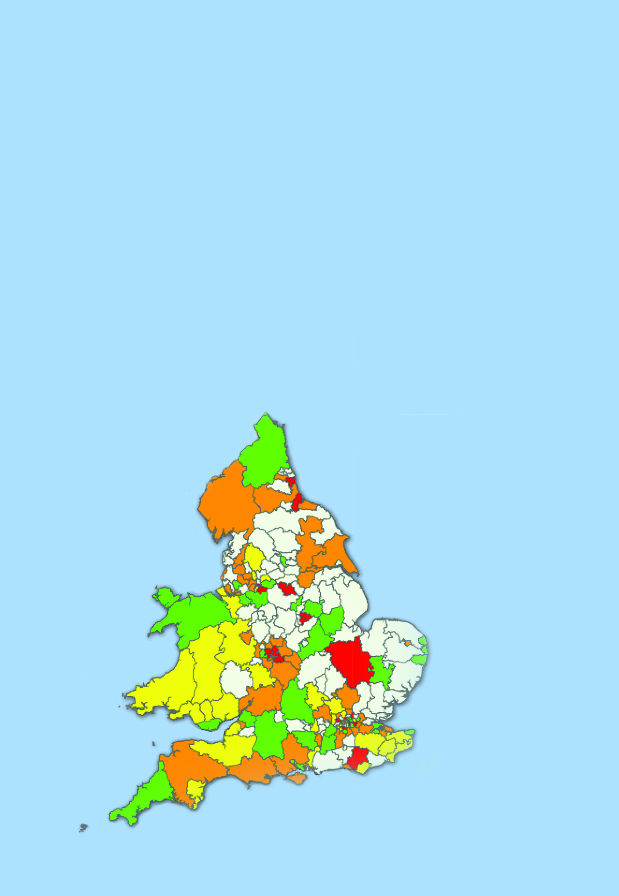
Aims
Map of coverage of NCKDA within practices using Informatic Audit Plus software
>75% of possible
Aims:
To review identification and management of CKD in primary care
To describe patient outcomes
50 – 75%
25 – 50%
<25 %
No possible participants
Measures:
Performance against NICE quality standards
Variation

Slide 4
Methods
Prognosis of CKD by eGFR and proteinuria categories
 |  |  | Kidney damage stage albumin/creatinine ratio Description and range
 |  |  | A1 | A2 | A3
Kidney function stage eGFR (ml/min/1.73m) Description and range |  |  | Normal to mild increase <30mg/g | Moderate increase 30-300mg/g | Severe increase >300mg/g
G1 | Normal or high | ≥90
G2 | Mild decrease | 60-89
G3a | Mild to moderate decrease | 45-59
G3b | Moderate to severe decrease | 30-44
G4 | Severe decrease | 15-29
G5 | Kidney failure | <15
Kidney Disease: Improving Global Outcomes (KDIGO) CKD Work Group. KDIGO 2012 Clinical Practice Guideline for the Evaluation and Management of Chronic Kidney Disease. Kidney Int Suppl. 2013;3(1):1–150

Slide 5
Methods
Prognosis of CKD by eGFR and proteinuria categories
 |  |  | Kidney damage stage albumin/creatinine ratio Description and range
 |  |  | A1 | A2 | A3
Kidney function stage eGFR (ml/min/1.73m) Description and range |  |  | Normal to mild increase <30mg/g | Moderate increase 30-300mg/g | Severe increase >300mg/g
G1 | Normal or high | ≥90
G2 | Mild decrease | 60-89
G3a | Mild to moderate decrease | 45-59
G3b | Moderate to severe decrease | 30-44
G4 | Severe decrease | 15-29
G5 | Kidney failure | <15
Kidney Disease: Improving Global Outcomes (KDIGO) CKD Work Group. KDIGO 2012 Clinical Practice Guideline for the Evaluation and Management of Chronic Kidney Disease. Kidney Int Suppl. 2013;3(1):1–150

Slide 6
Methods
Prognosis of CKD by eGFR and proteinuria categories
 |  |  | Kidney damage stage albumin/creatinine ratio Description and range
 |  |  | A1 | A2 | A3
Kidney function stage eGFR (ml/min/1.73m) Description and range |  |  | Normal to mild increase <30mg/g | Moderate increase 30-300mg/g | Severe increase >300mg/g
G1 | Normal or high | ≥90
G2 | Mild decrease | 60-89
G3a | Mild to moderate decrease | 45-59
G3b | Moderate to severe decrease | 30-44
G4 | Severe decrease | 15-29
G5 | Kidney failure | <15
Kidney Disease: Improving Global Outcomes (KDIGO) CKD Work Group. KDIGO 2012 Clinical Practice Guideline for the Evaluation and Management of Chronic Kidney Disease. Kidney Int Suppl. 2013;3(1):1–150

Slide 7
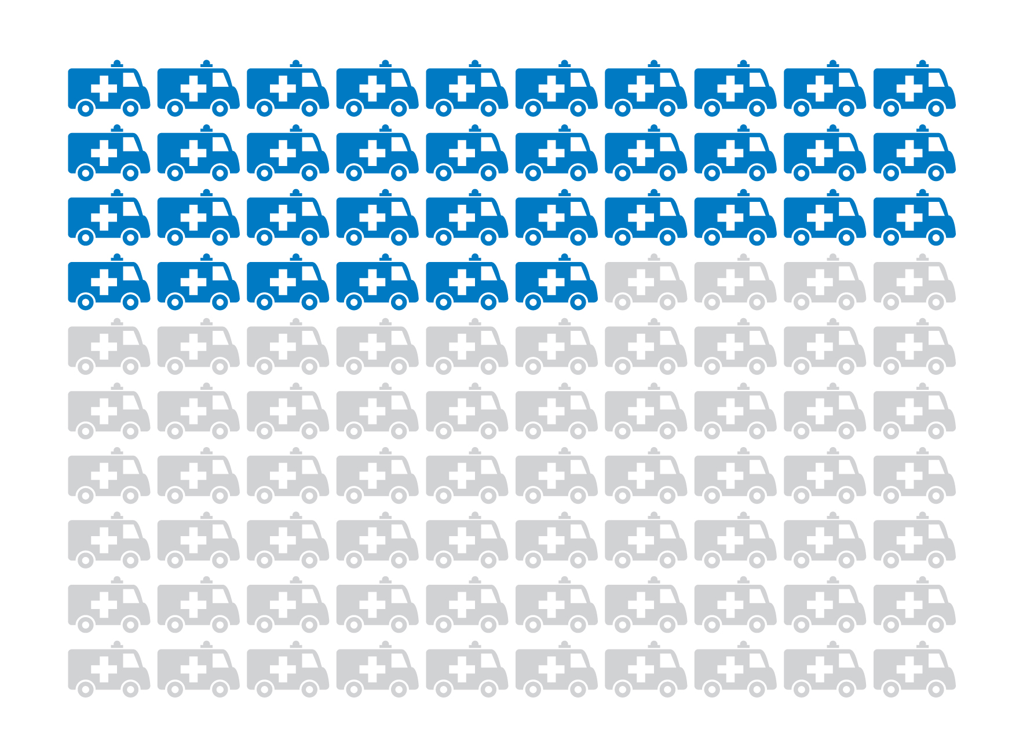
Findings
Findings for every
100 Patients
With CKD Stage 3:
36 unplanned admissions annually

Slide 8
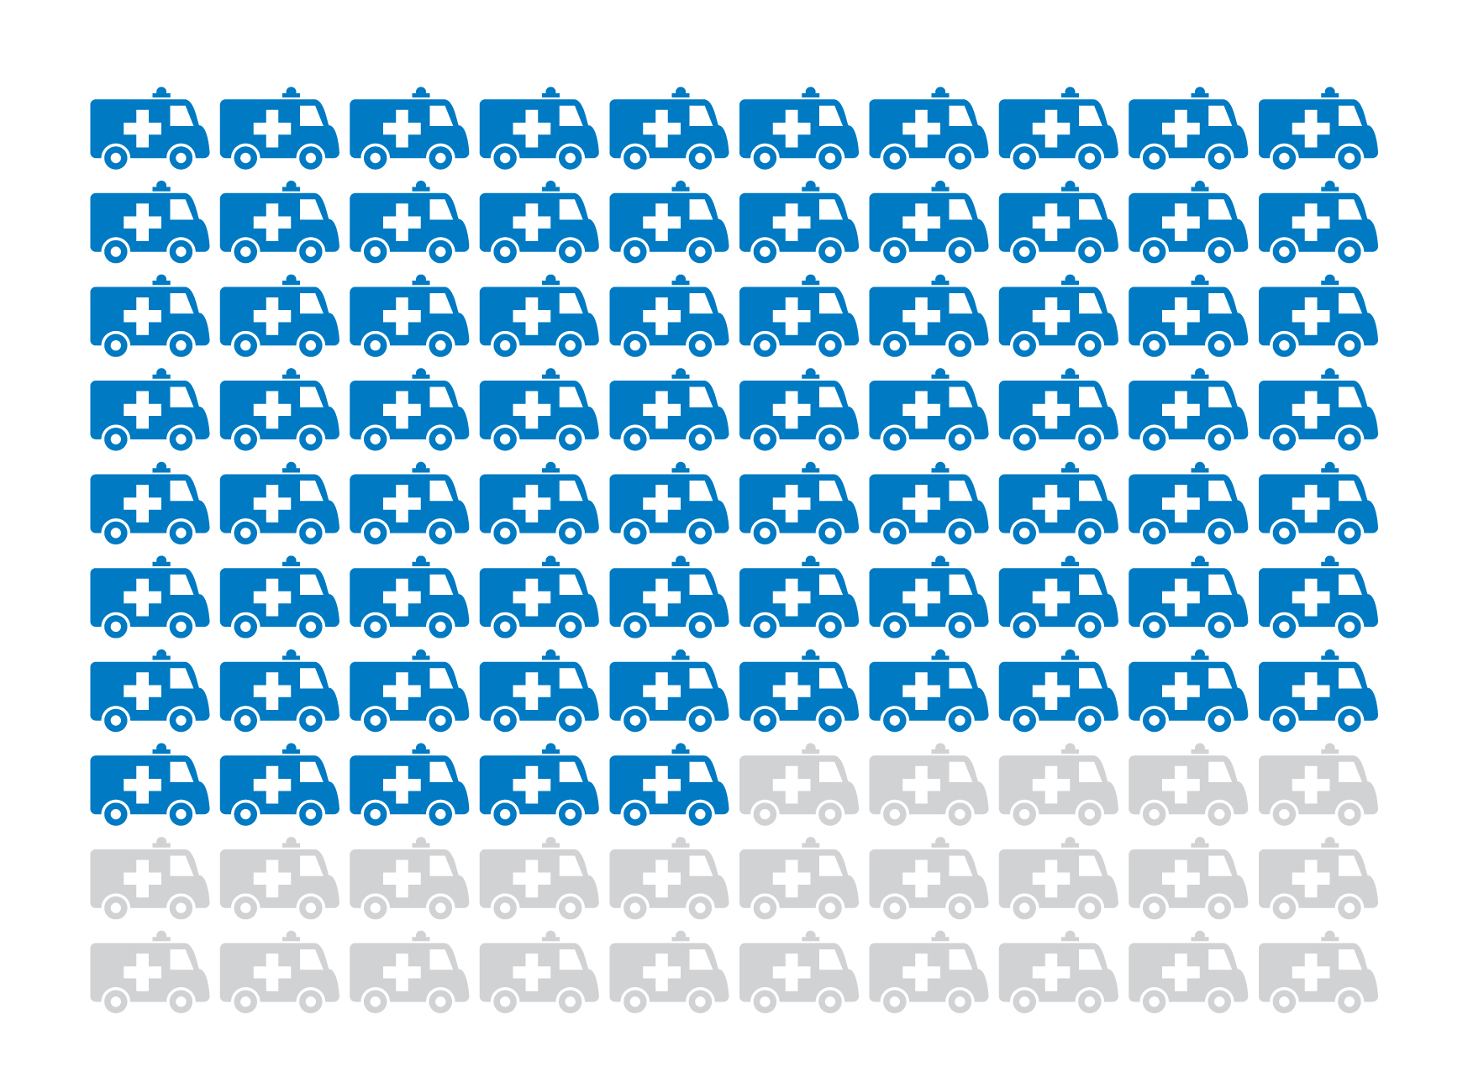
Findings
Findings for every
100 Patients
With CKD Stage 4:
75 unplanned admissions annually

Slide 9
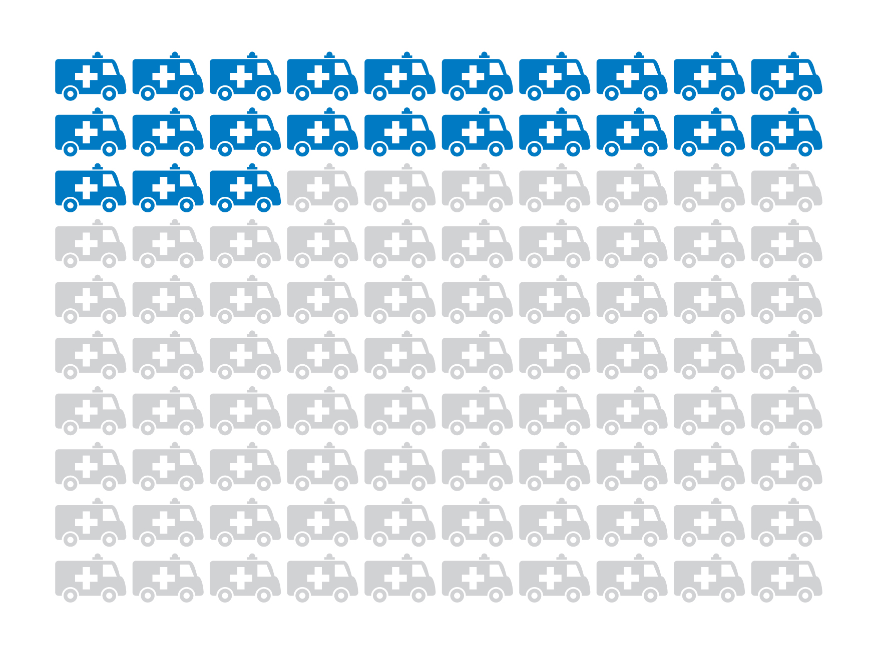
Findings
Findings for every
100 Patients
With other renal codes:
23 unplanned admissions annually

Slide 10
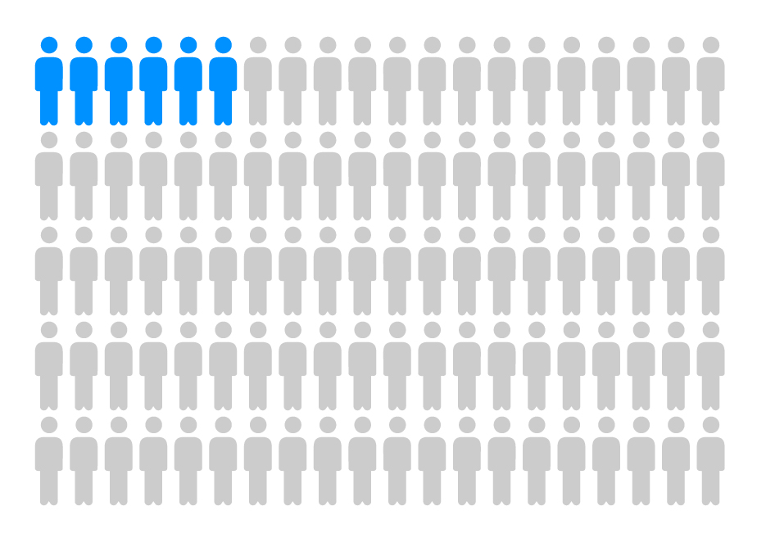
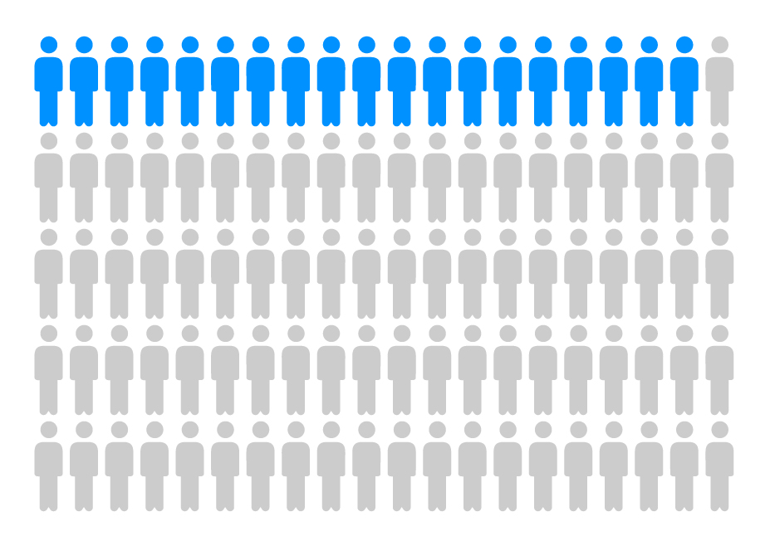
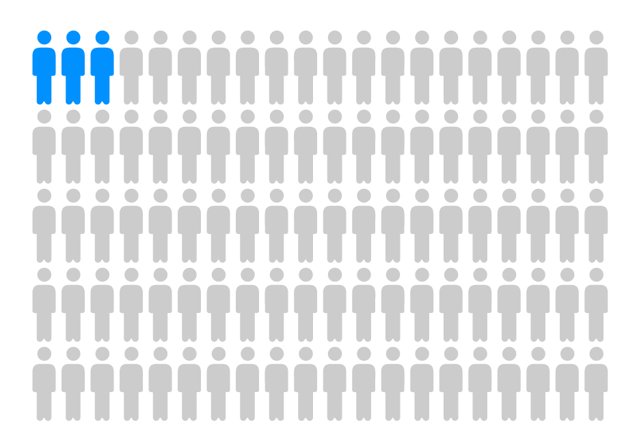
Findings
Findings for every
100 Patients
With CKD Stage 3:
With CKD Stage 4:
With other renal codes:
6 patients
die annually
19 patients
die annually
3 patients
die annually

Slide 11
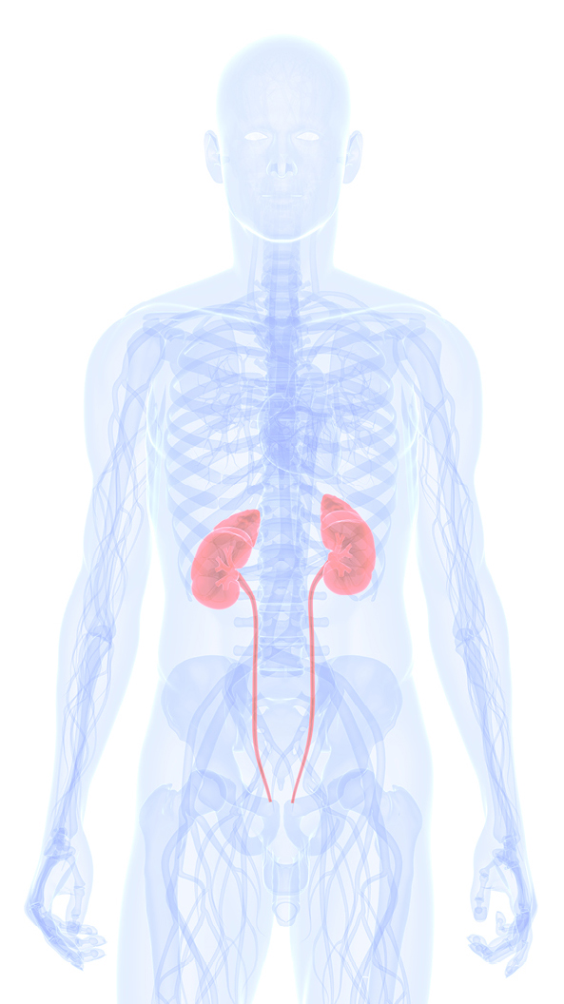
Recommendation 1
Clinical commissioning groups should put in place quality improvement tools and incentives, to support the identification and regular clinical review of patients with CKD

Slide 12
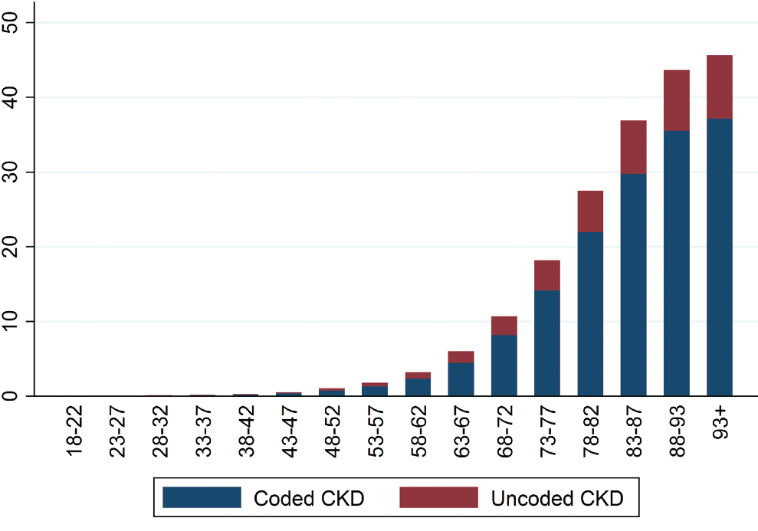
Findings
Total CKD Prevalence, by Age Group
Age-Stratified Total CKD Prevalence (%)

Slide 13
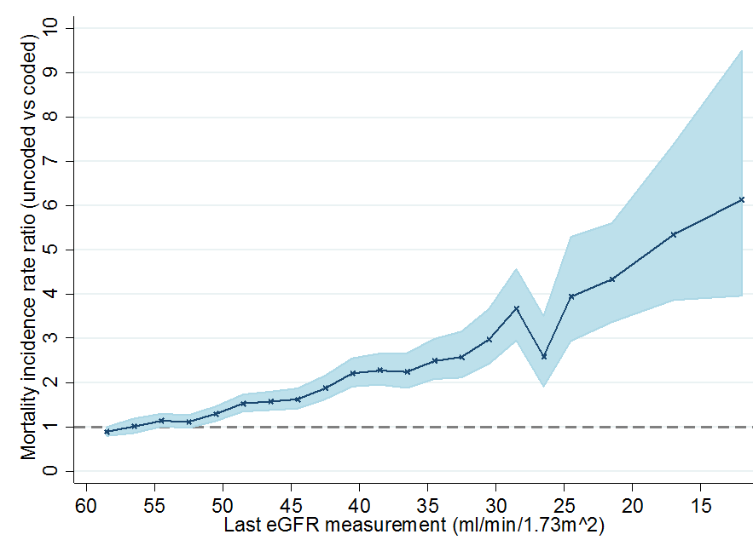
Findings
Comparison of death rates between uncoded and coded patients with biochemical CKD stages 3-5
Relative mortality risk comparing uncoded to coded CKD cases

Slide 14
Recommendation 2
GPs should review their practice to improve the coding of people with CKD.
Read-coding of those with CKD enables automated identification of these patients in practice records allowing regular follow-up and care. Coding of people with CKD is a proxy for better clinical scrutiny and management.

Slide 15
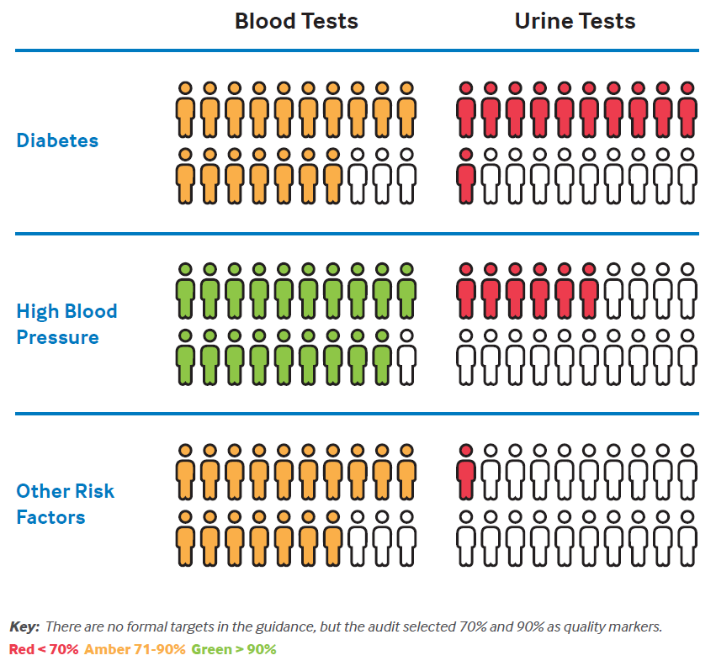
Findings
Proportion of patients with different risk factors for CKD who have had blood and urine tests
Nitsch D, Caplin B, Hull S, Wheeler D. National Chronic Kidney Disease Audit - National Report (Part 1). 2017

Slide 16
Recommendation 3
For people at high risk of CKD (particularly diabetes and hypertension) GPs should ensure they include BOTH blood tests for eGFR and urine tests for ACR

Slide 17
Recommendation 4
Further research is needed to establish whether there is a causal link between CKD coding (as a proxy for clinical recognition and care) and hospital admissions/all-cause mortality

Slide 18
References
Nitsch D, Caplin B, Hull S, Wheeler D. National Chronic Kidney Disease Audit - National Report (Part 1). 2017
Kidney Disease: Improving Global Outcomes (KDIGO) CKD Work Group. KDIGO 2012 Clinical Practice Guideline for the Evaluation and Management of Chronic Kidney Disease. Kidney Int Suppl [Internet]. 2013;3(1):1–150. Available from: http://www.kdigo.org/clinical_practice_guidelines/pdf/CKD/KDIGO CKD-MBD GL KI Suppl 113.pdf%5Cnhttp://www.nature.com/doifinder/10.1038/kisup.2012.73%5Cnhttp://www.nature.com/doifinder/10.1038/kisup.2012.76
NICE. Chronic kidney disease in adults: quality standard. 2011;(March). Available from: nice.org.uk/guidance/gs5

